Slide 1
Natural Light Product Photography

Slide 2
Still life photography is an additive process. You construct the image by assembling the scene in front of the camera as opposed to a subtractive process where you frame a portion of your environment.

Slide 3
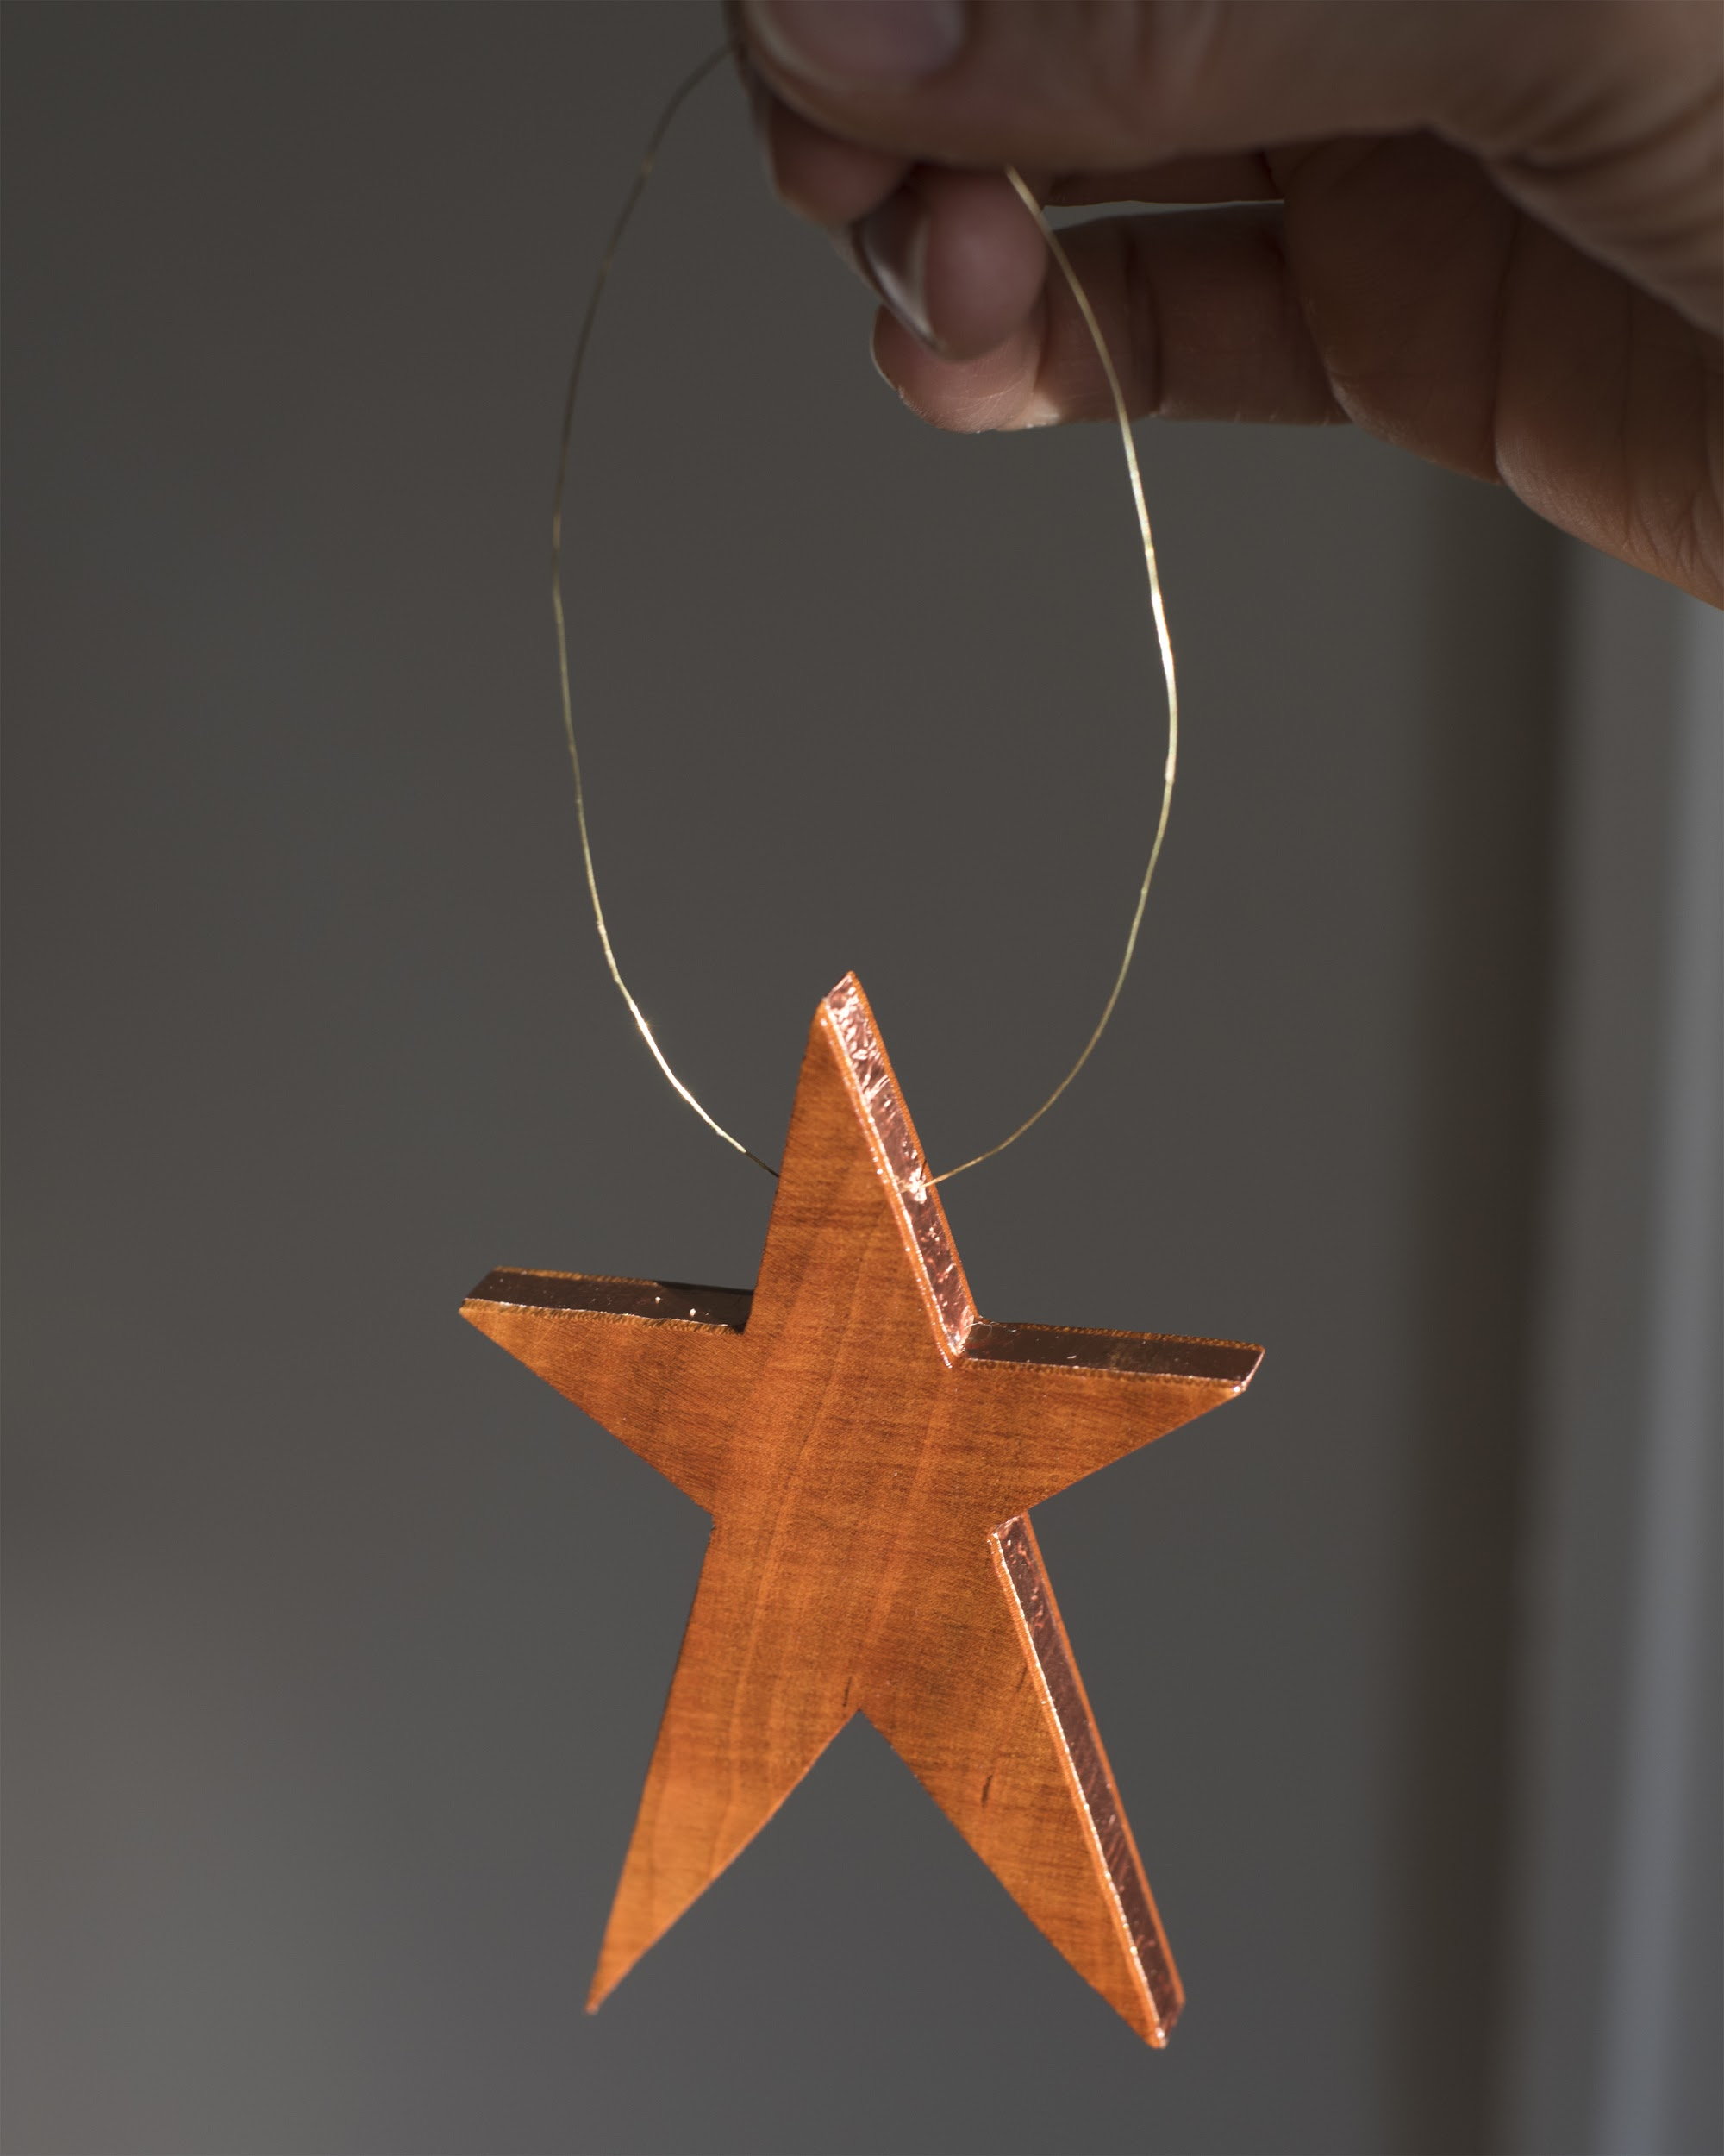
Where to set up
Choose a background that will best feature your work.

Slide 4
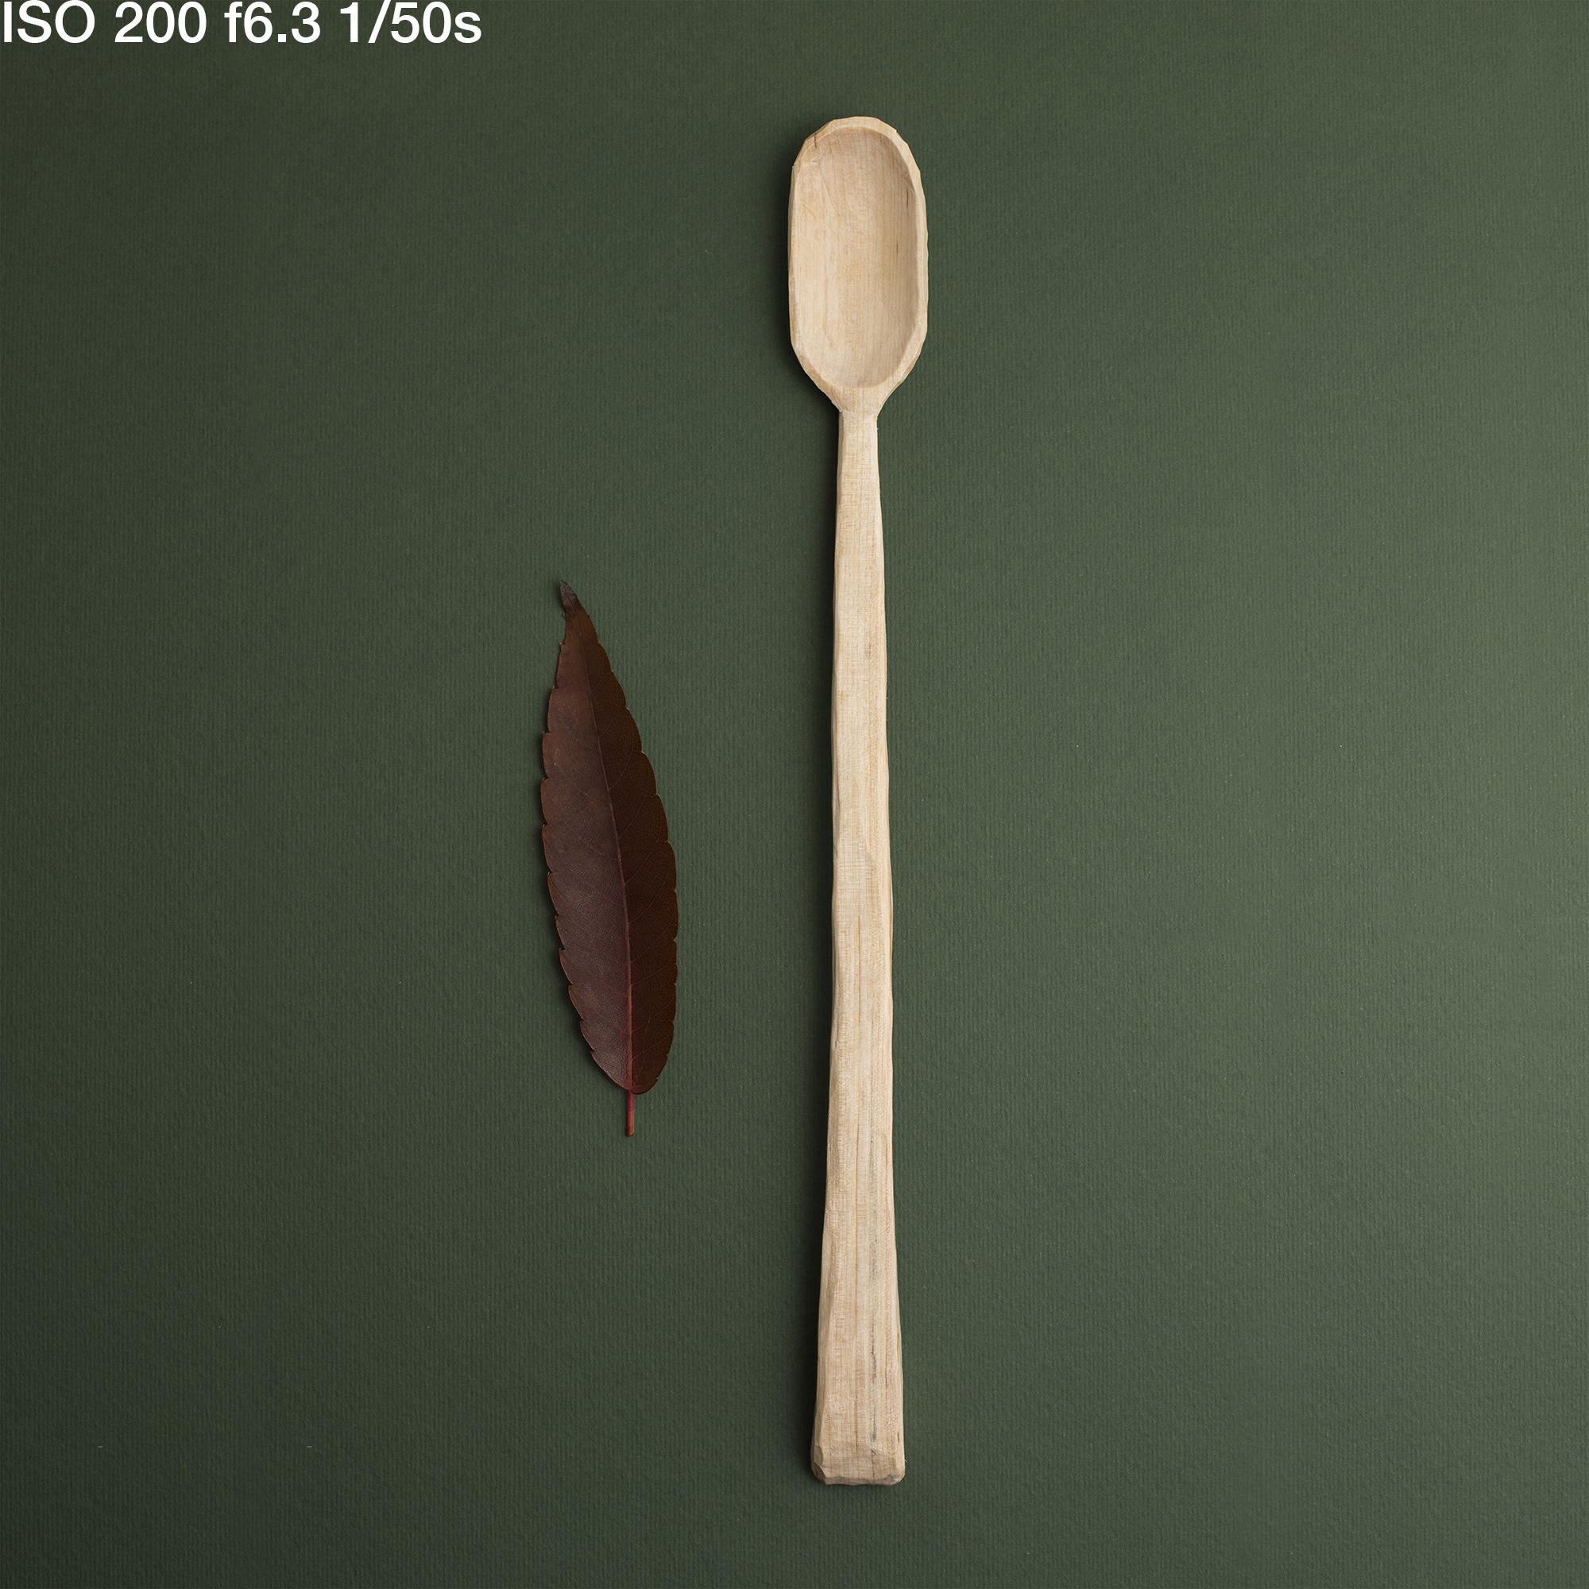
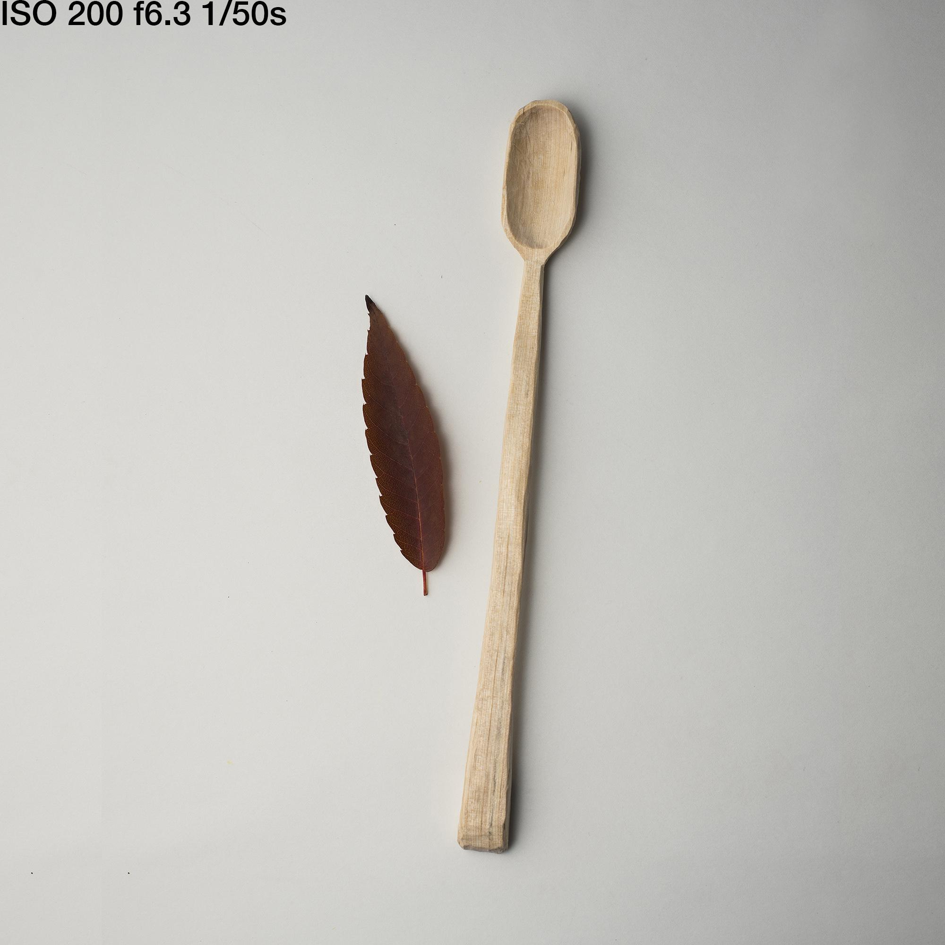
Consider contrast - a high contrast background will emphasize the contours of the piece, while lower contrast will give you a softer tone.

Slide 5
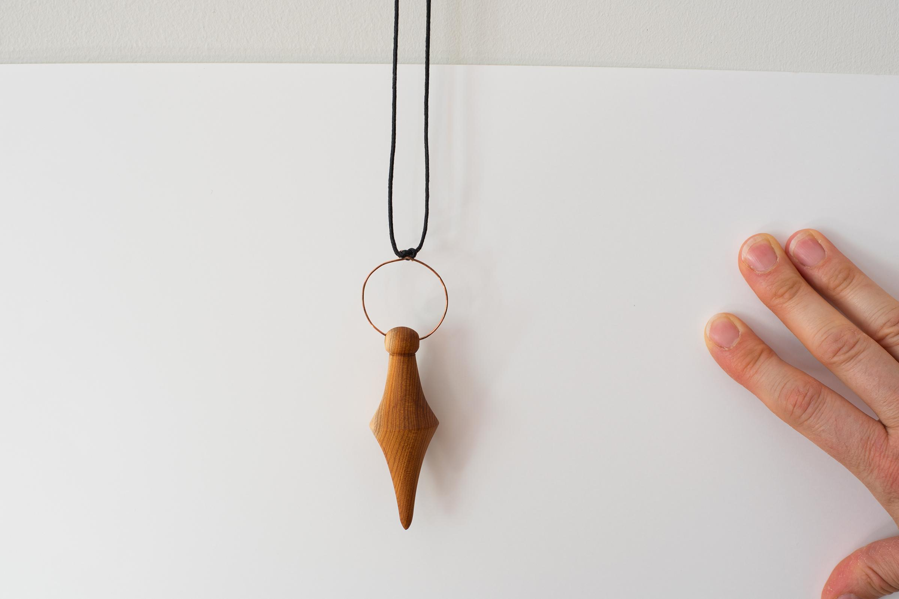
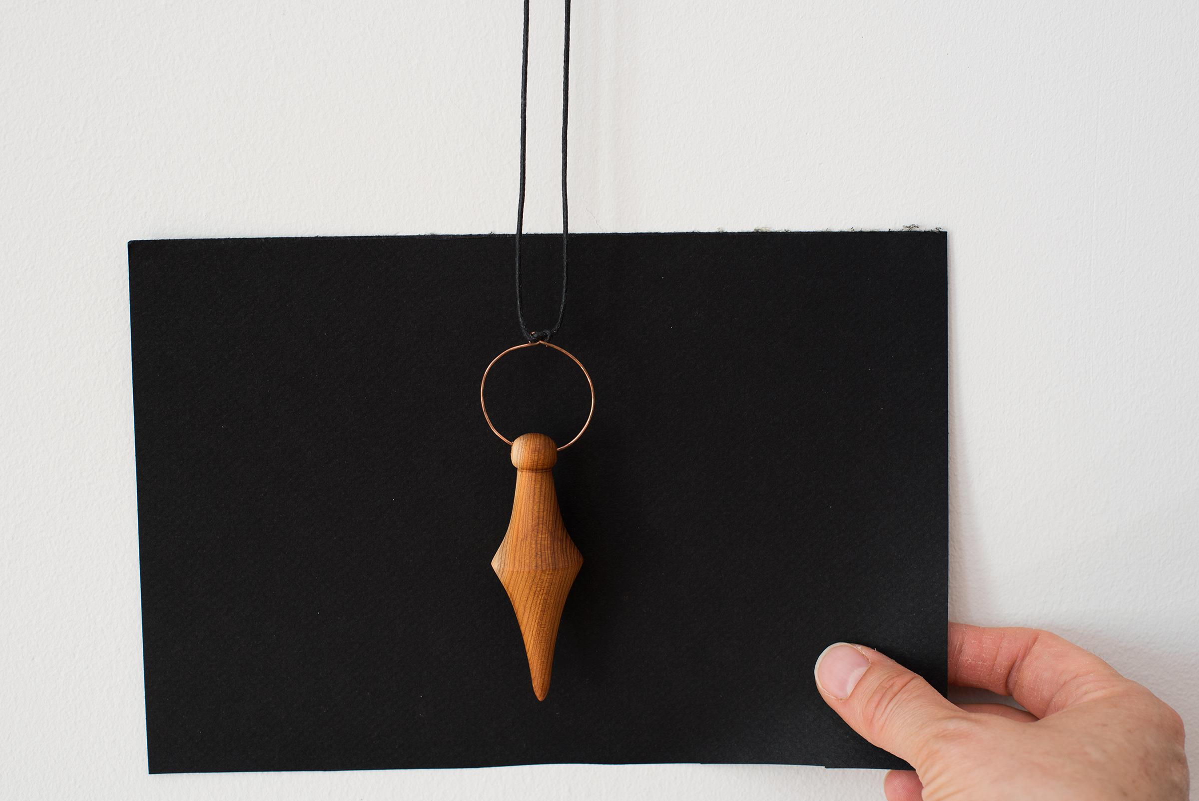
A high contrast background can also emphasize color.

Slide 6
Ideas for backgrounds:
I have used my kitchen countertop, various walls, a white worktable with and without watercolor paper or poster board. Black drawing paper, black furniture in my bedroom. I have used a baking sheet, dinner plates and bowls.

Slide 7
Indoor versus outdoor set up
Indoors
Pros:
No weather conditions such as wind & rain
Soft light
Outdoors
Pros:
Brighter lighting conditions
Less complicated lighting considerations

Slide 8
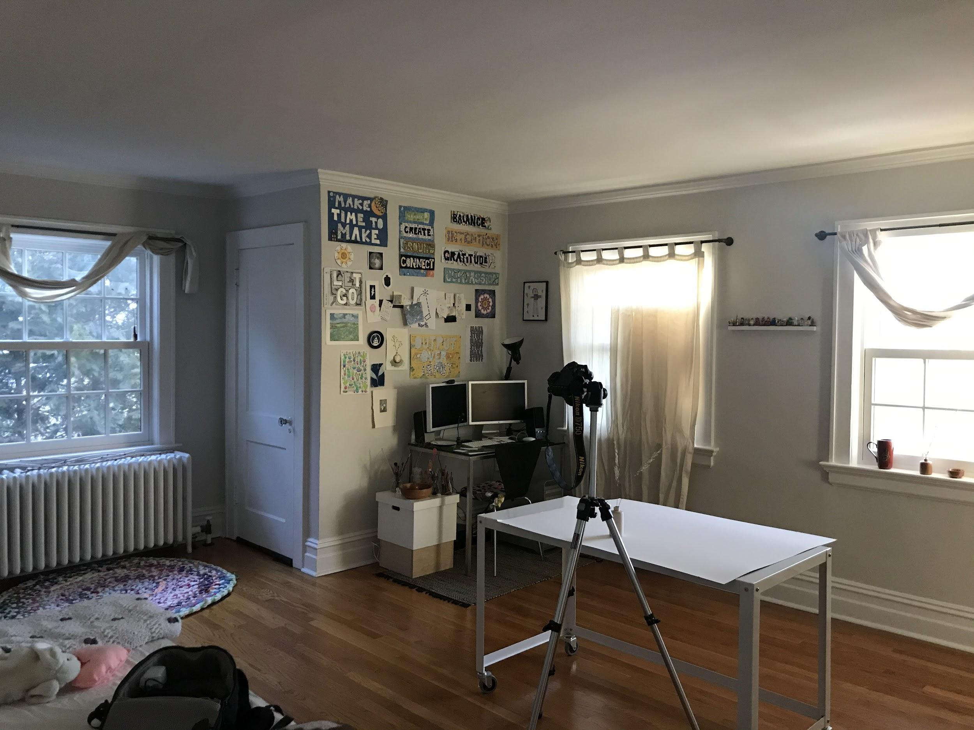
Indoor window light - windows and doors are “lights”
When shooting in a room with multiple windows, because the sun entering the windows on the same wall is of equal intensity, each window functions as a separate “light” and will cast crossing shadows.

Slide 9
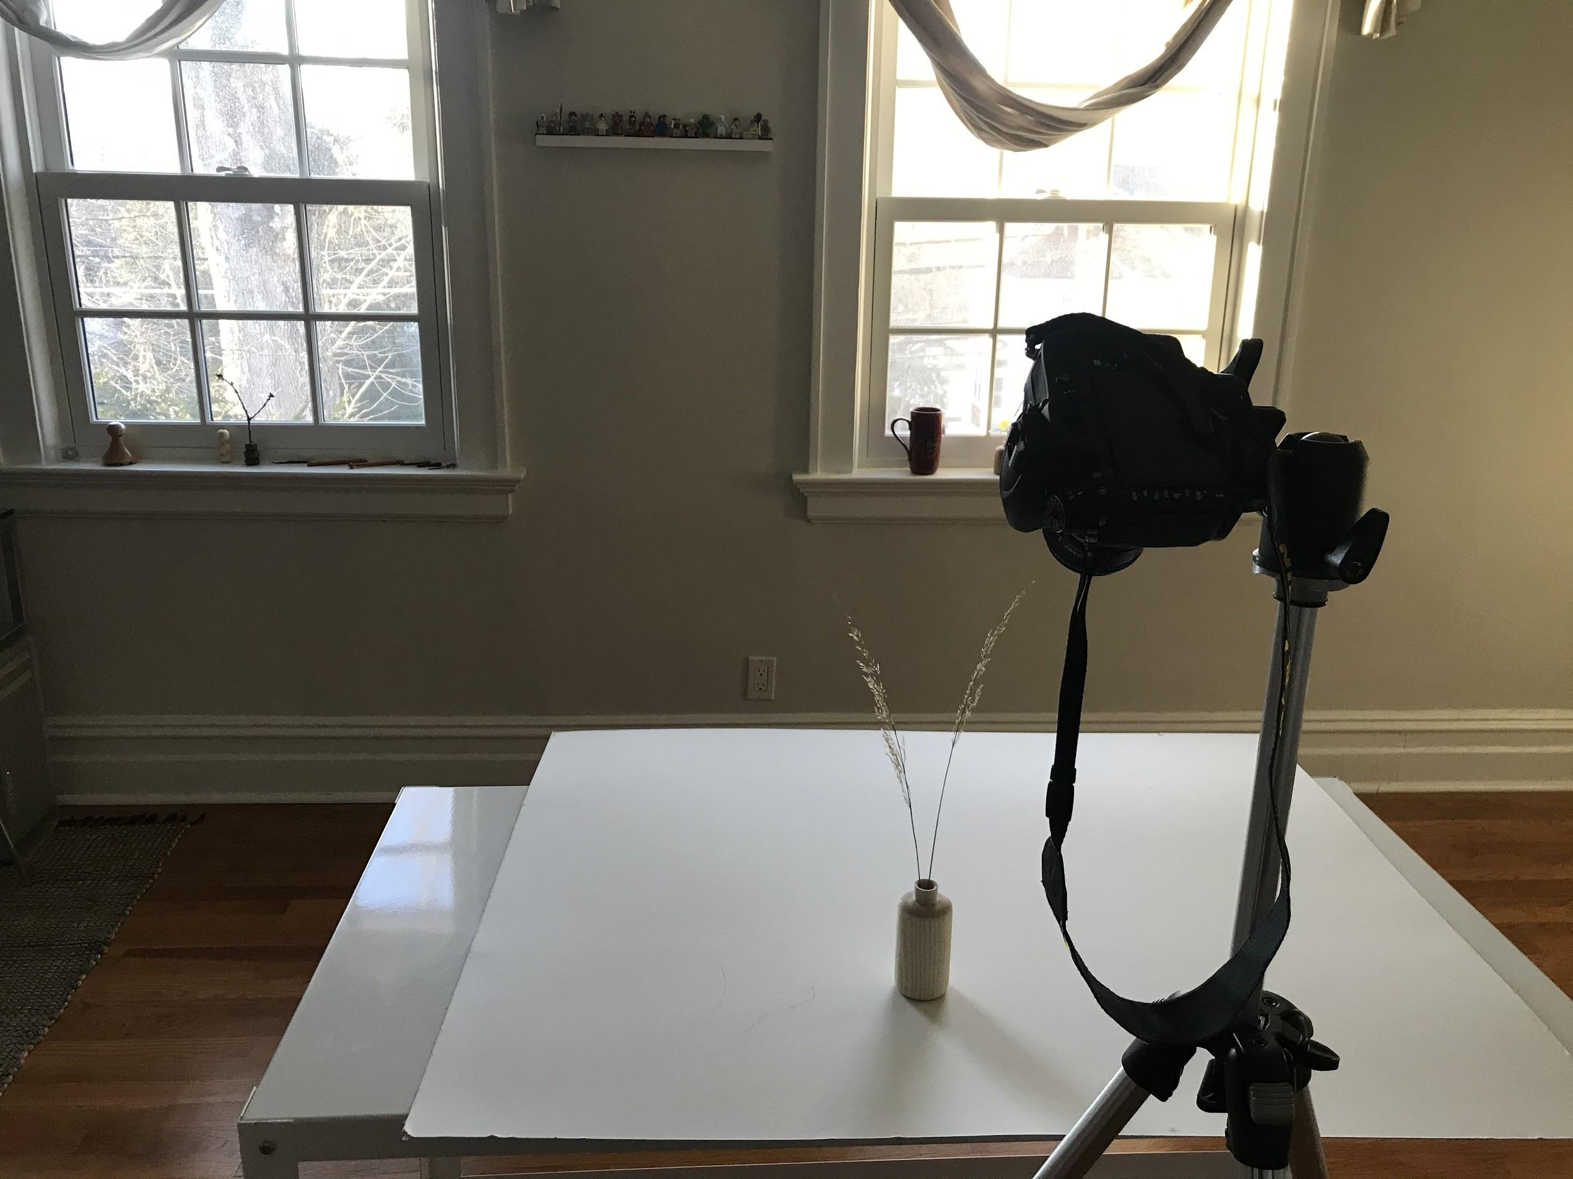
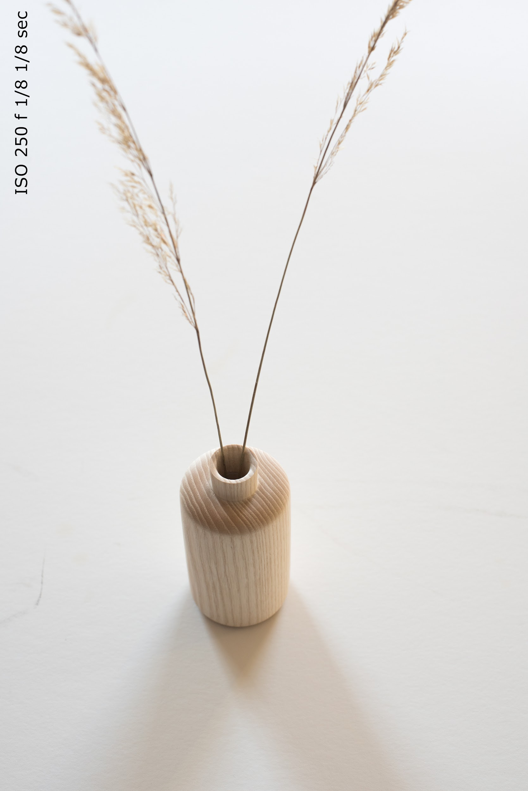
Light from 2 windows, note the crossing shadows.

Slide 10
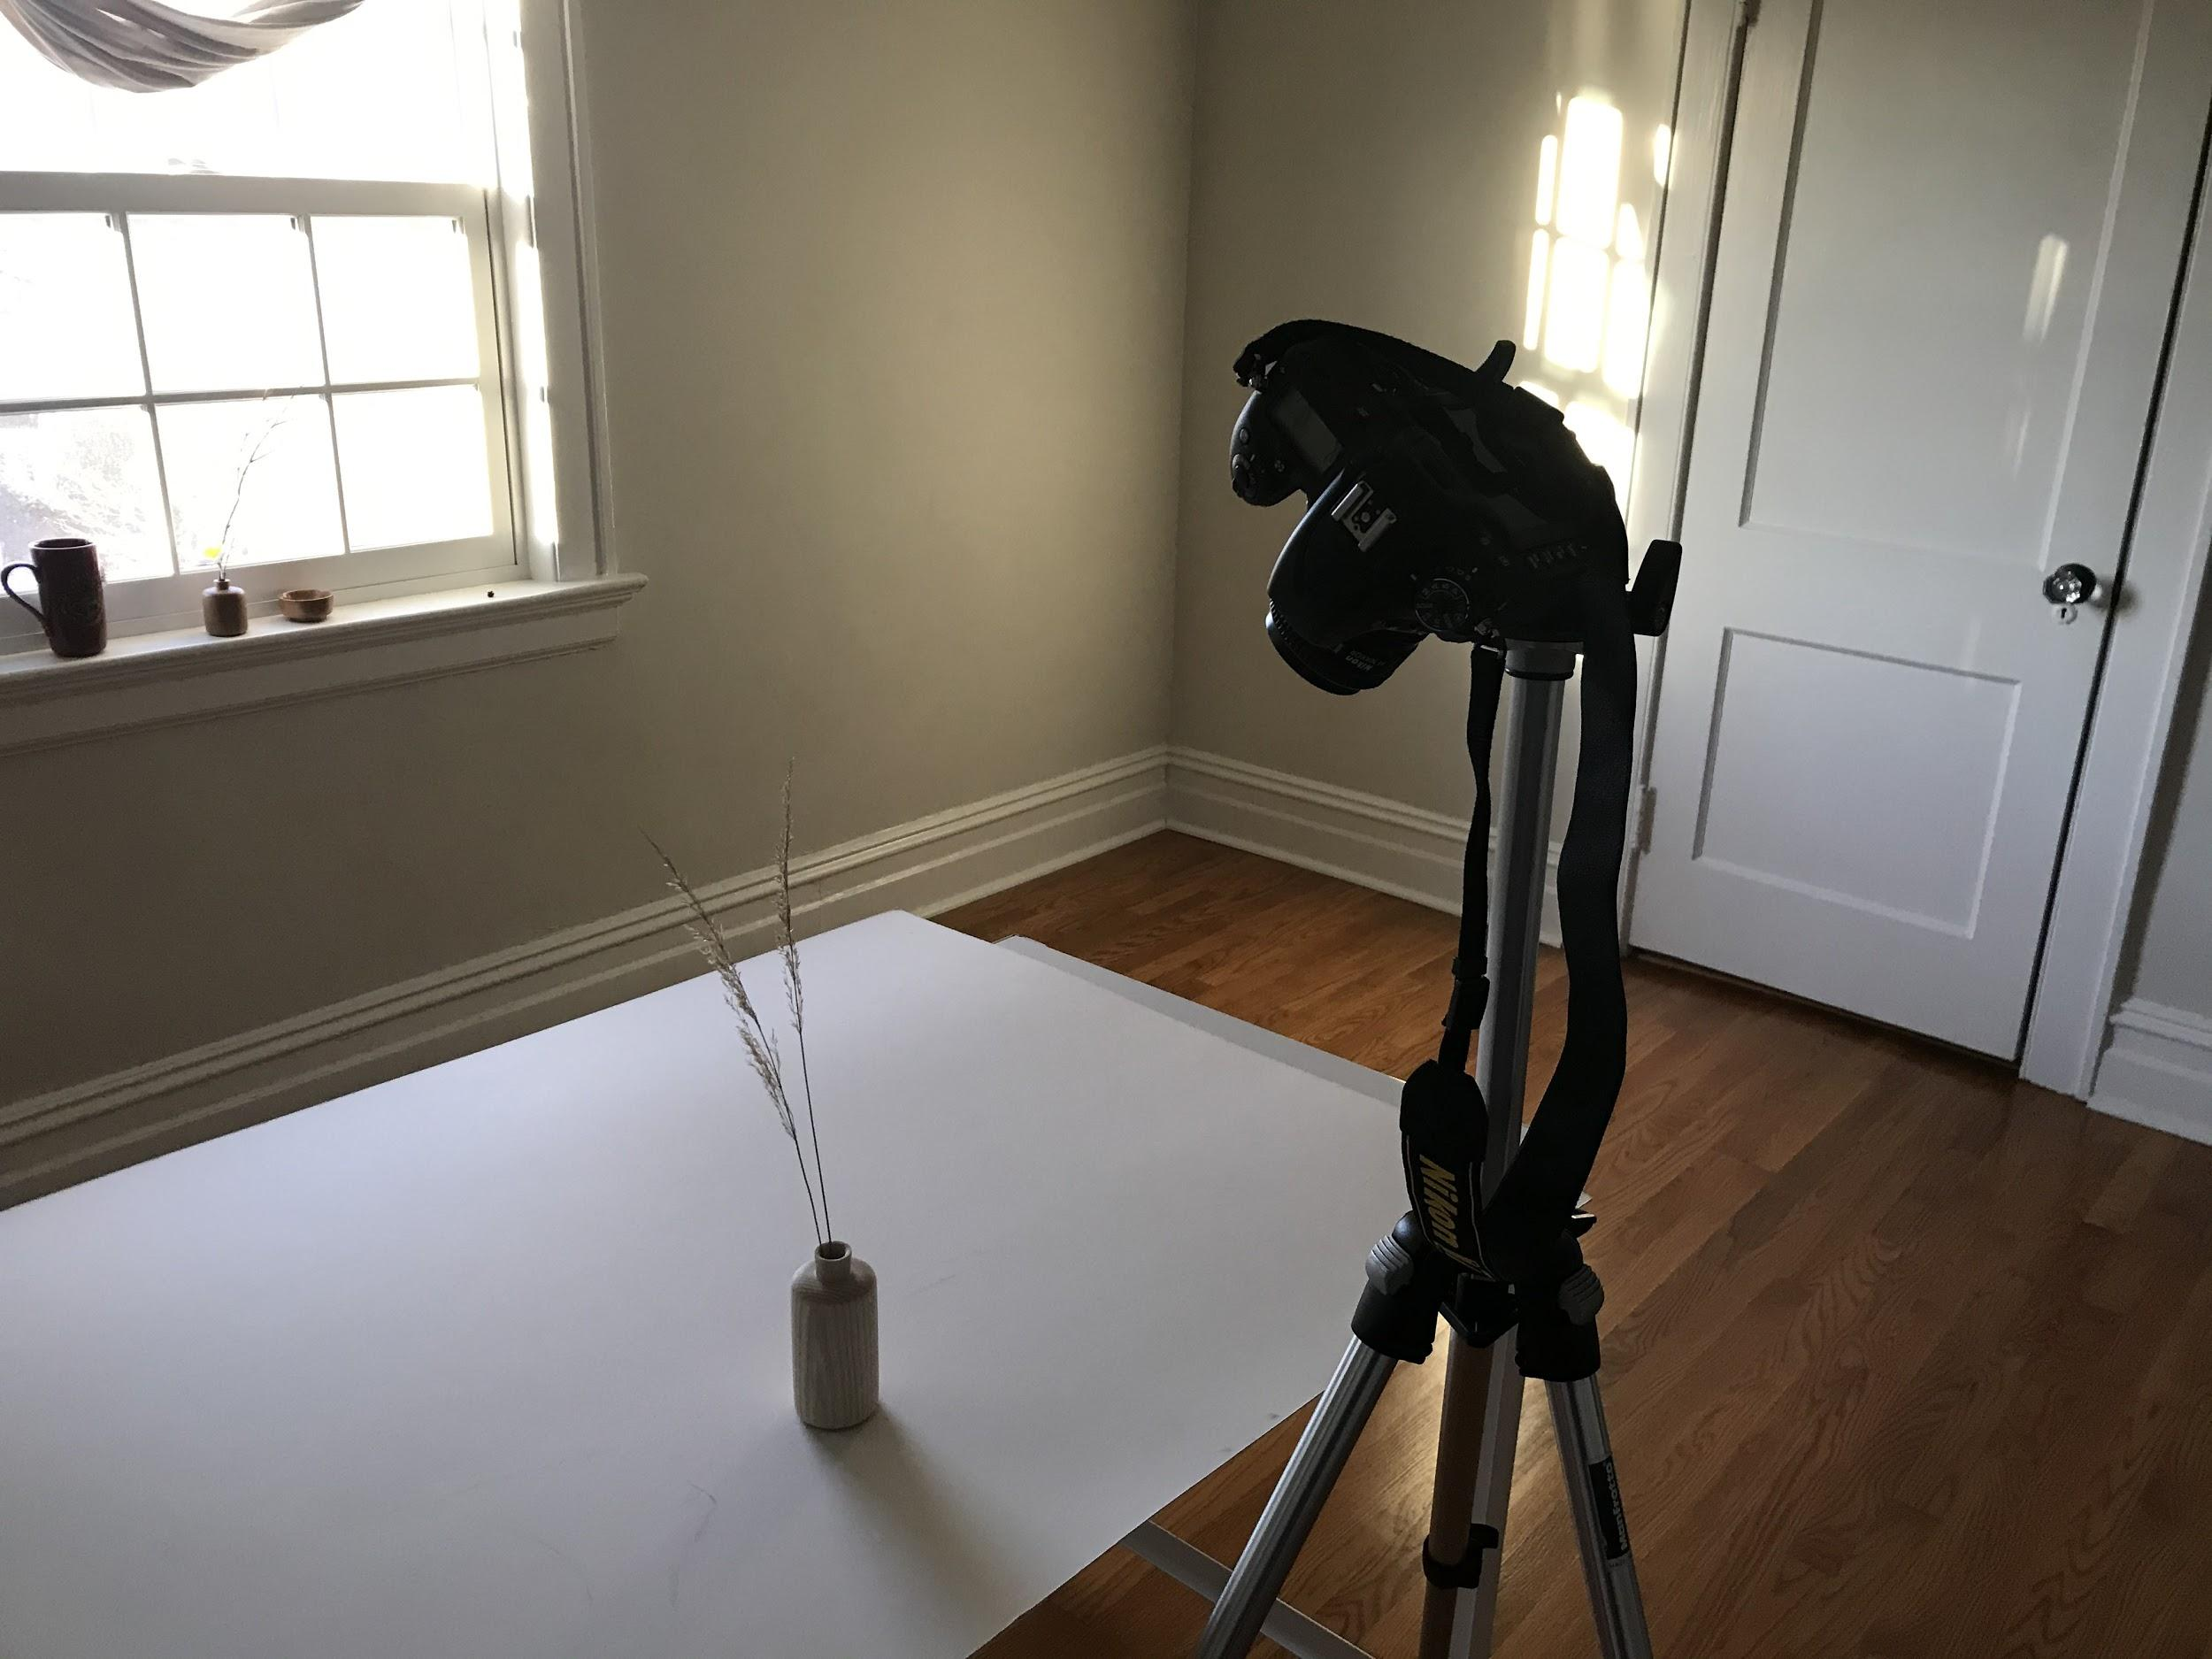
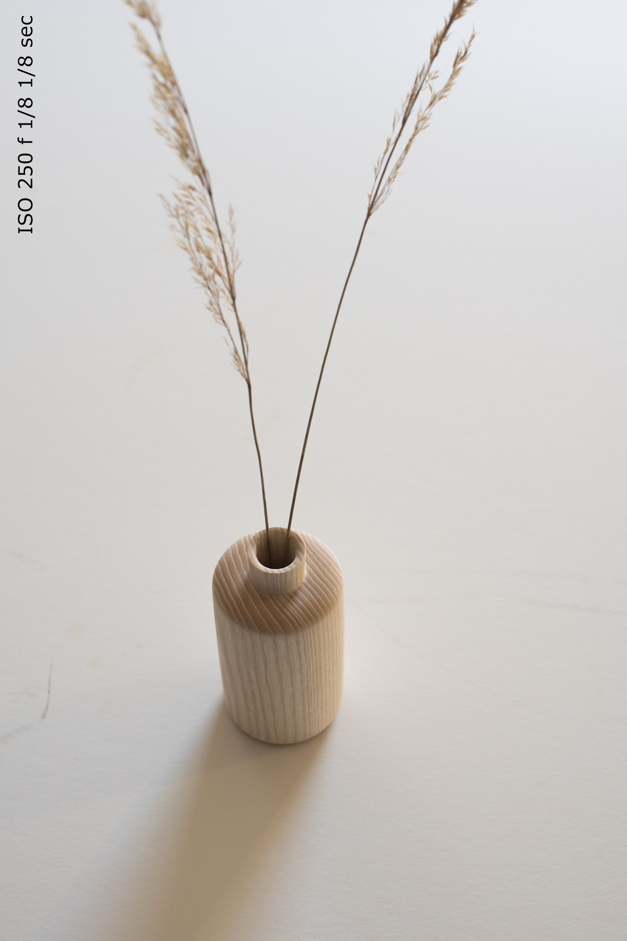
Light from one window plus sunspot

Slide 11
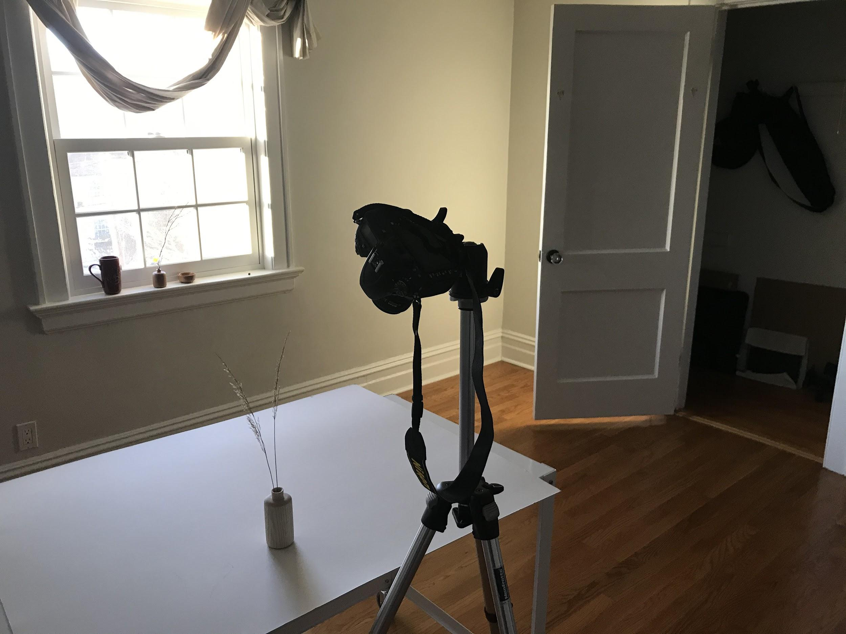
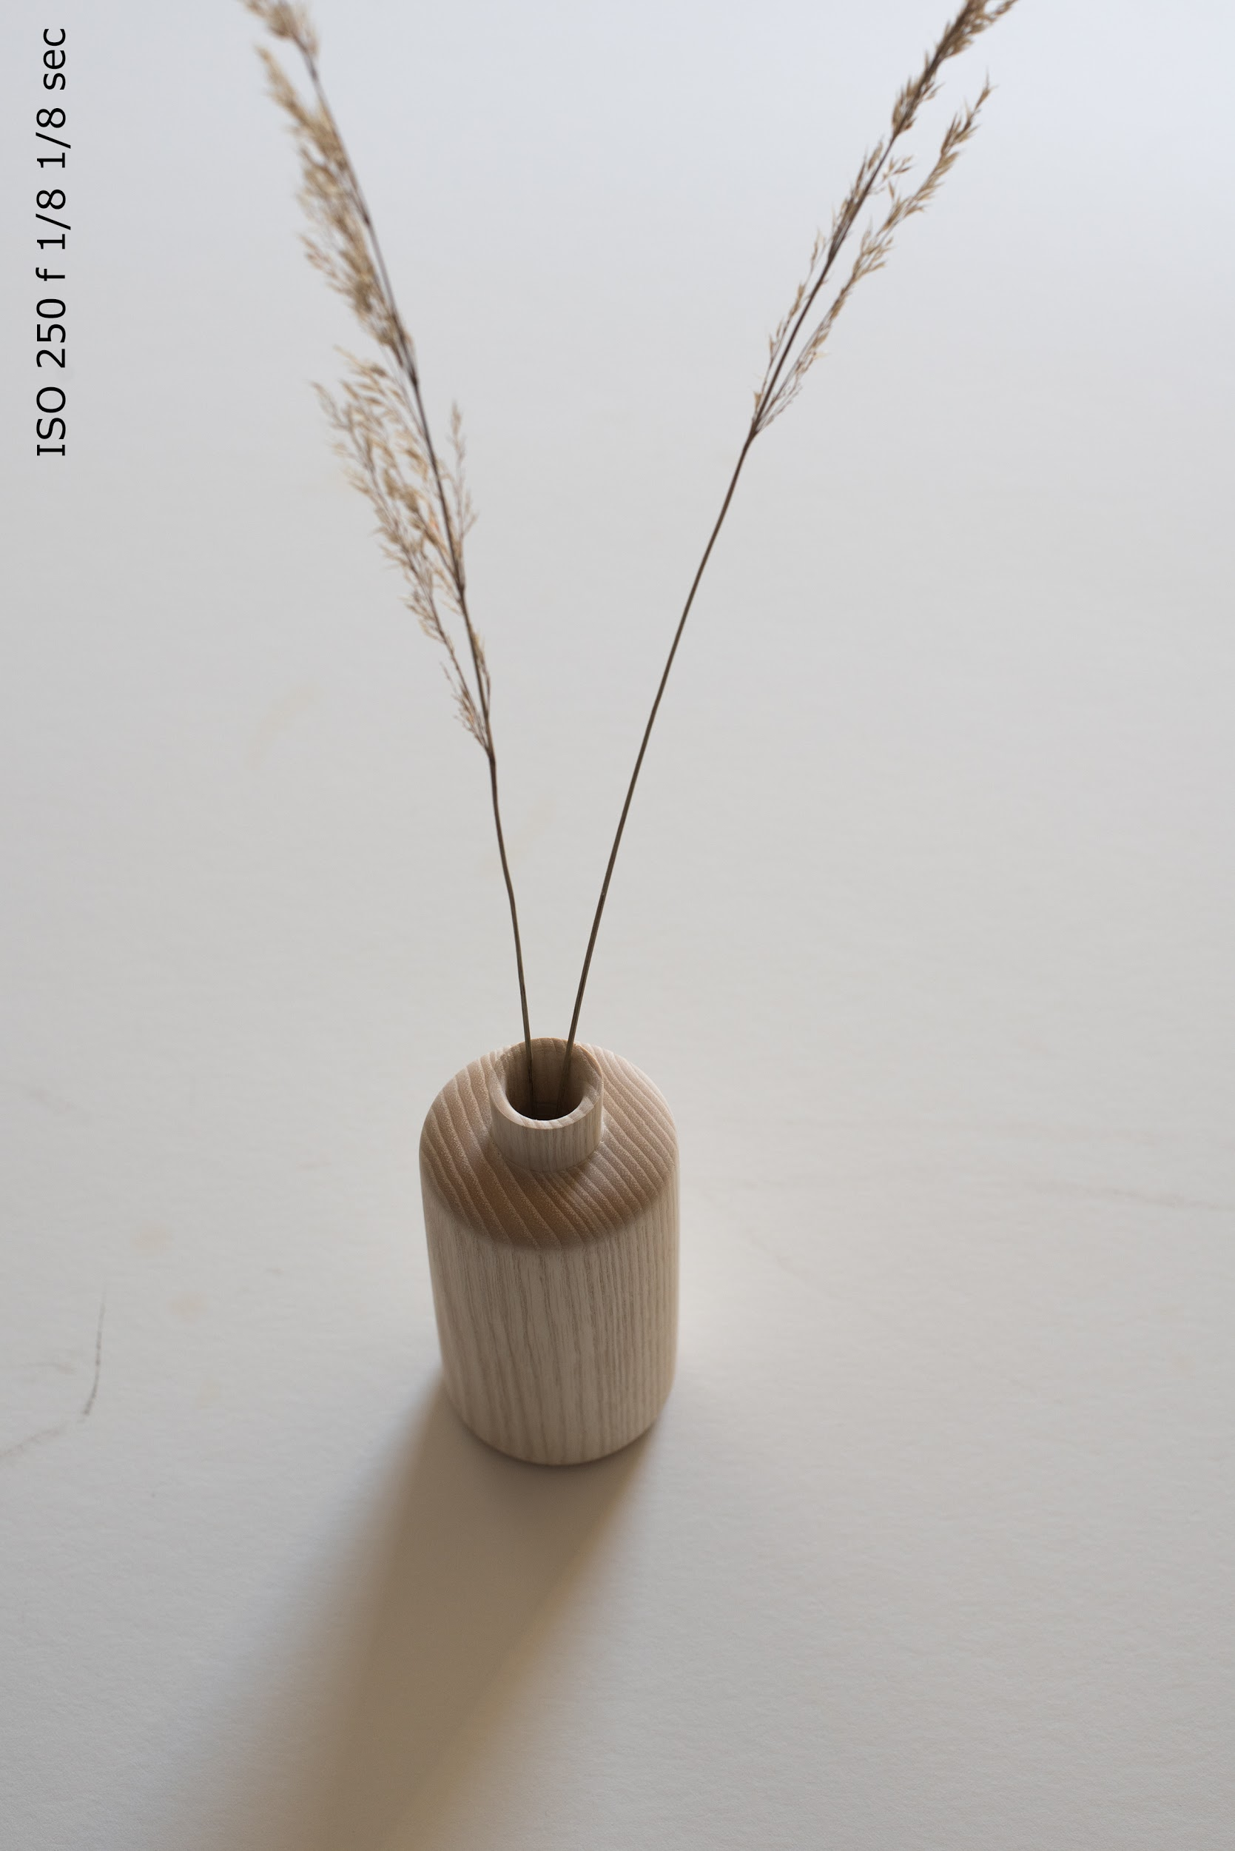
Light from one window (door is flagging sunspot)

Slide 12
Once you have picked a location, either inside or outside, establish your camera - object relationship.

Slide 13
Do you need a tripod? (Probably!)
The tripod gives you time to think through your composition, the use of both of your hands and to ability to use slow shutter speeds. If using a cell phone camera, consider purchasing a mini tripod for it.

Slide 14
When framing your shot, I strongly advise against using the viewfinder as your crop tool.
It is important to remember that all lenses have a minimum focusing distance.
For this and other reasons such as focal depth or rotation corrections, it makes sense to backup the camera and capture more than you need, then crop later using editing software.

Slide 15
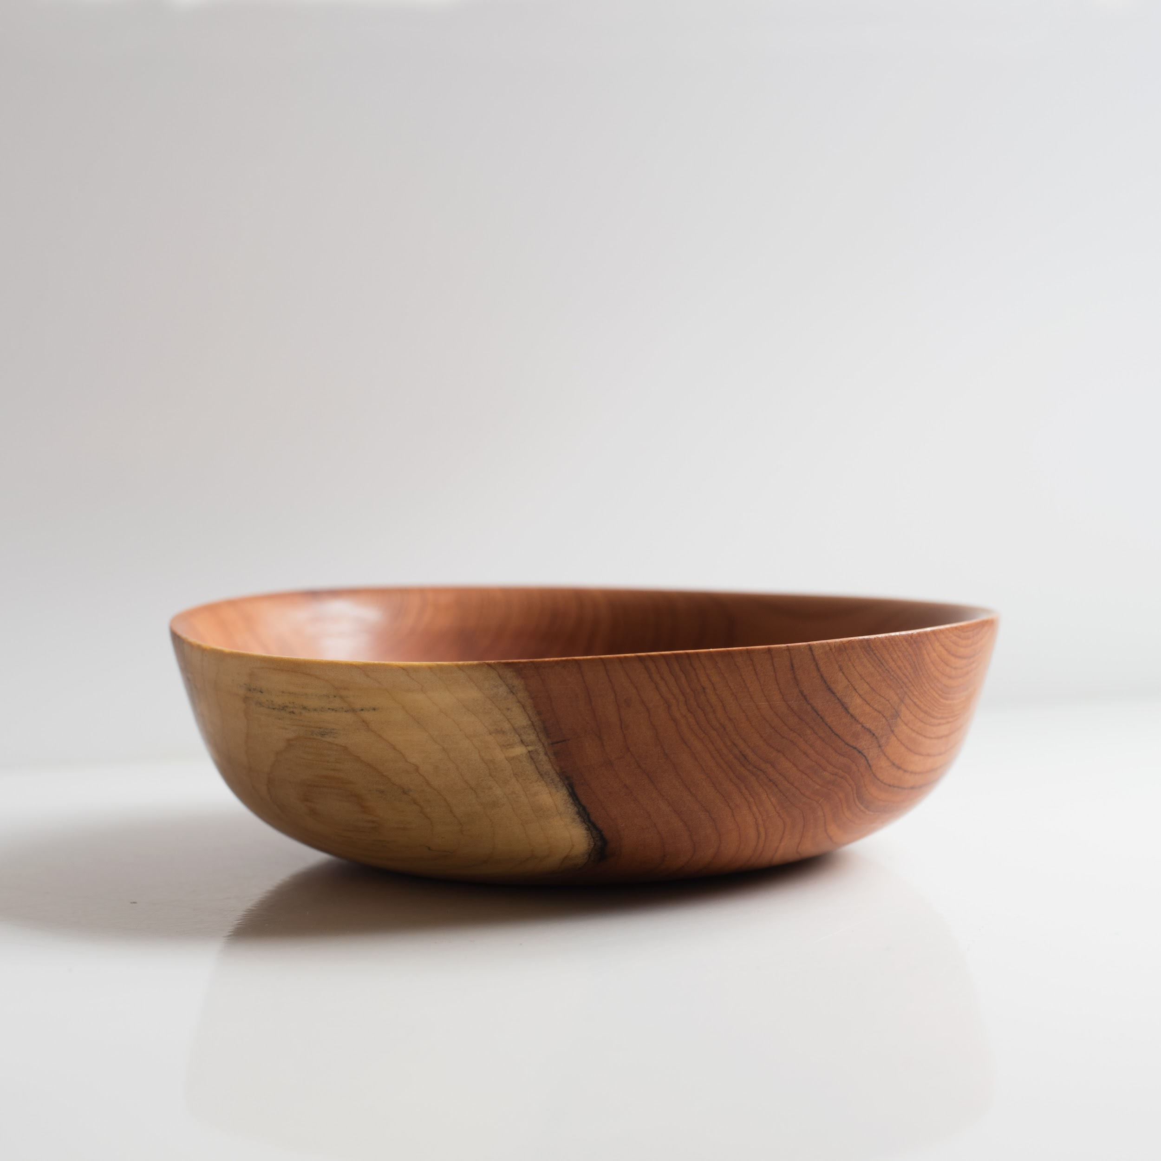
If you are shooting a bowl edge on, focus about halfway back on the rim, that will give you the widest focal range and a better chance that the front and back rim are in focus. For more focal depth, stop down the aperture, and, or physically backup.

Slide 16
Camera Settings
Low ISO to yield the sharpest grain
Small aperture to hold focus front to back
Slow shutter speed
Pro-tip:
Use the self-timer to mitigate vibration caused from hitting the shutter release button.

Slide 17
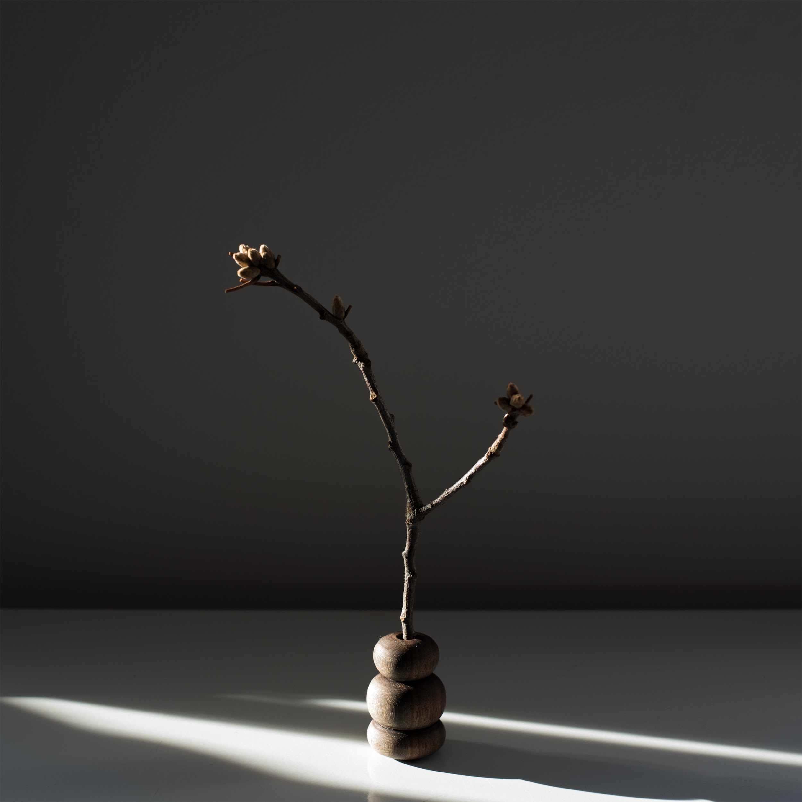
Lighting

Slide 18
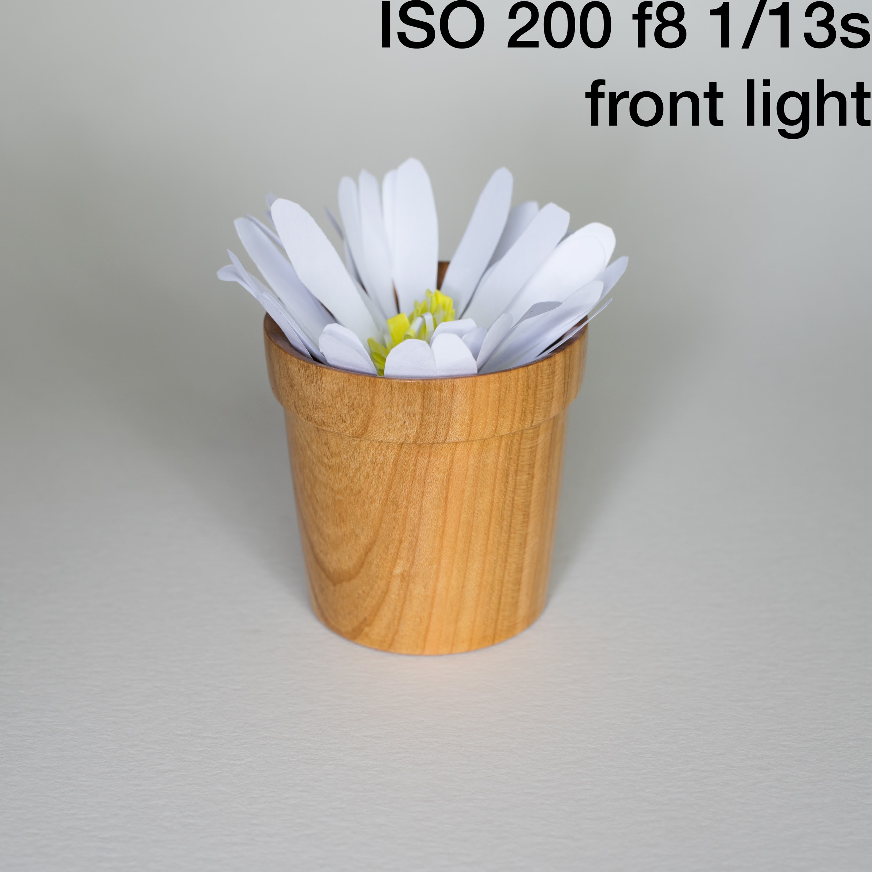
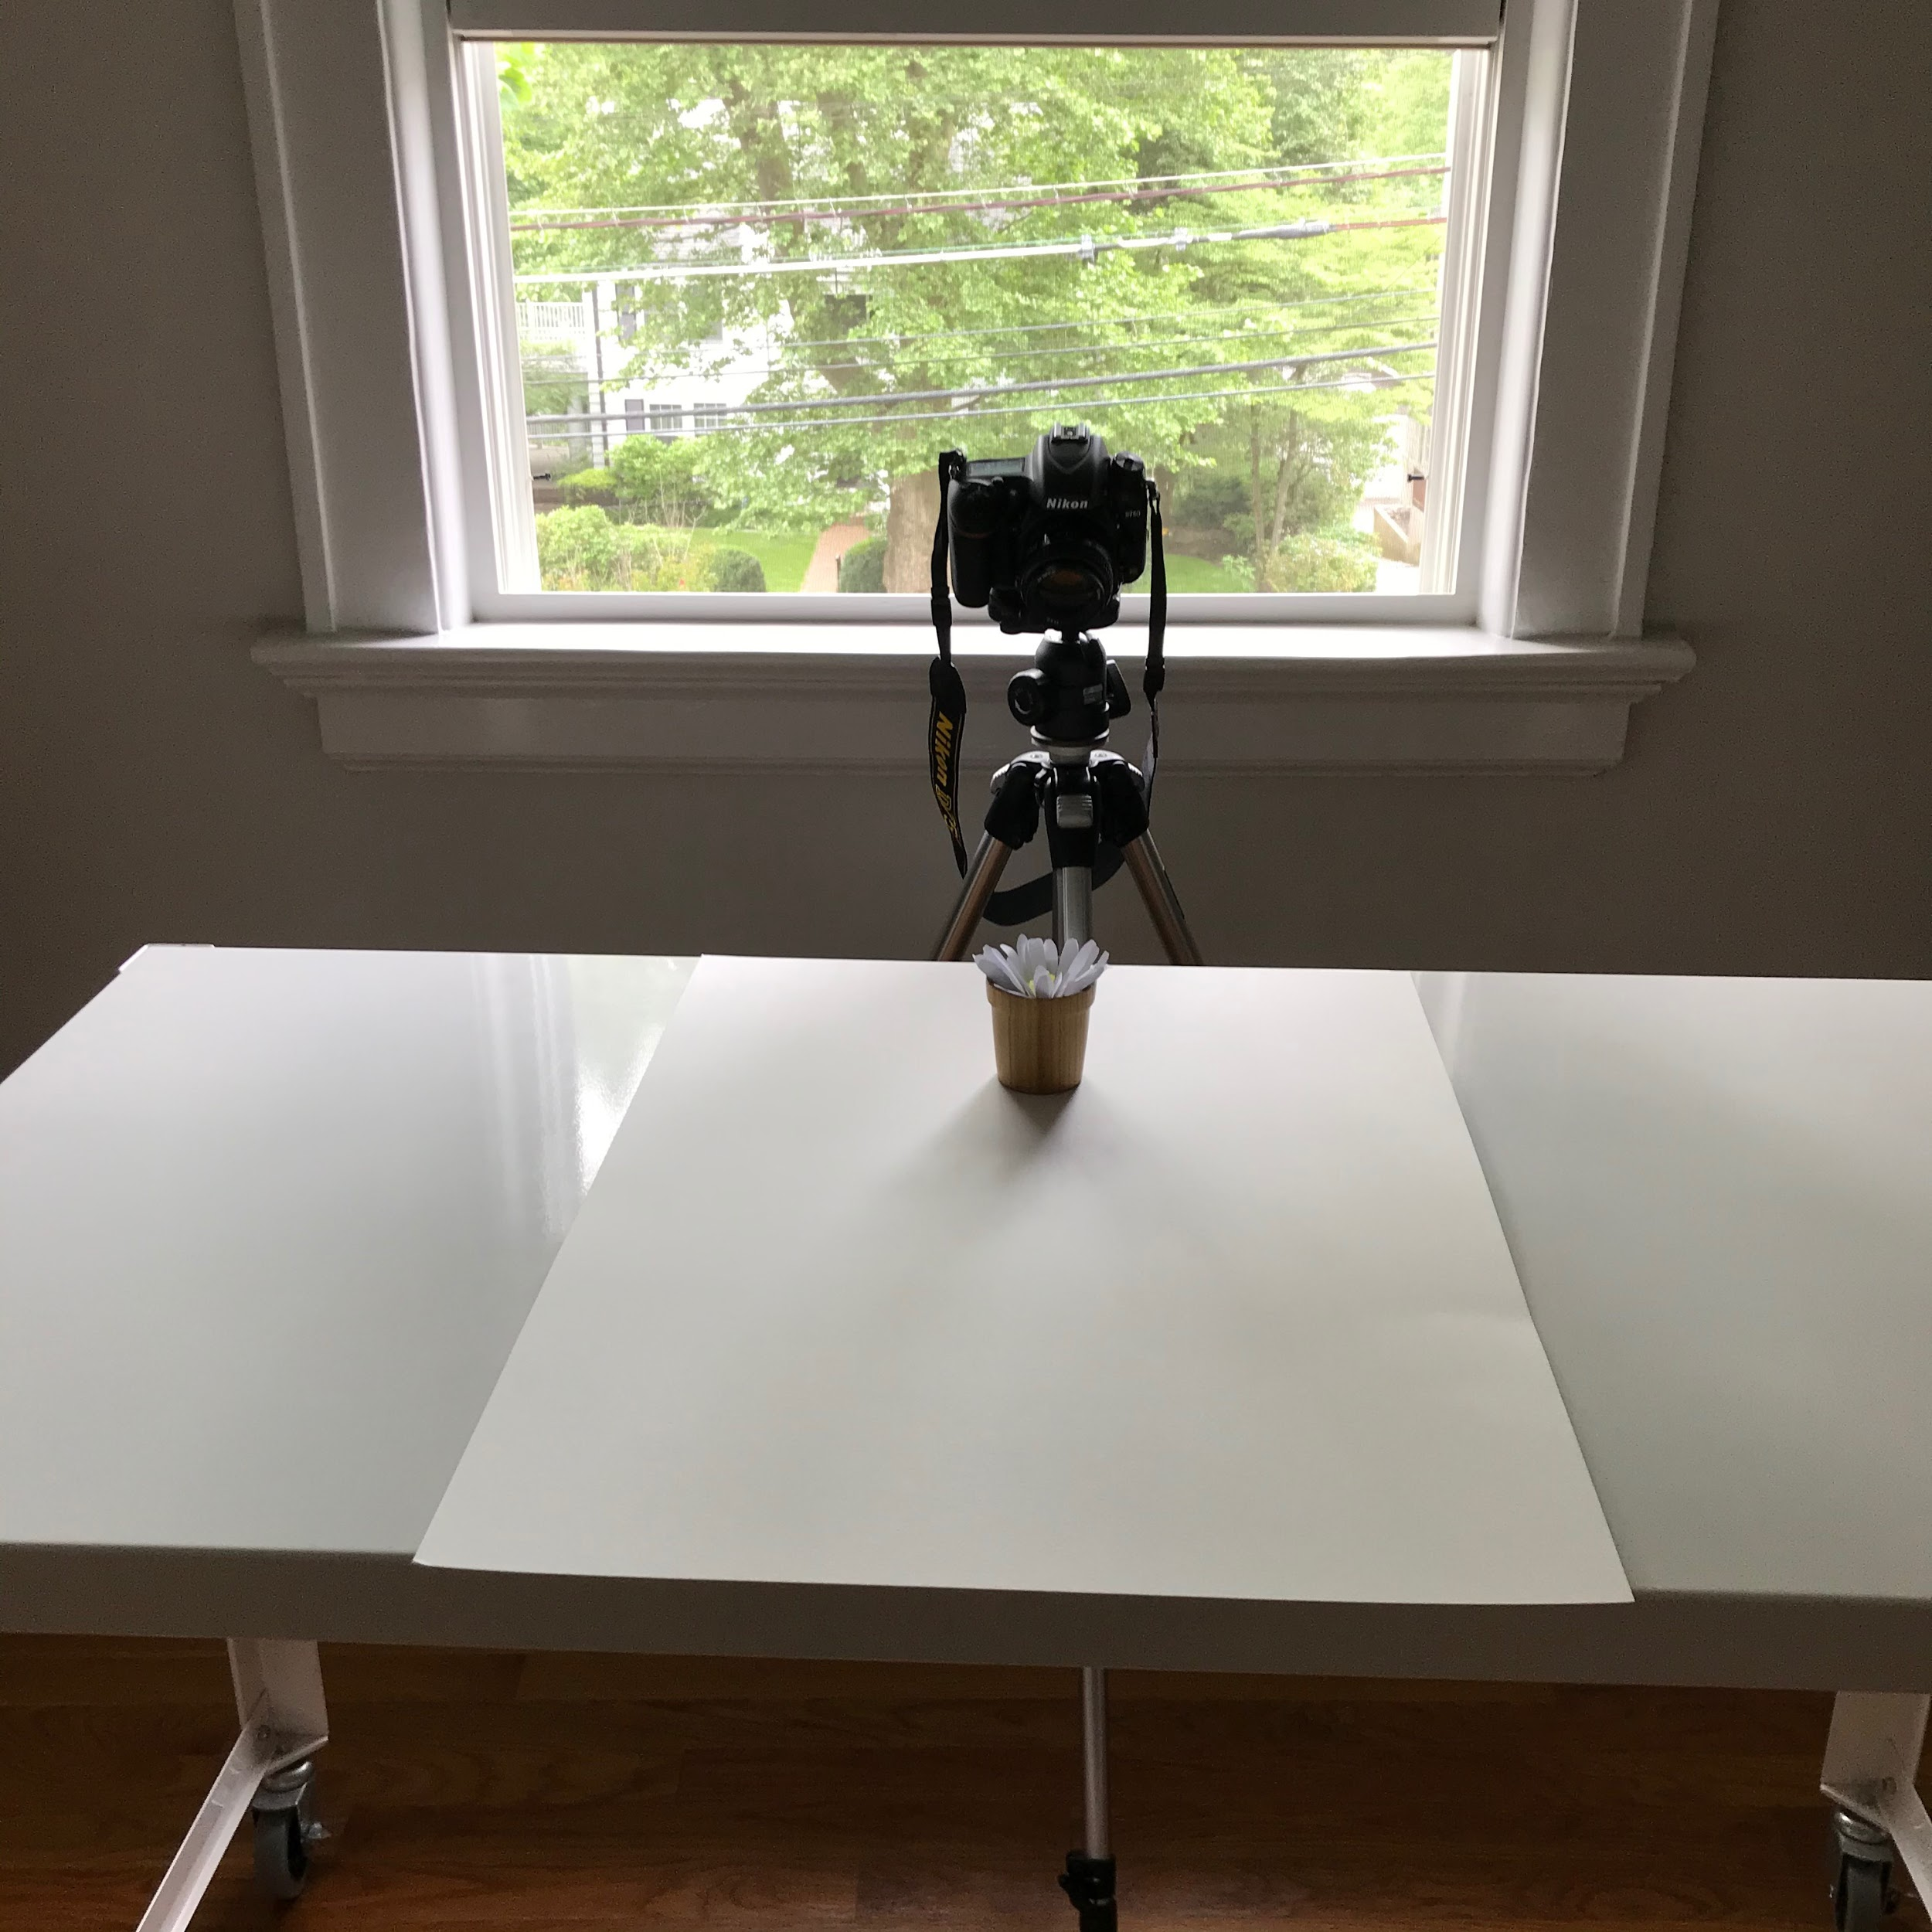
Front light
Illuminates color and detail

Slide 19
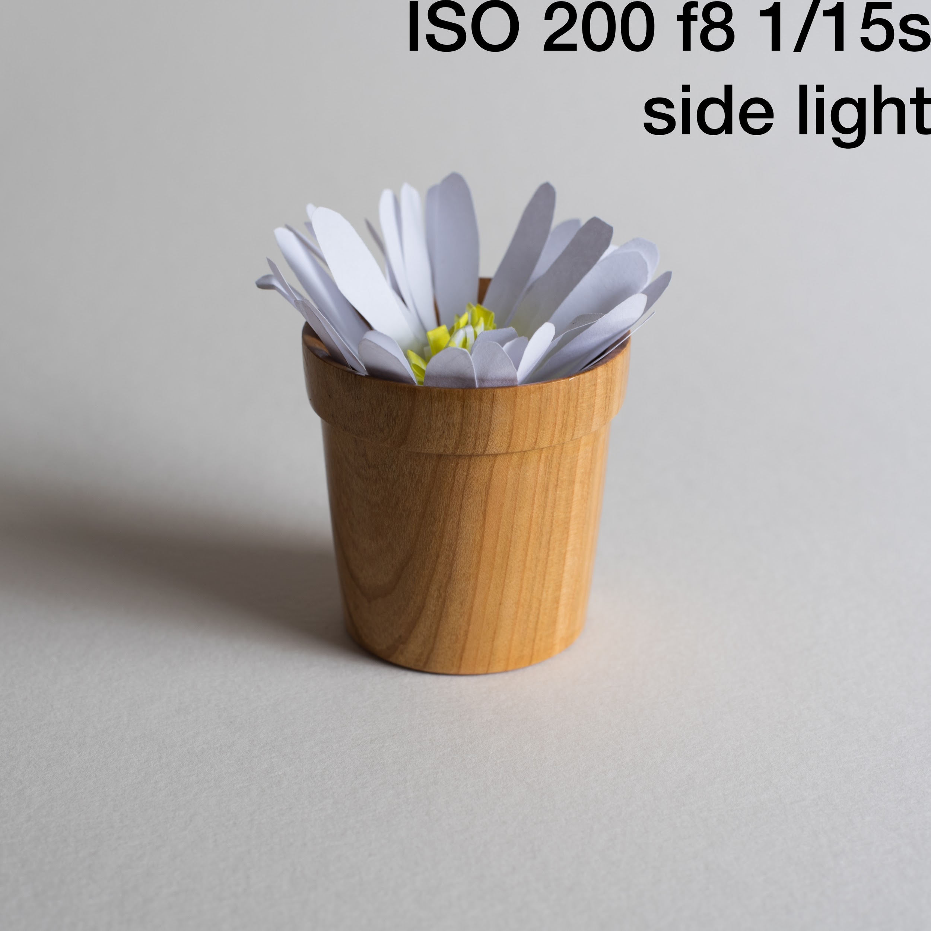
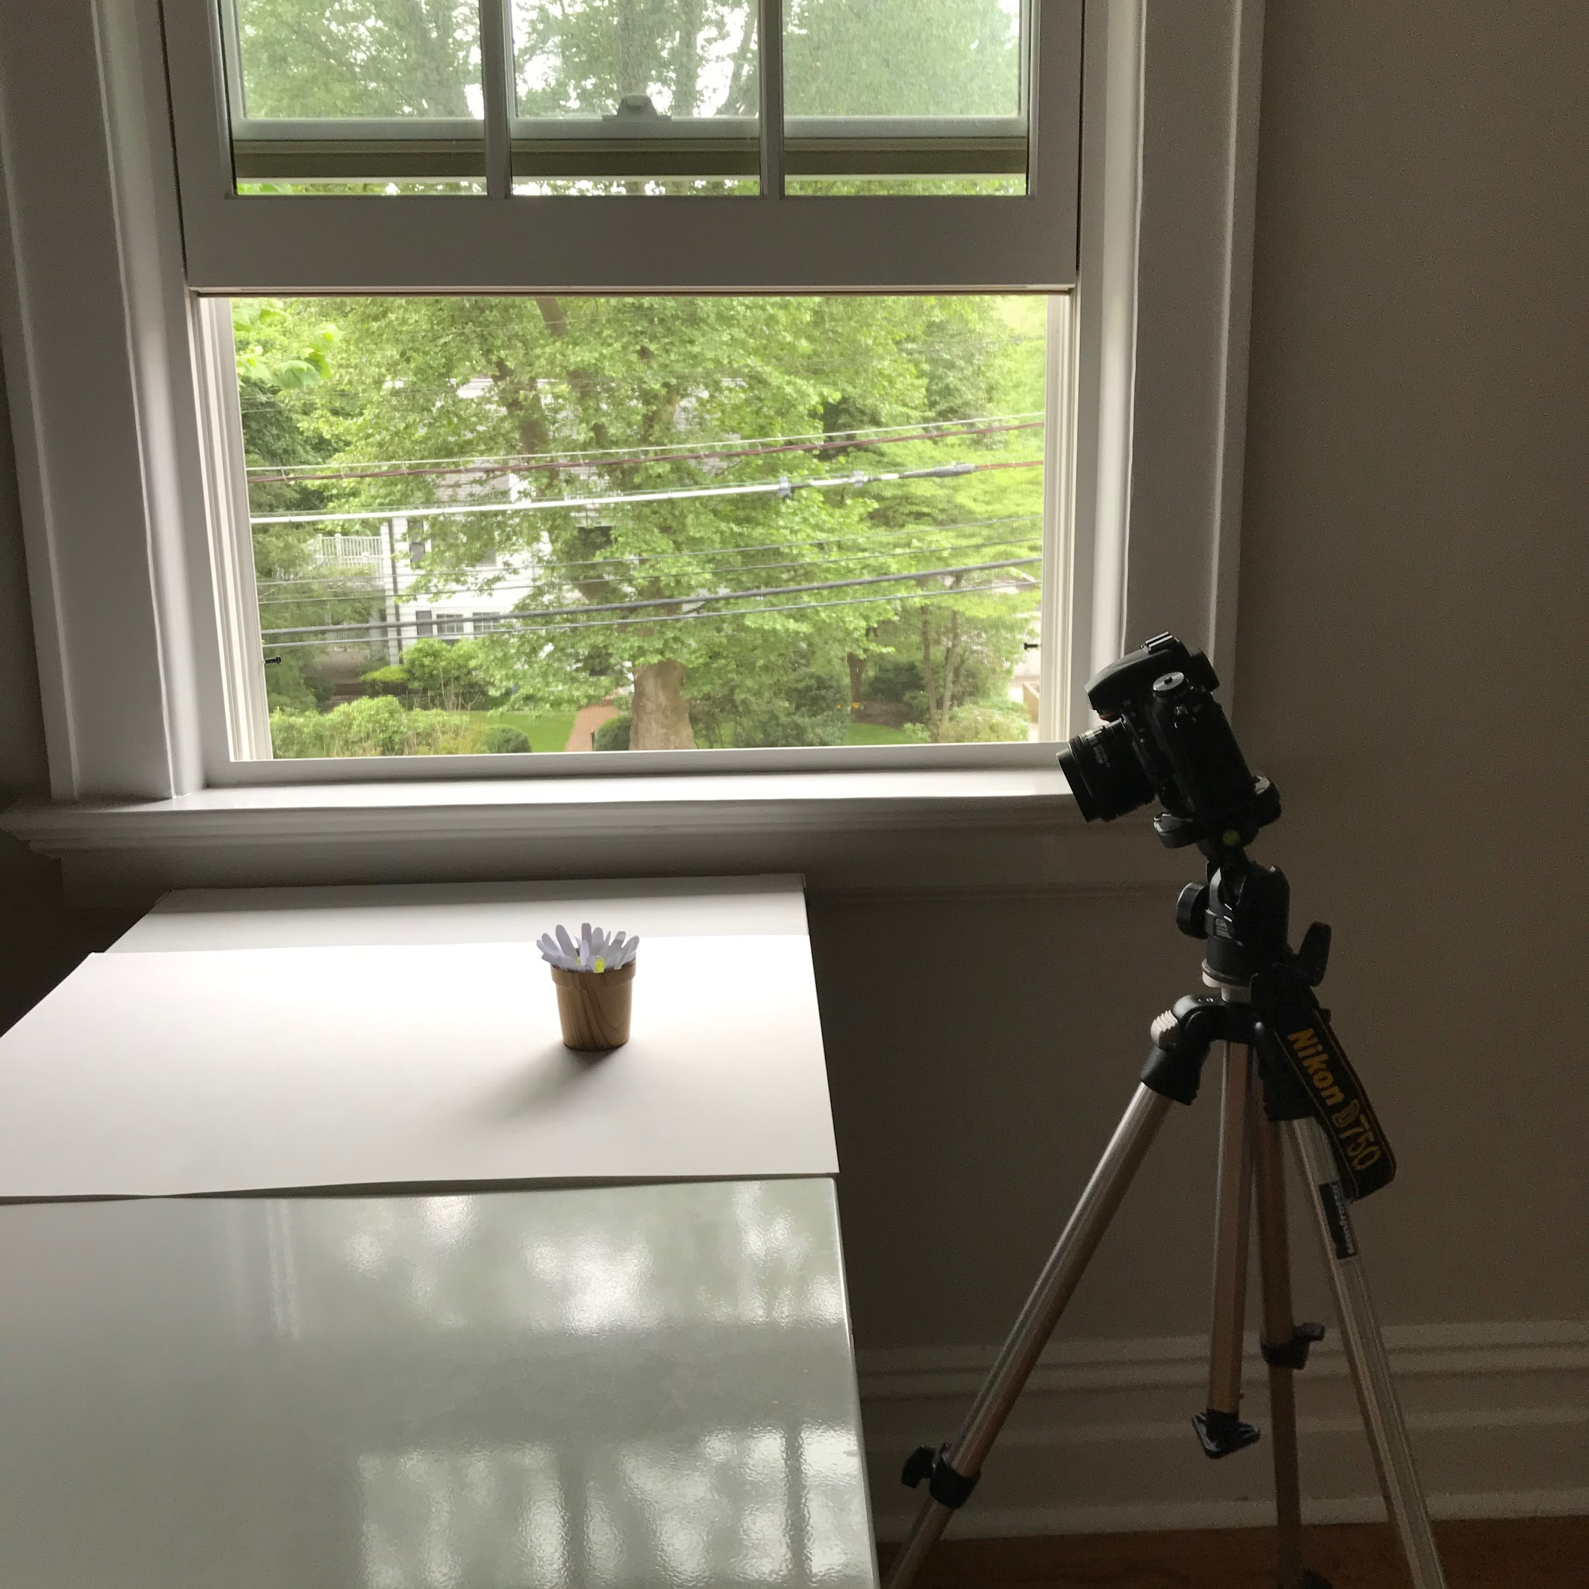
Side light
Good for showing form and texture

Slide 20
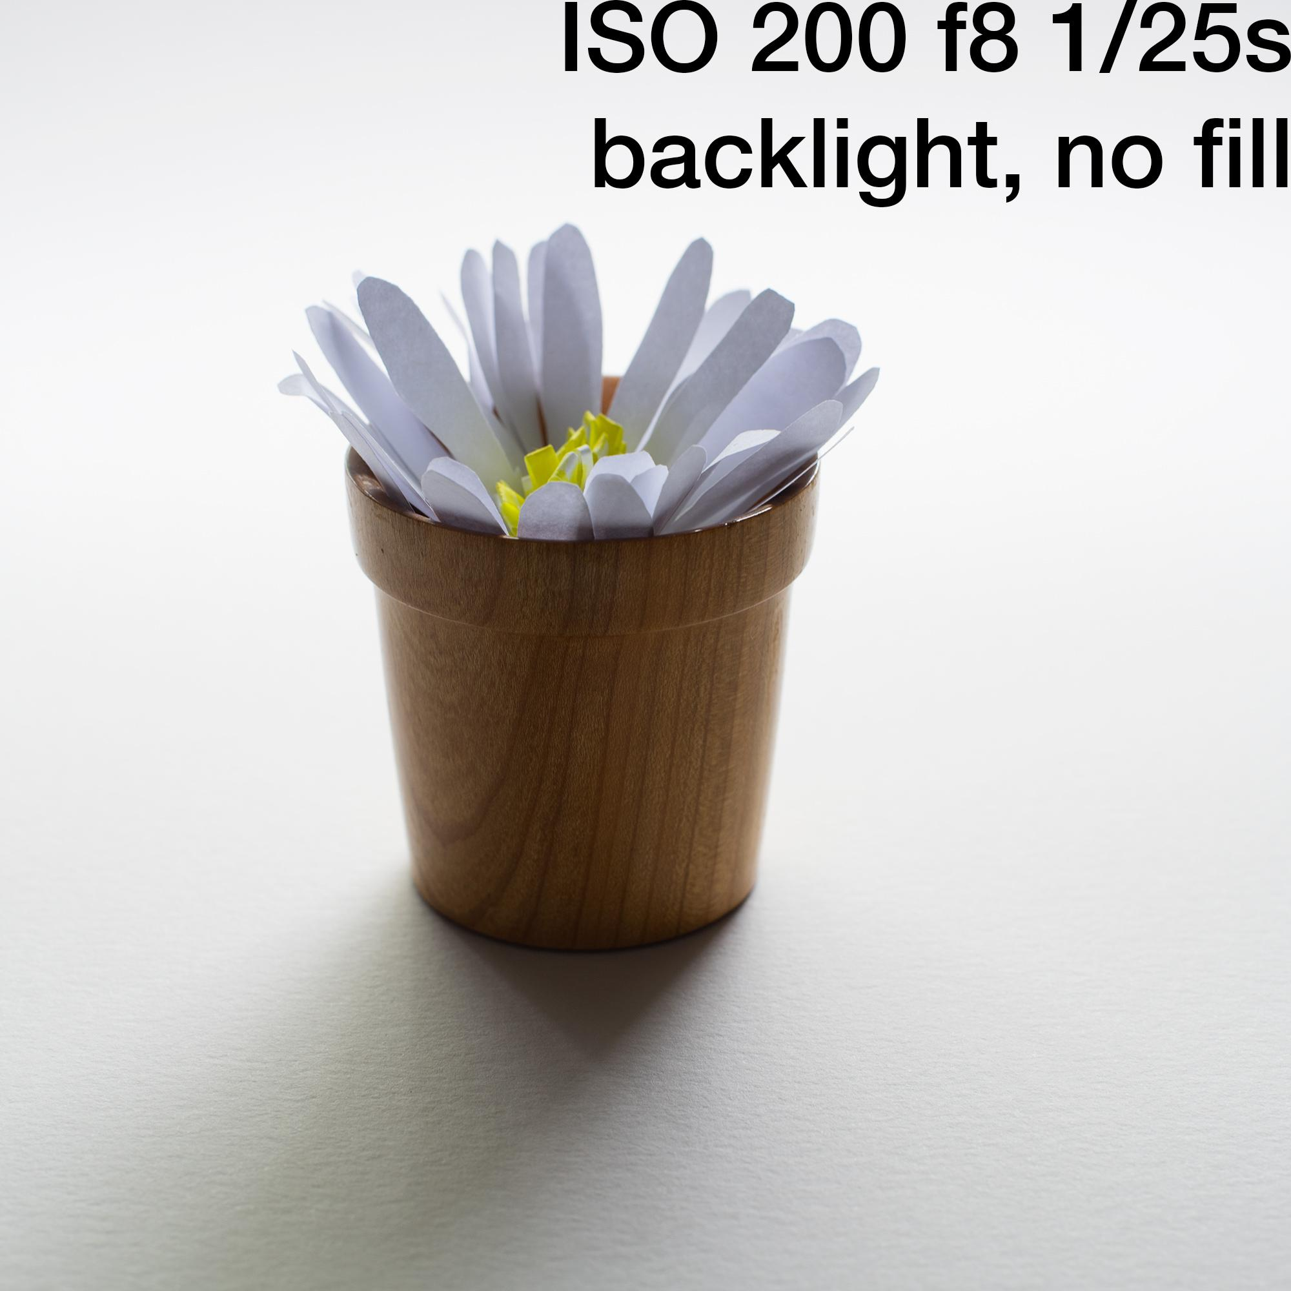
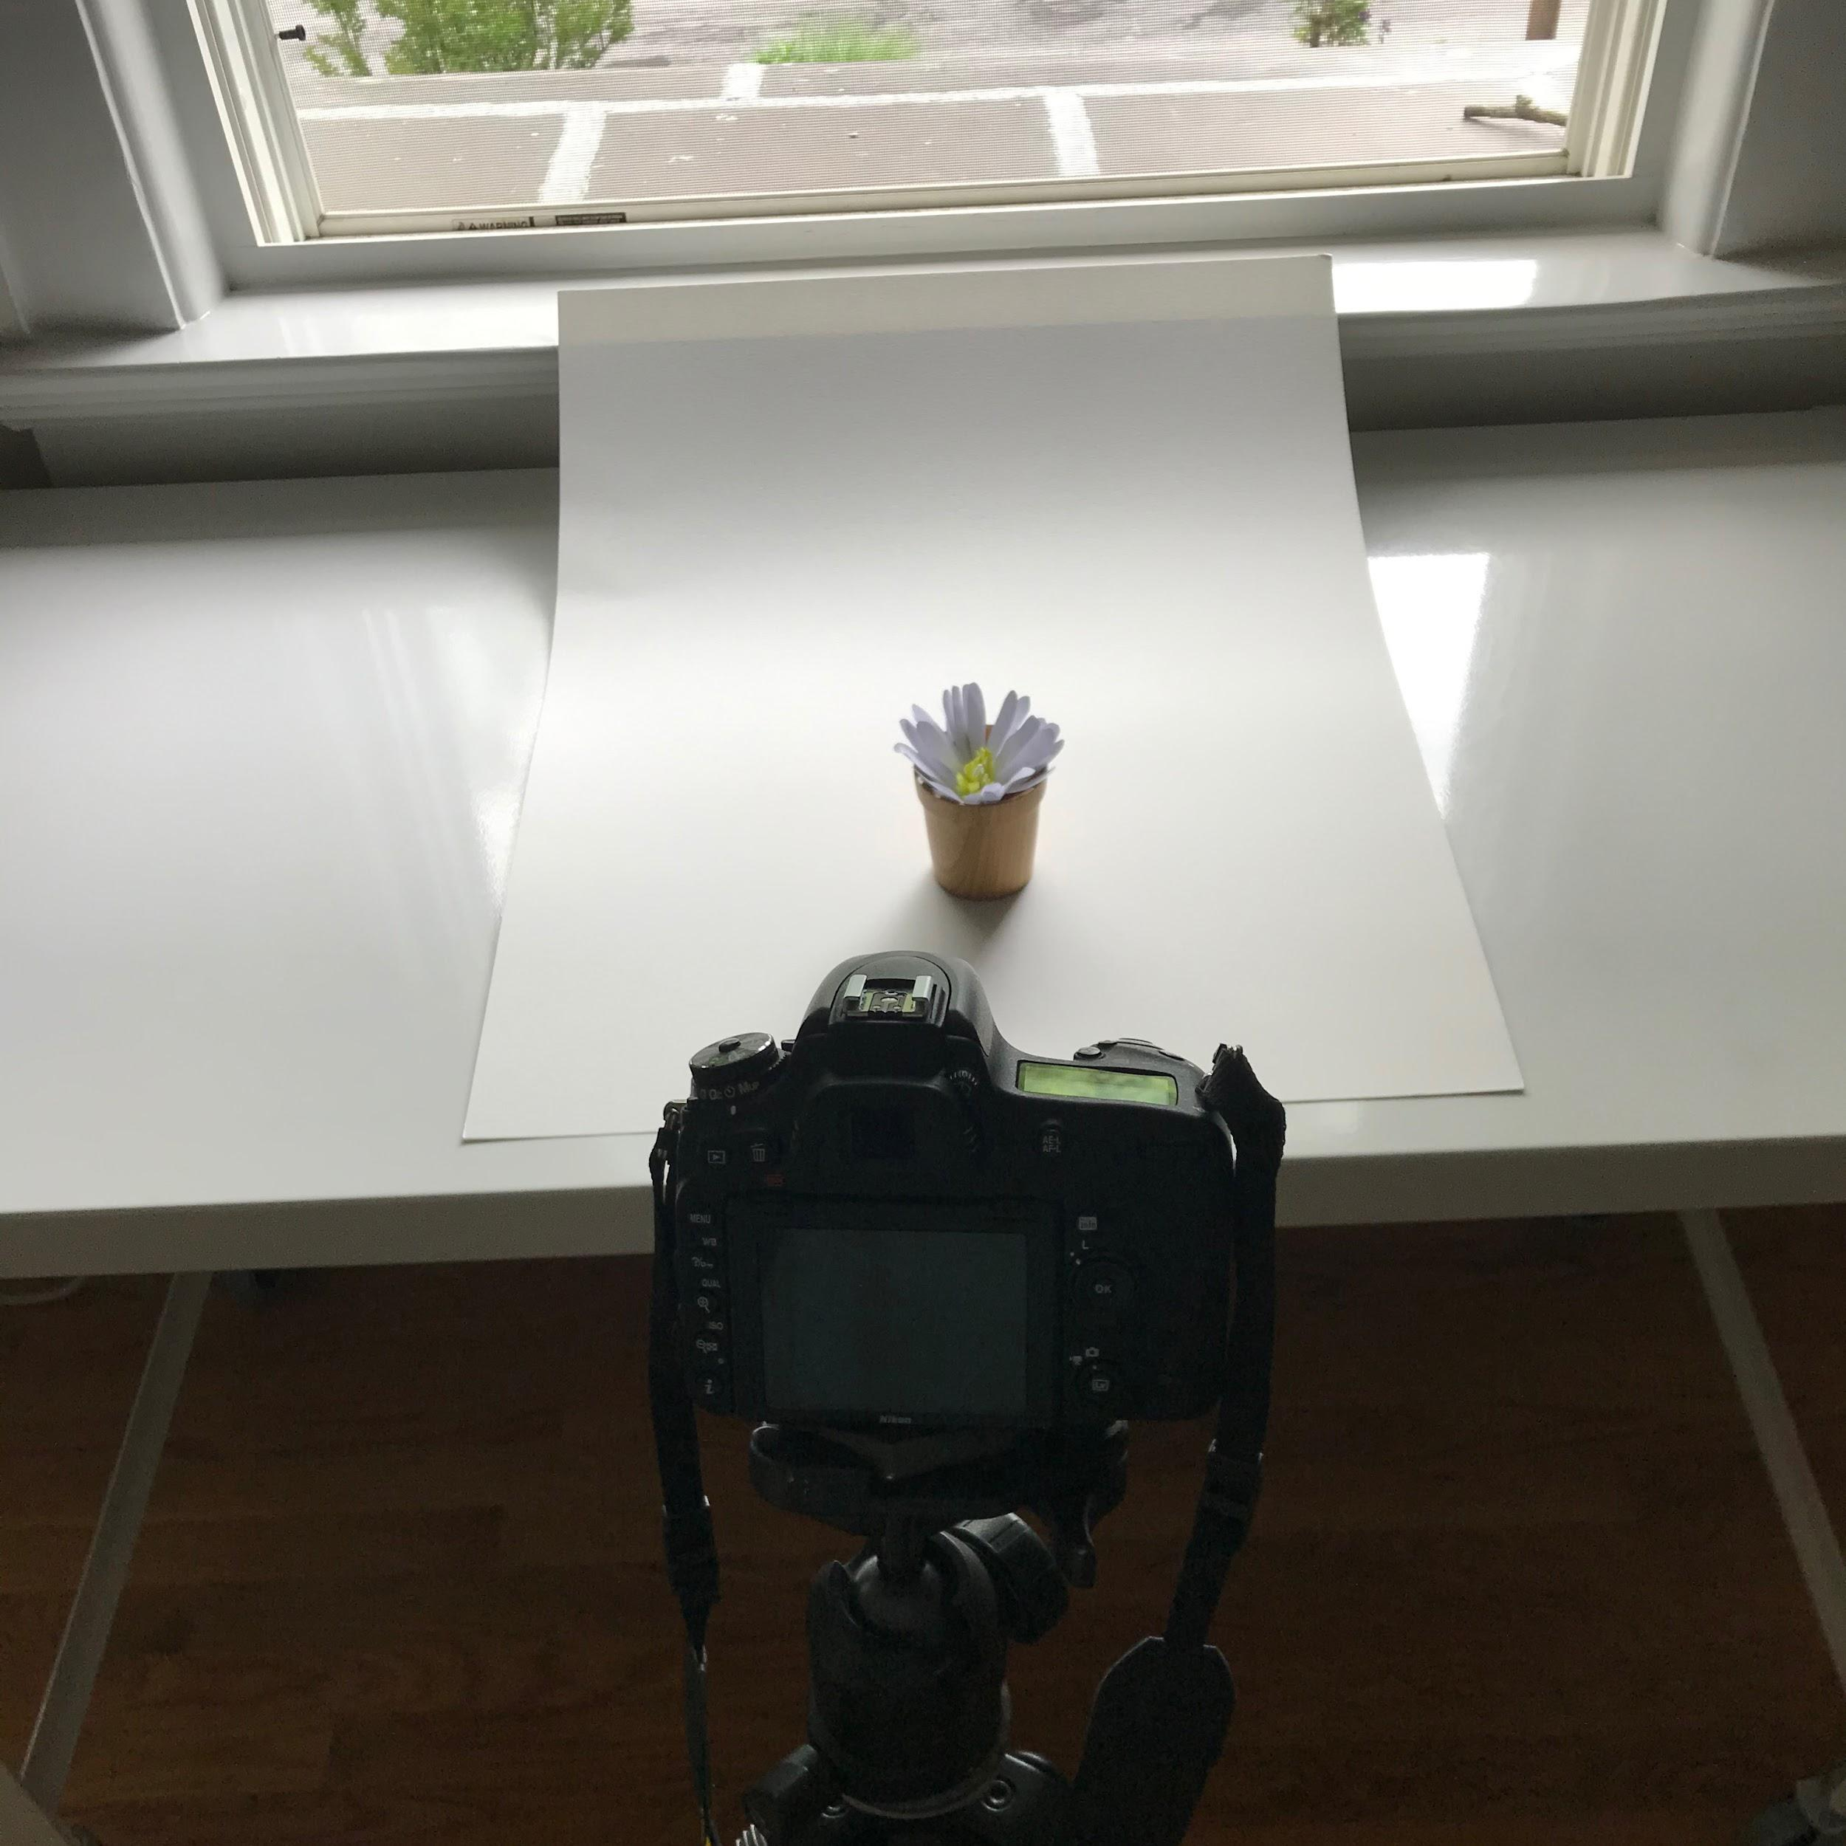
Back light
White background - good for shooting straight down.

Slide 21
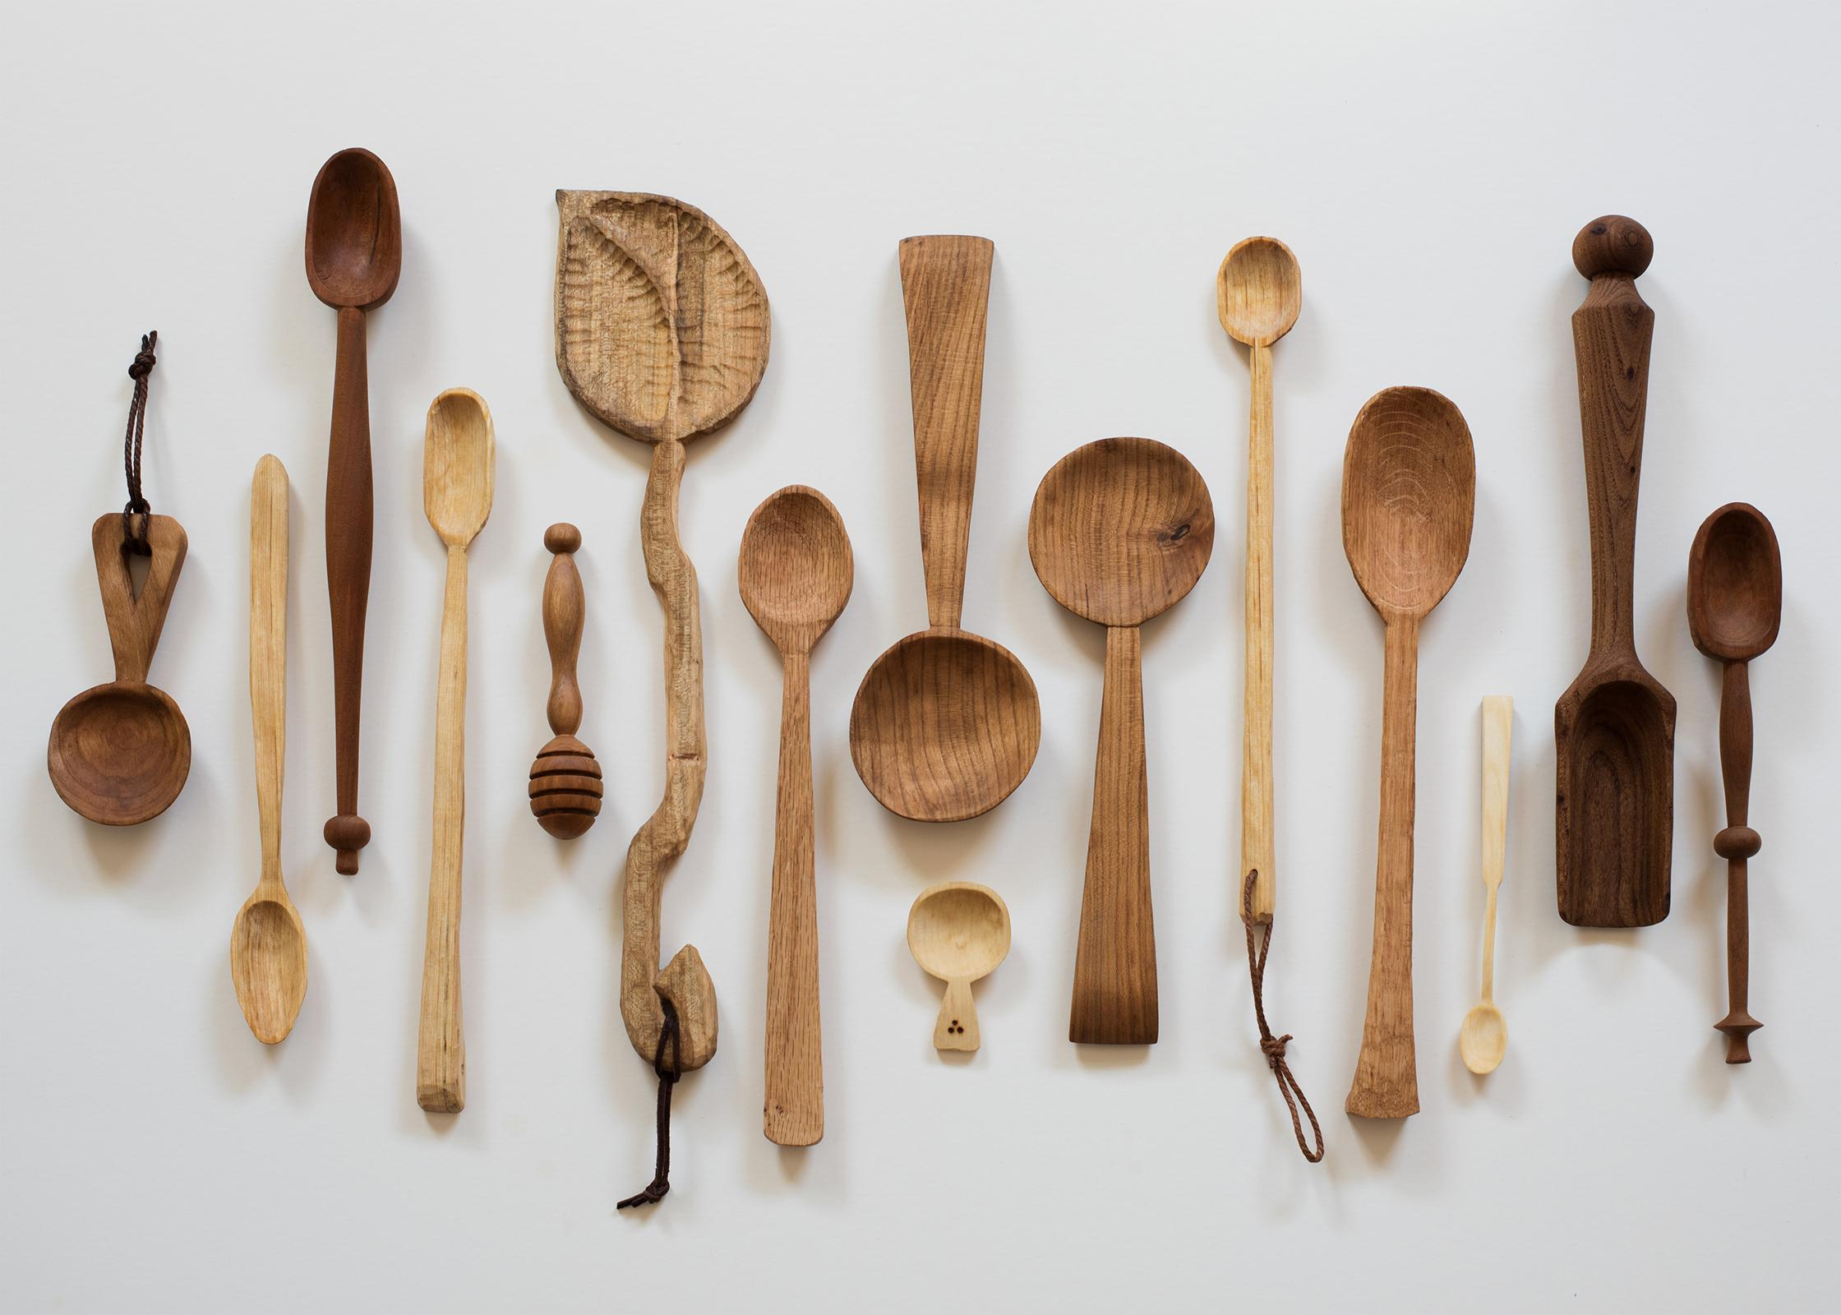
Top-down lighting

Slide 22
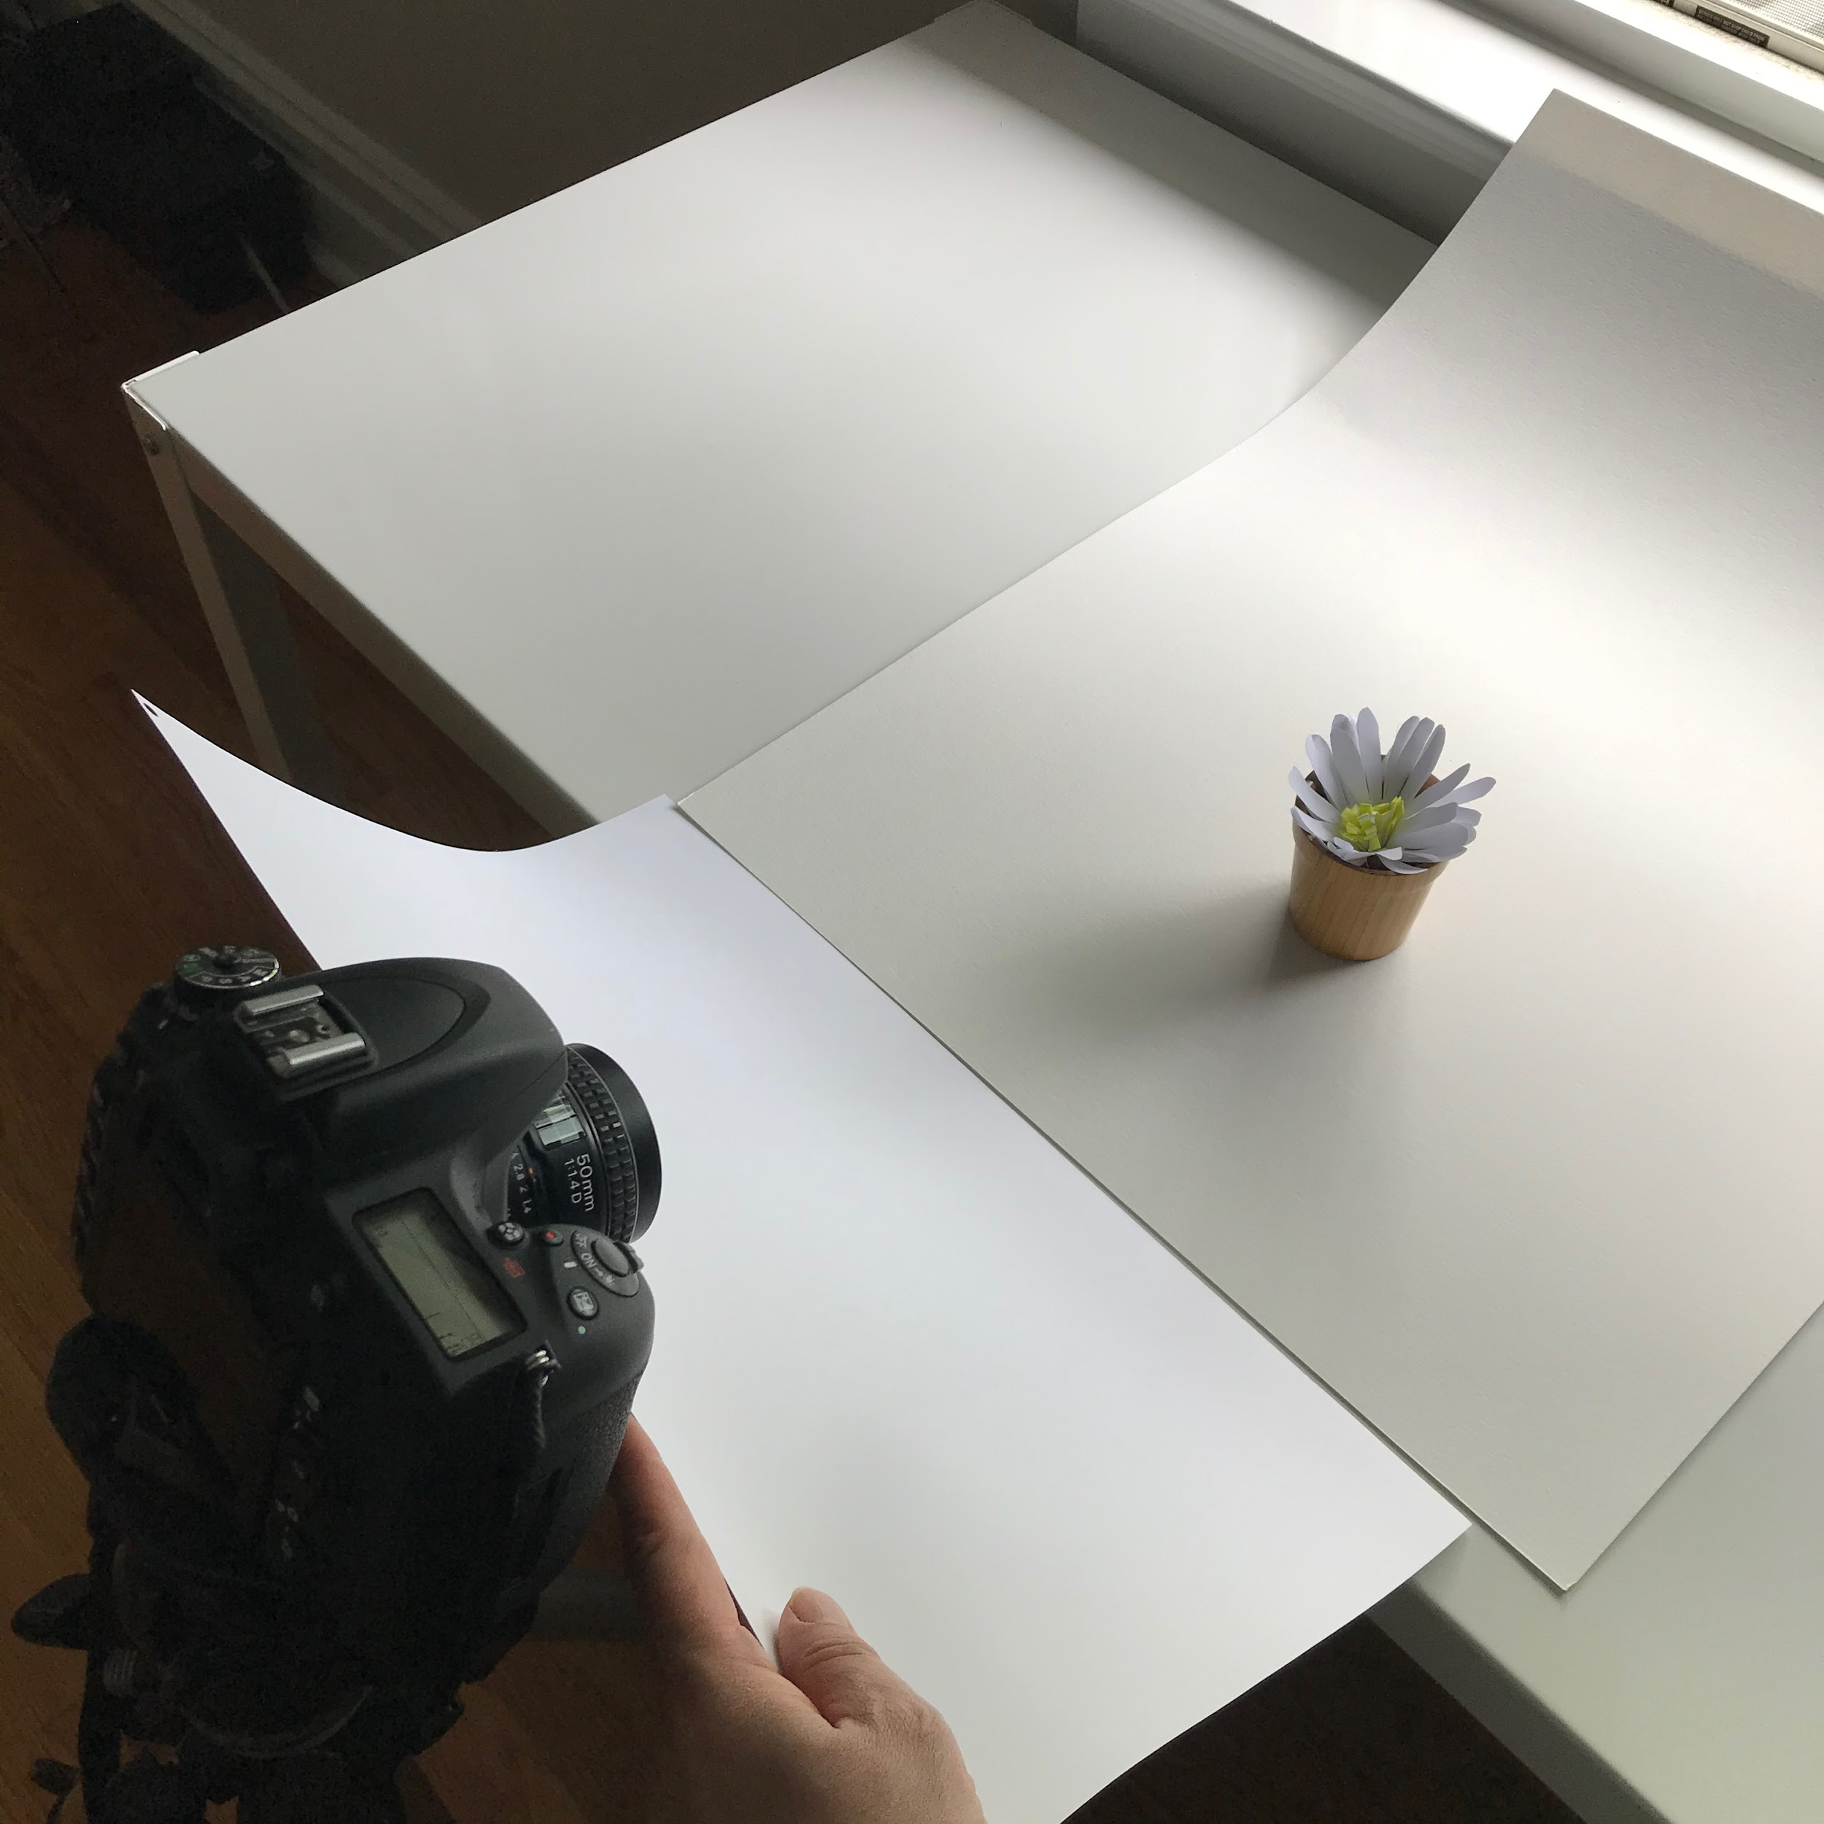
Using fill cards to bounce light into shadow areas
Use white cards for most diffuse fill - but downside is that they can lower contrast and have a flattening effect.
Use silver cards for more light - but downside is that they can make the lighting uneven and add more shadows.
Experiment to find what works best.

Slide 23
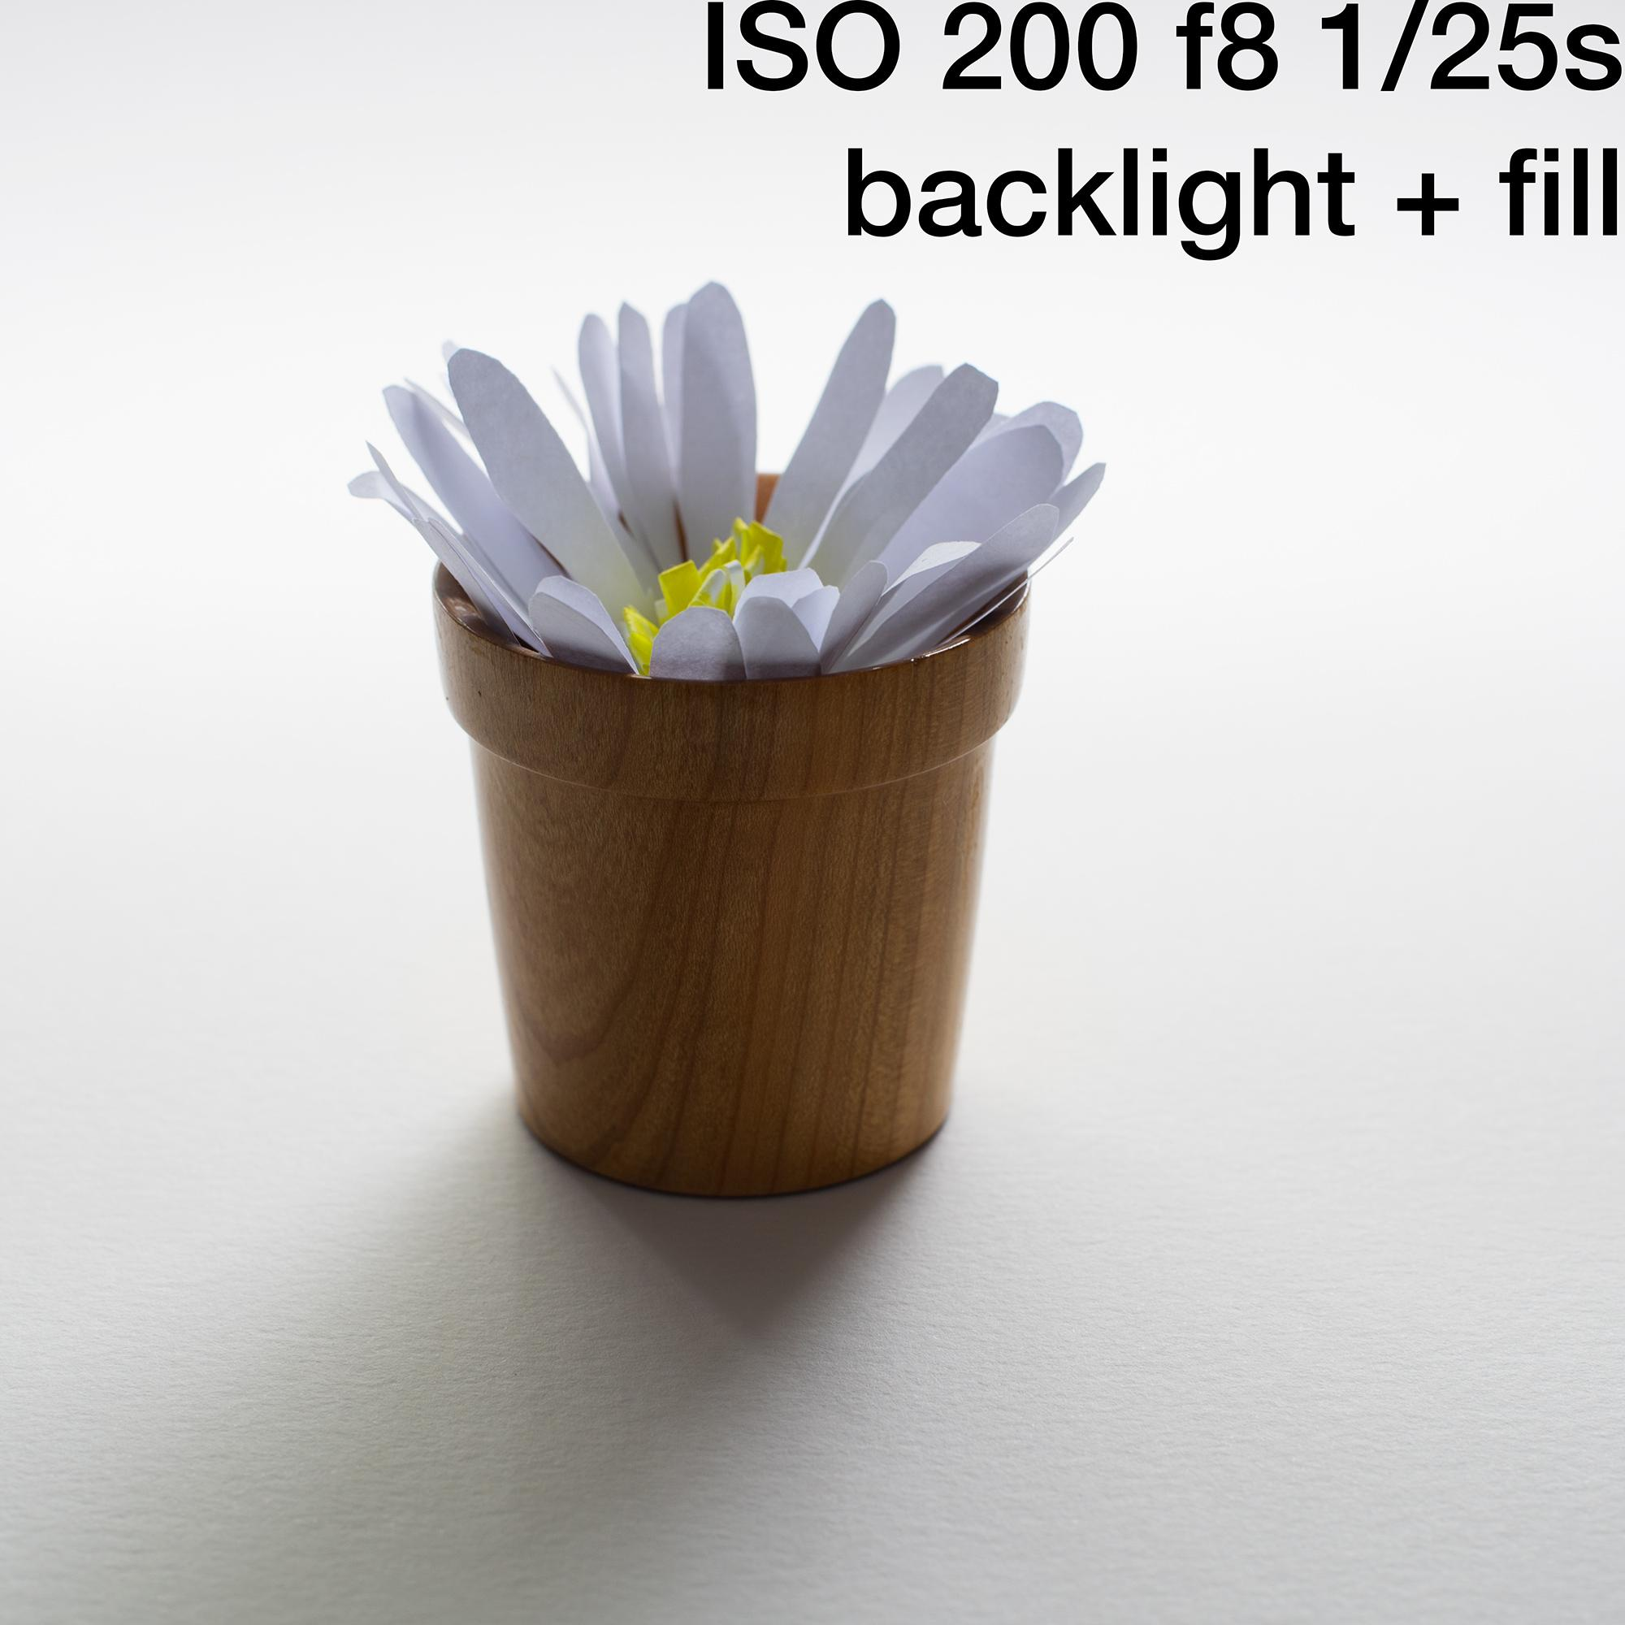

Slide 24
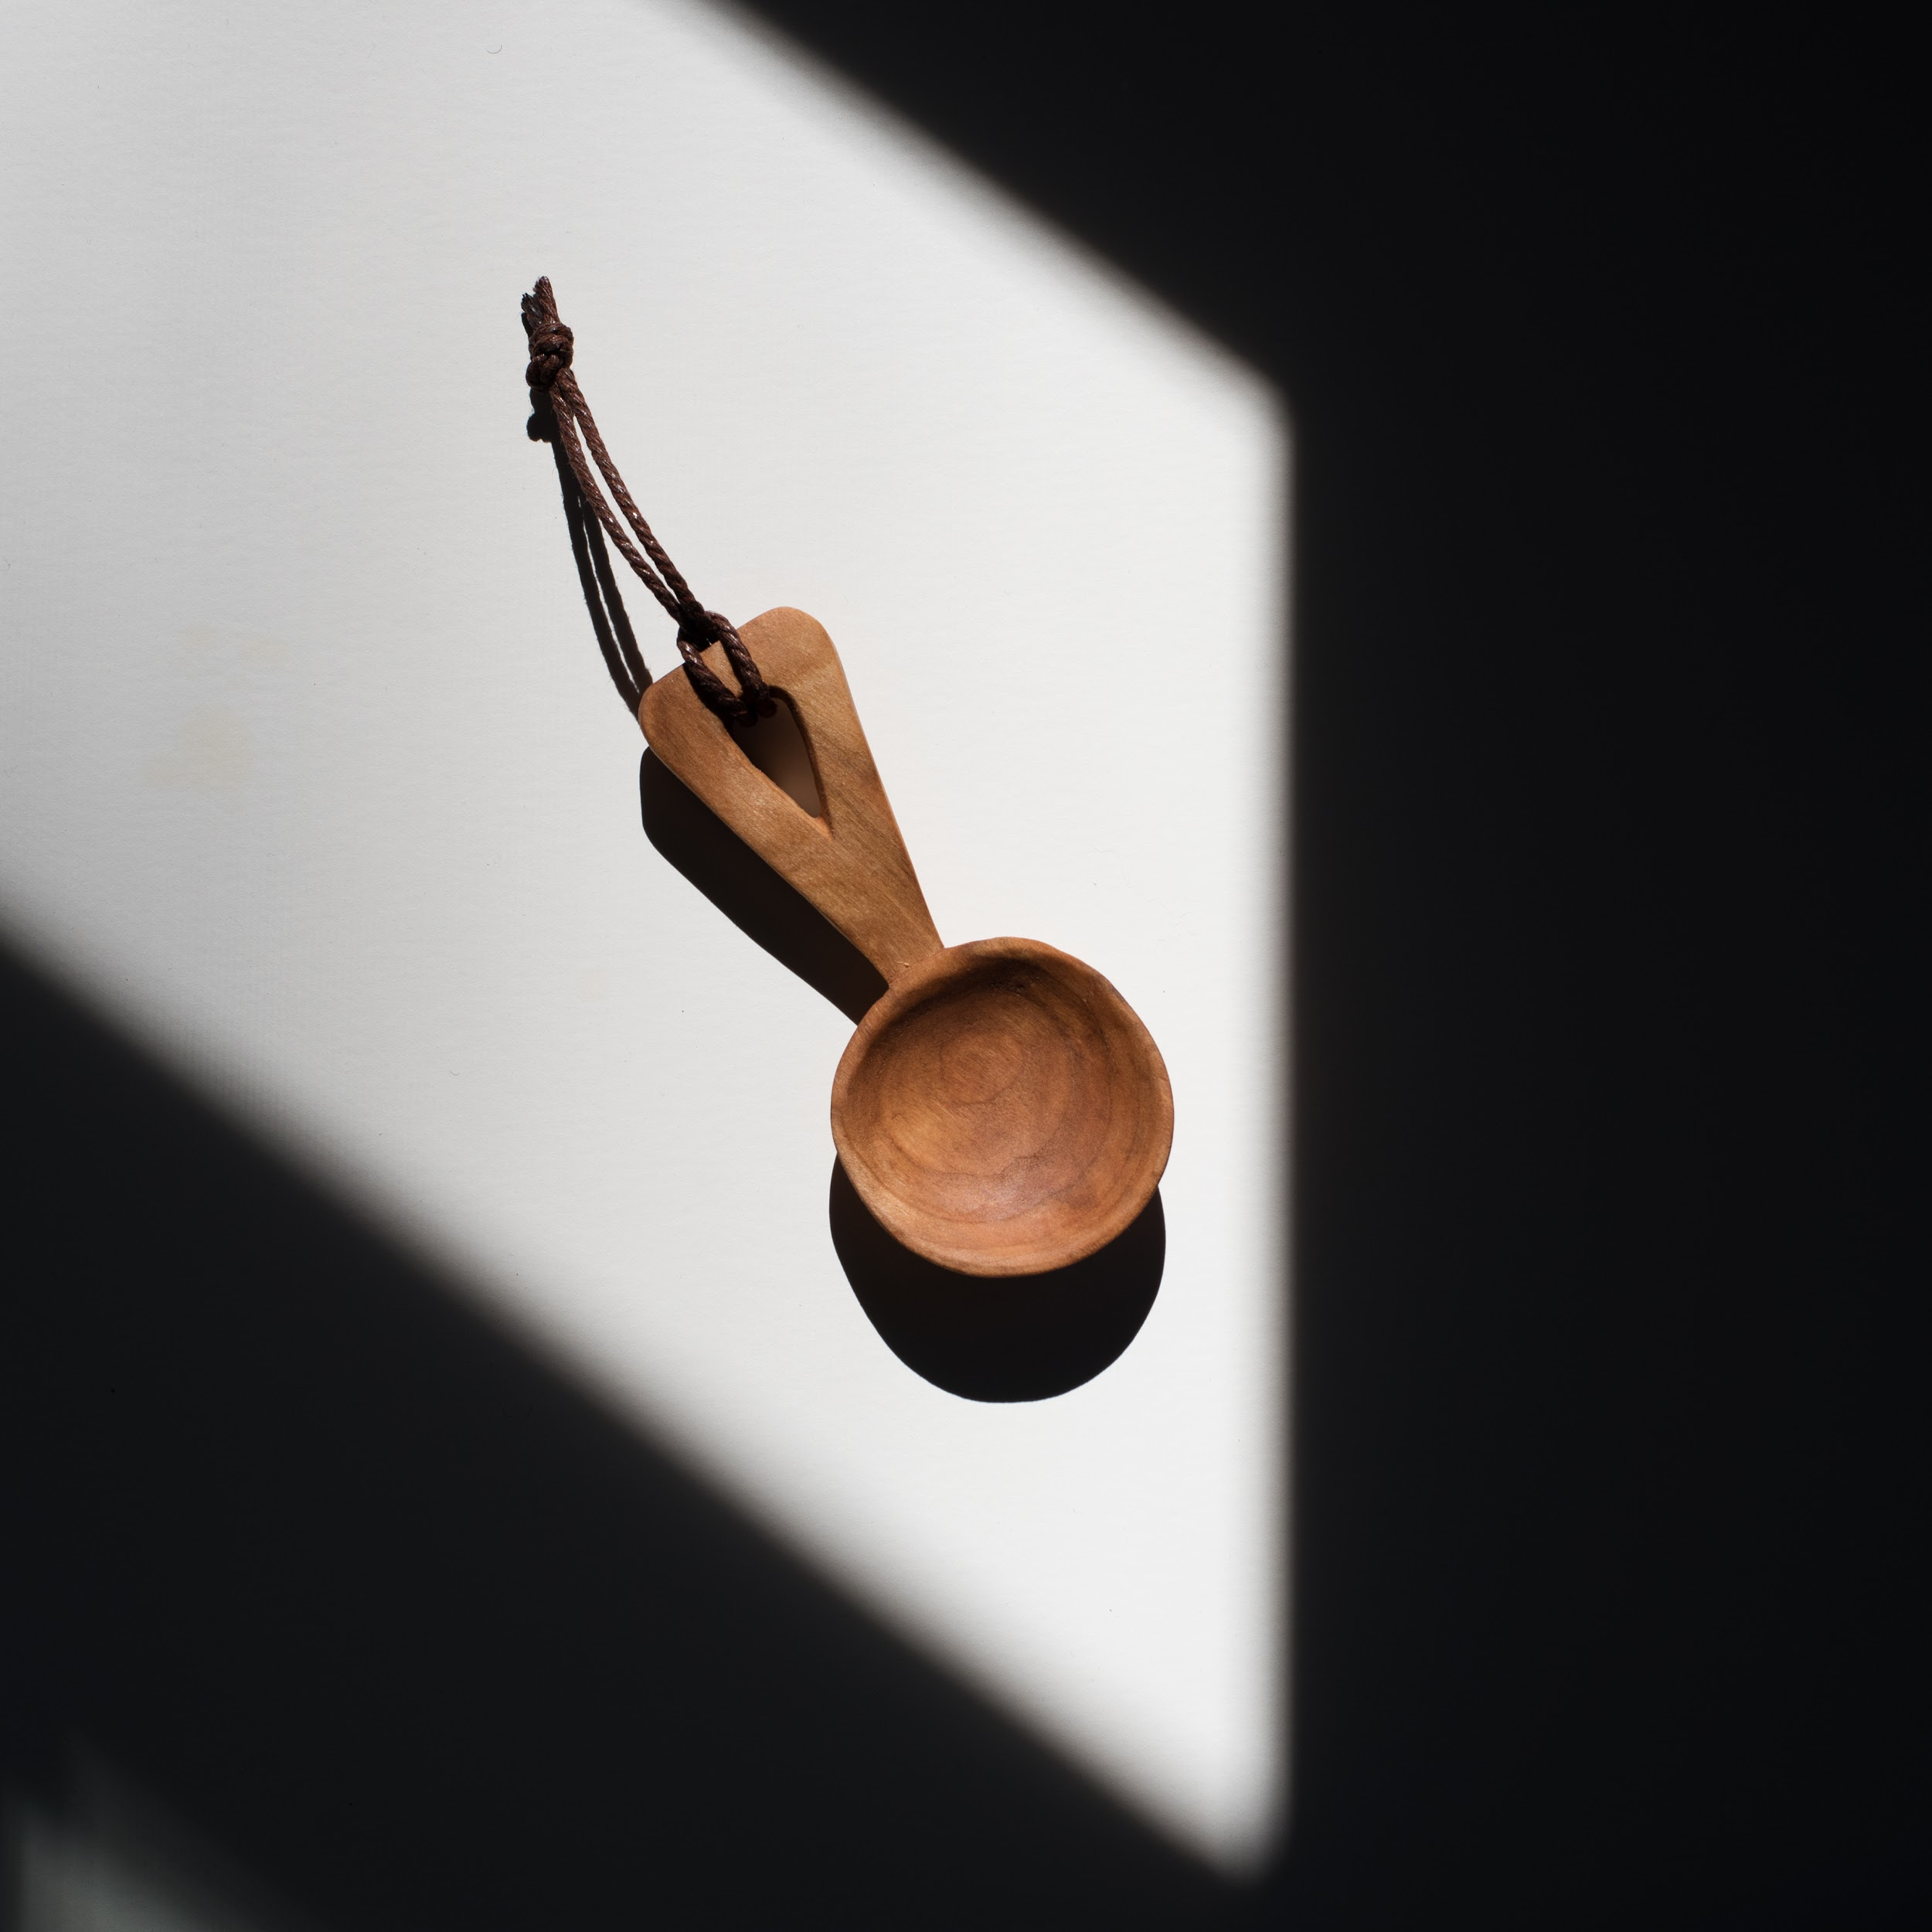
Quality of Light
Full sun versus diffused

Slide 25
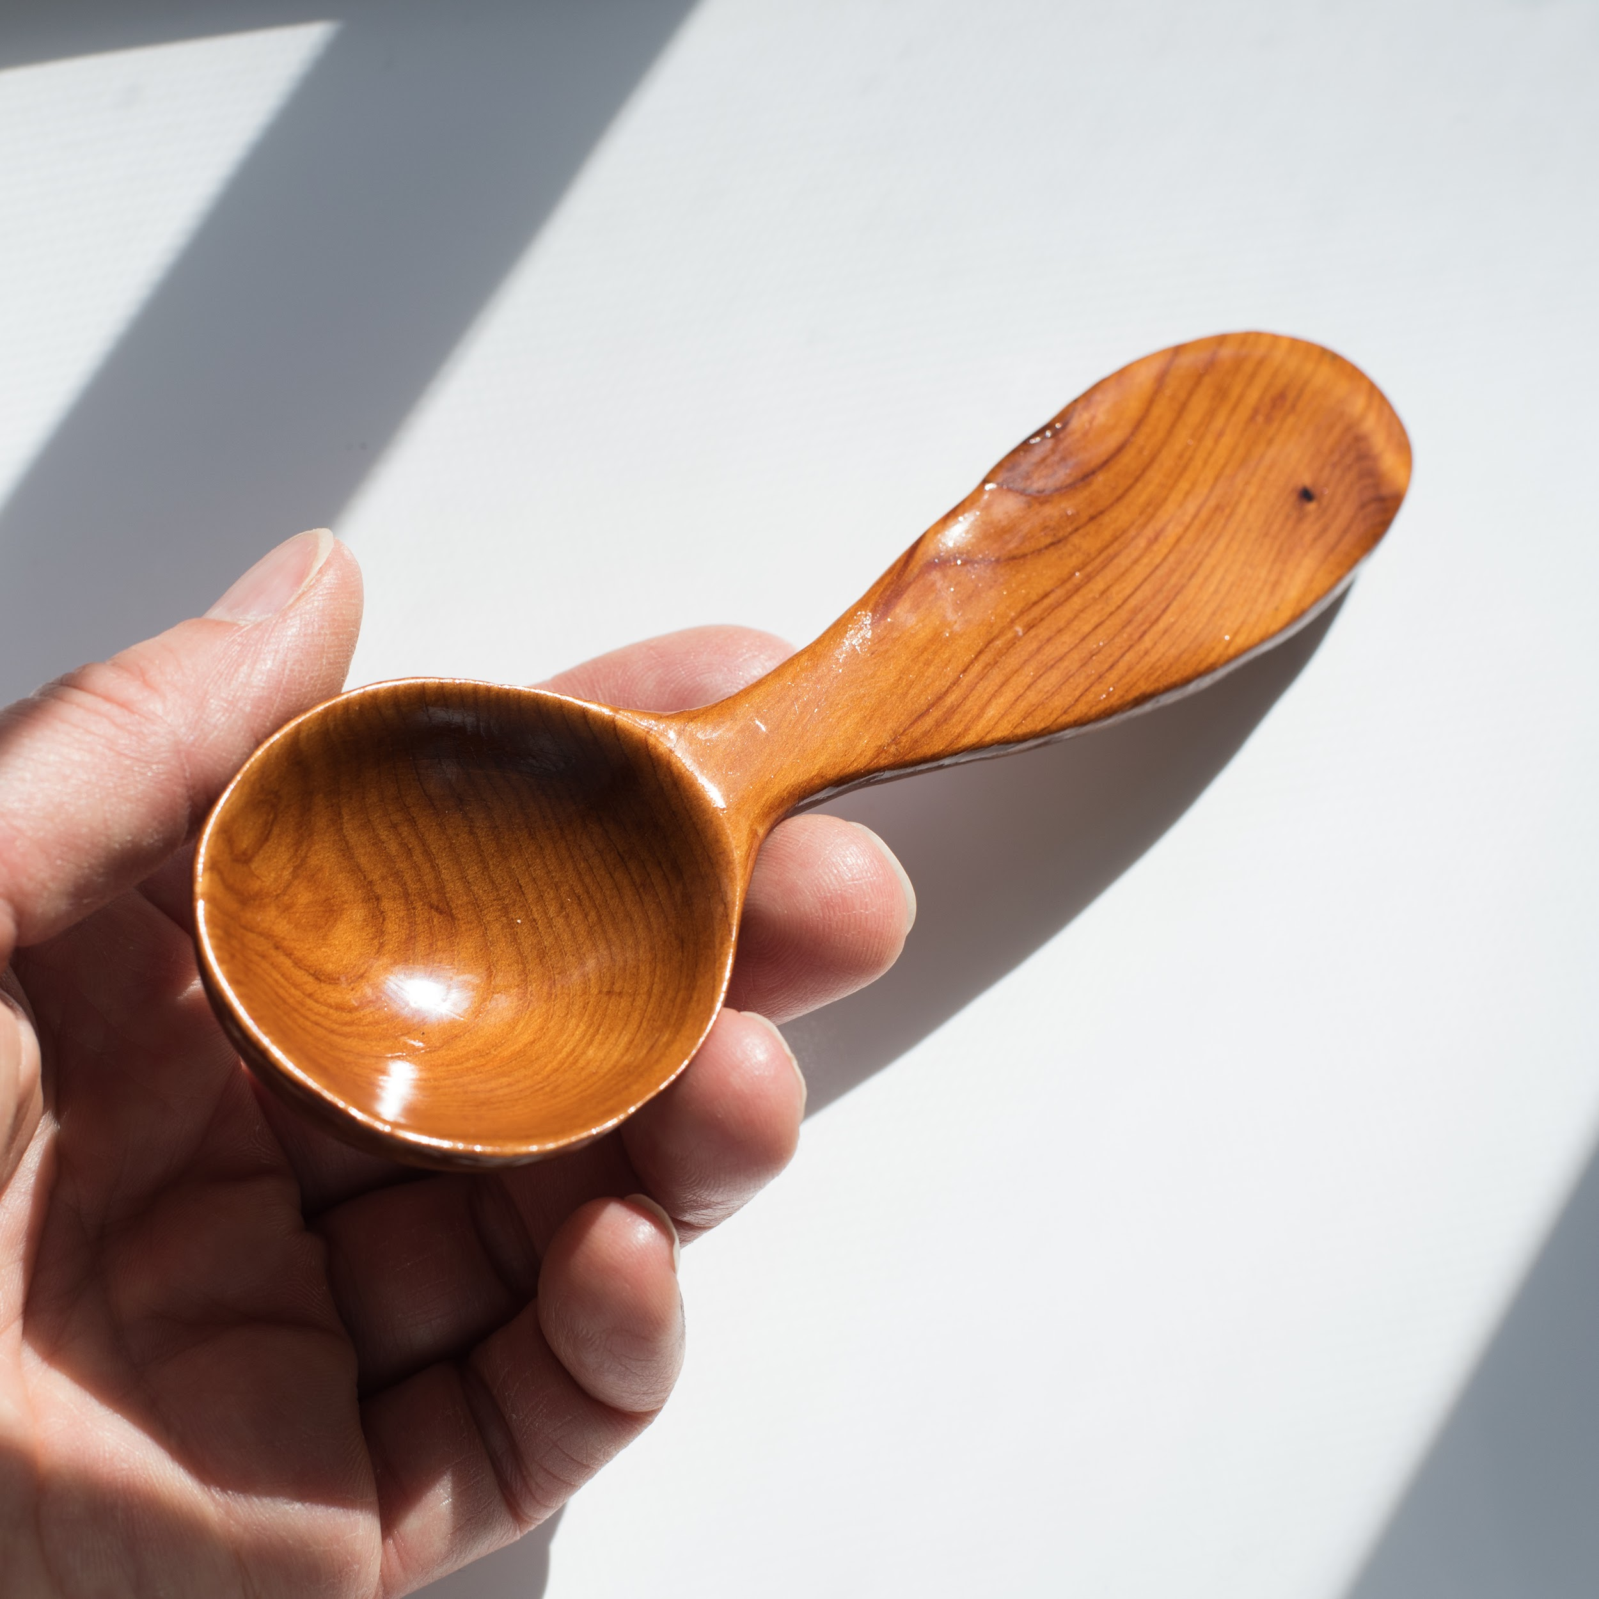
Full Sun (no diffusion)
Maximum illumination
Saturated colors
Very high contrast
Fast shutter speeds, small aperture, low ISO
No tripod necessary
Sharpest detail
Highlights finish esp. glossy
Glare risk
Weather and time of day dependent

Slide 26
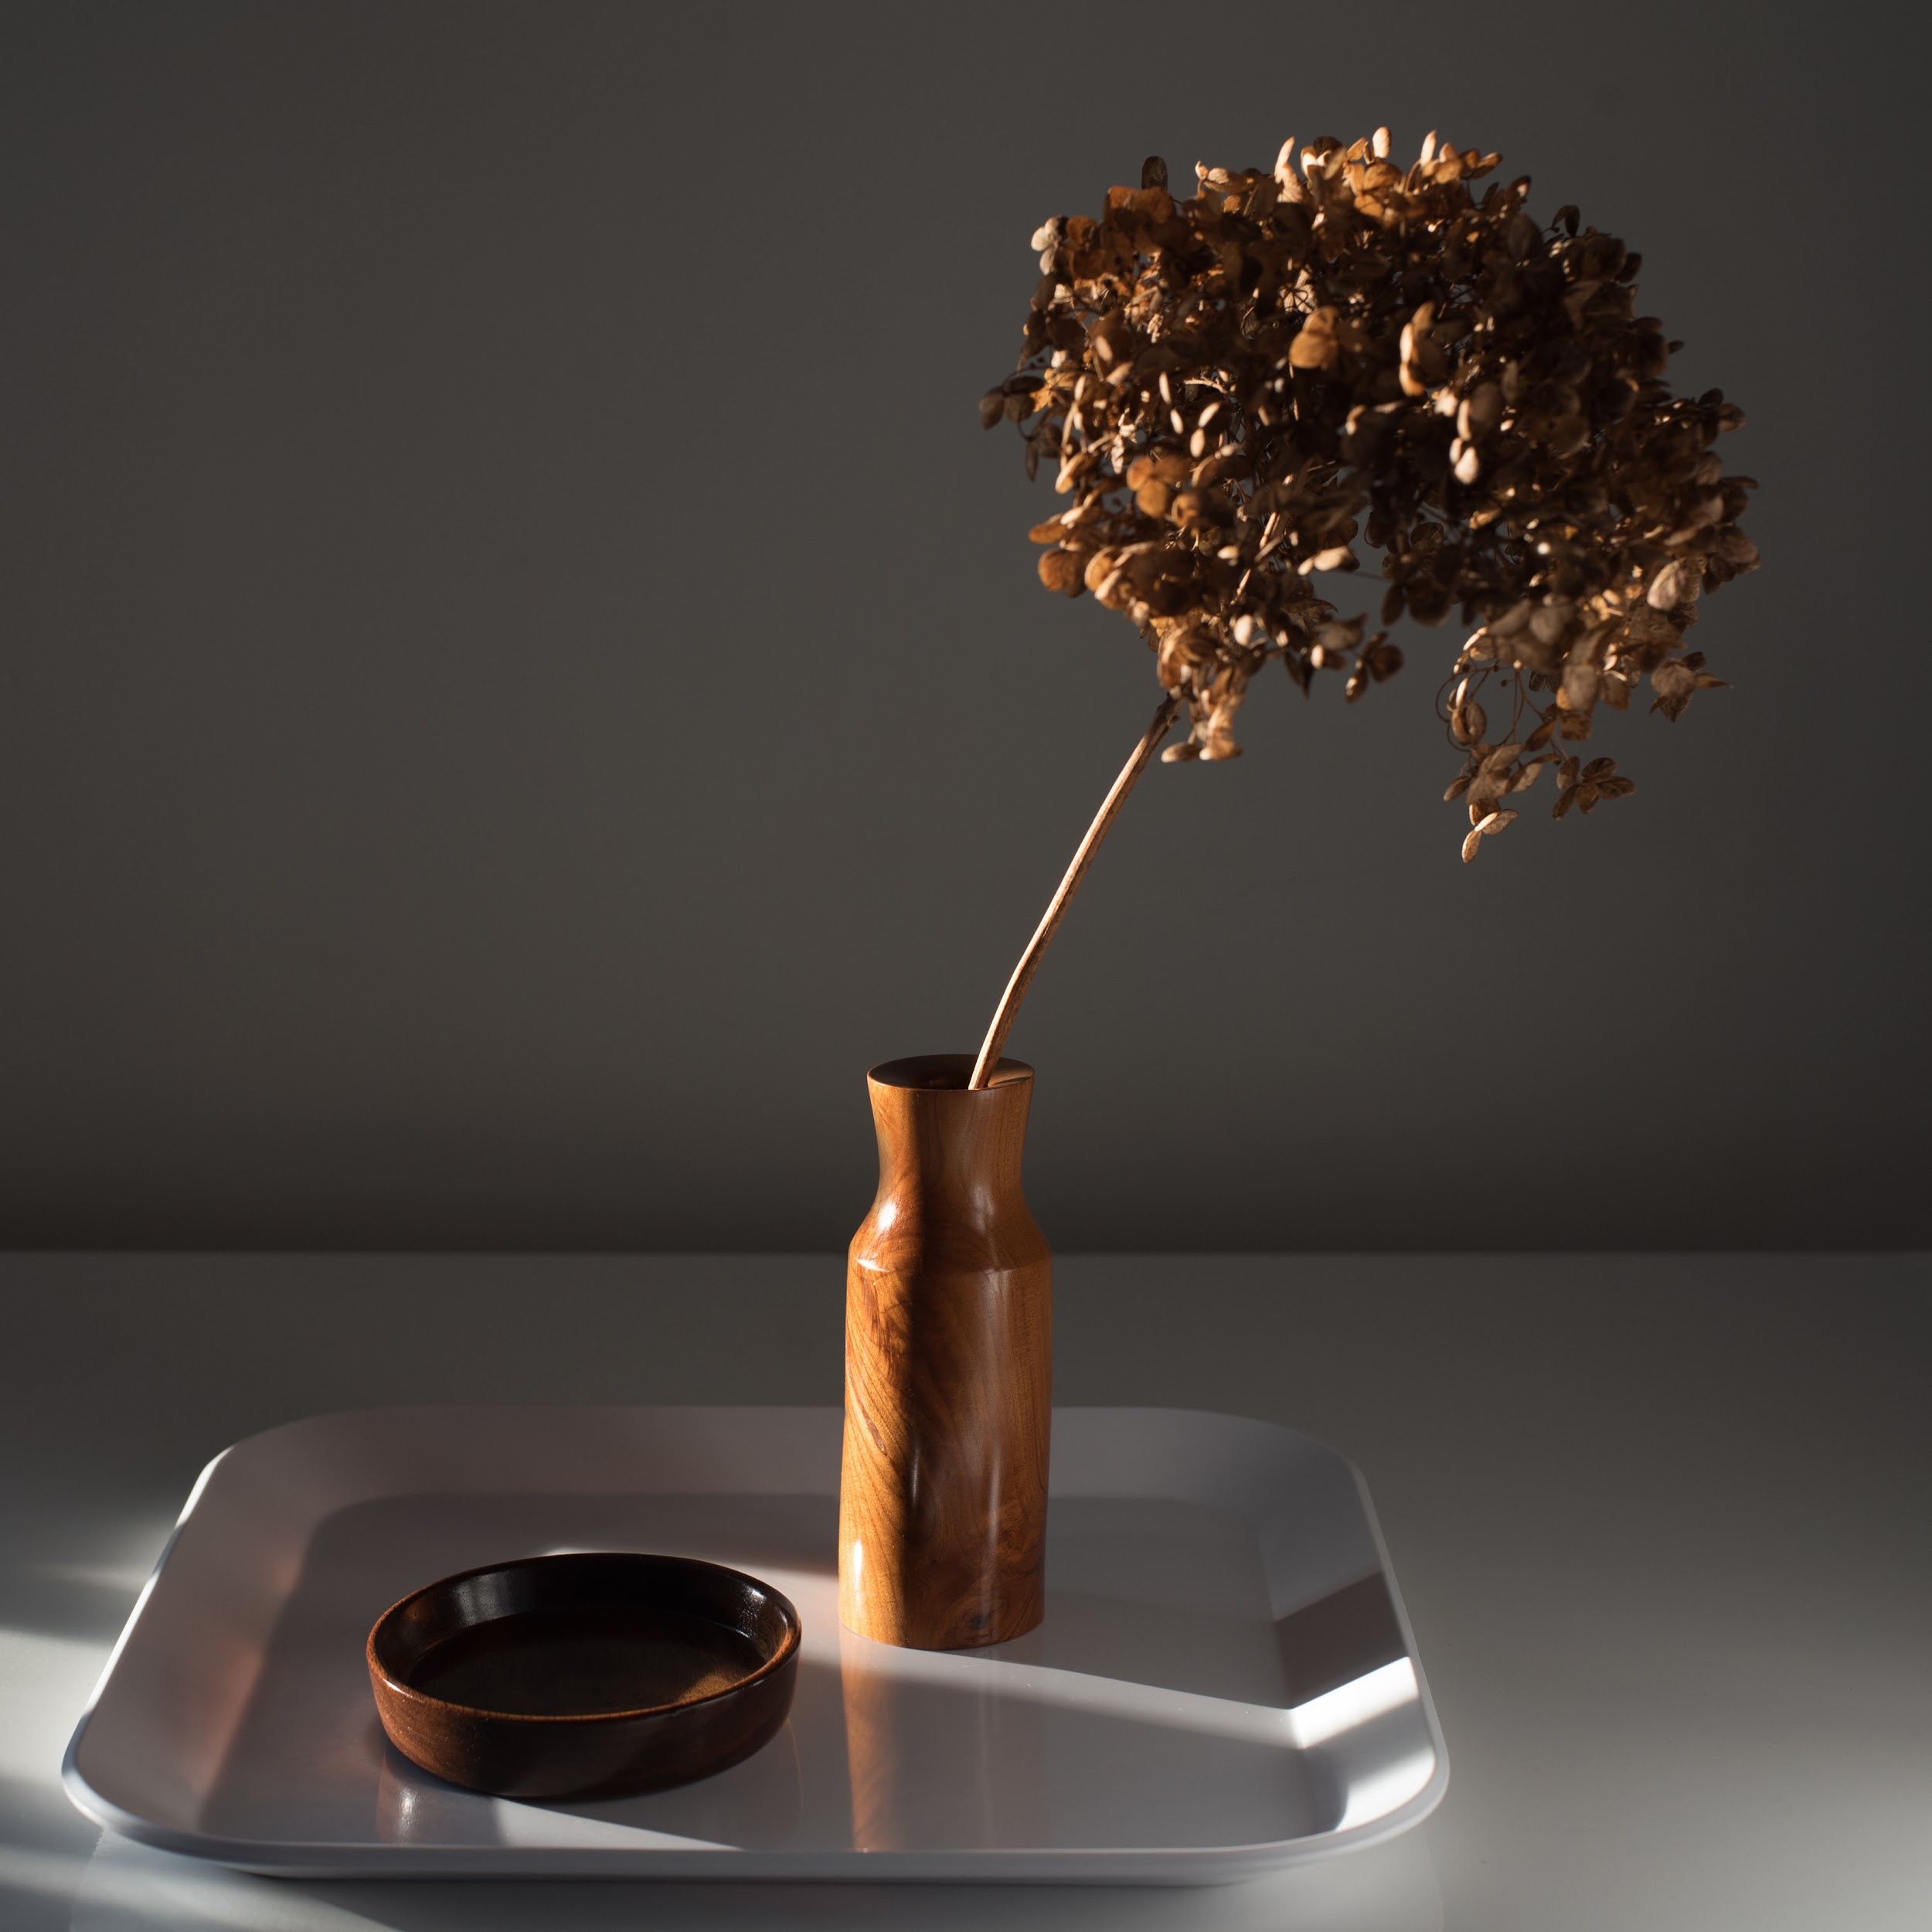
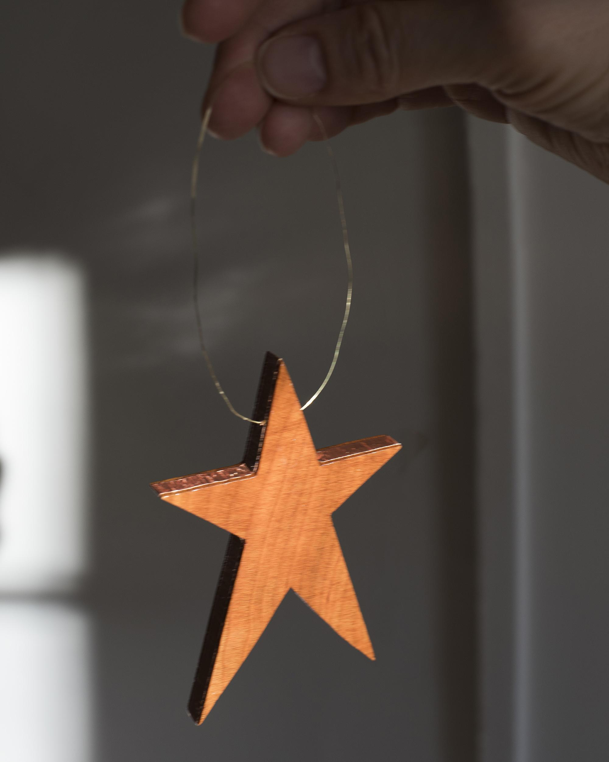
Full Sun Variations

Slide 27
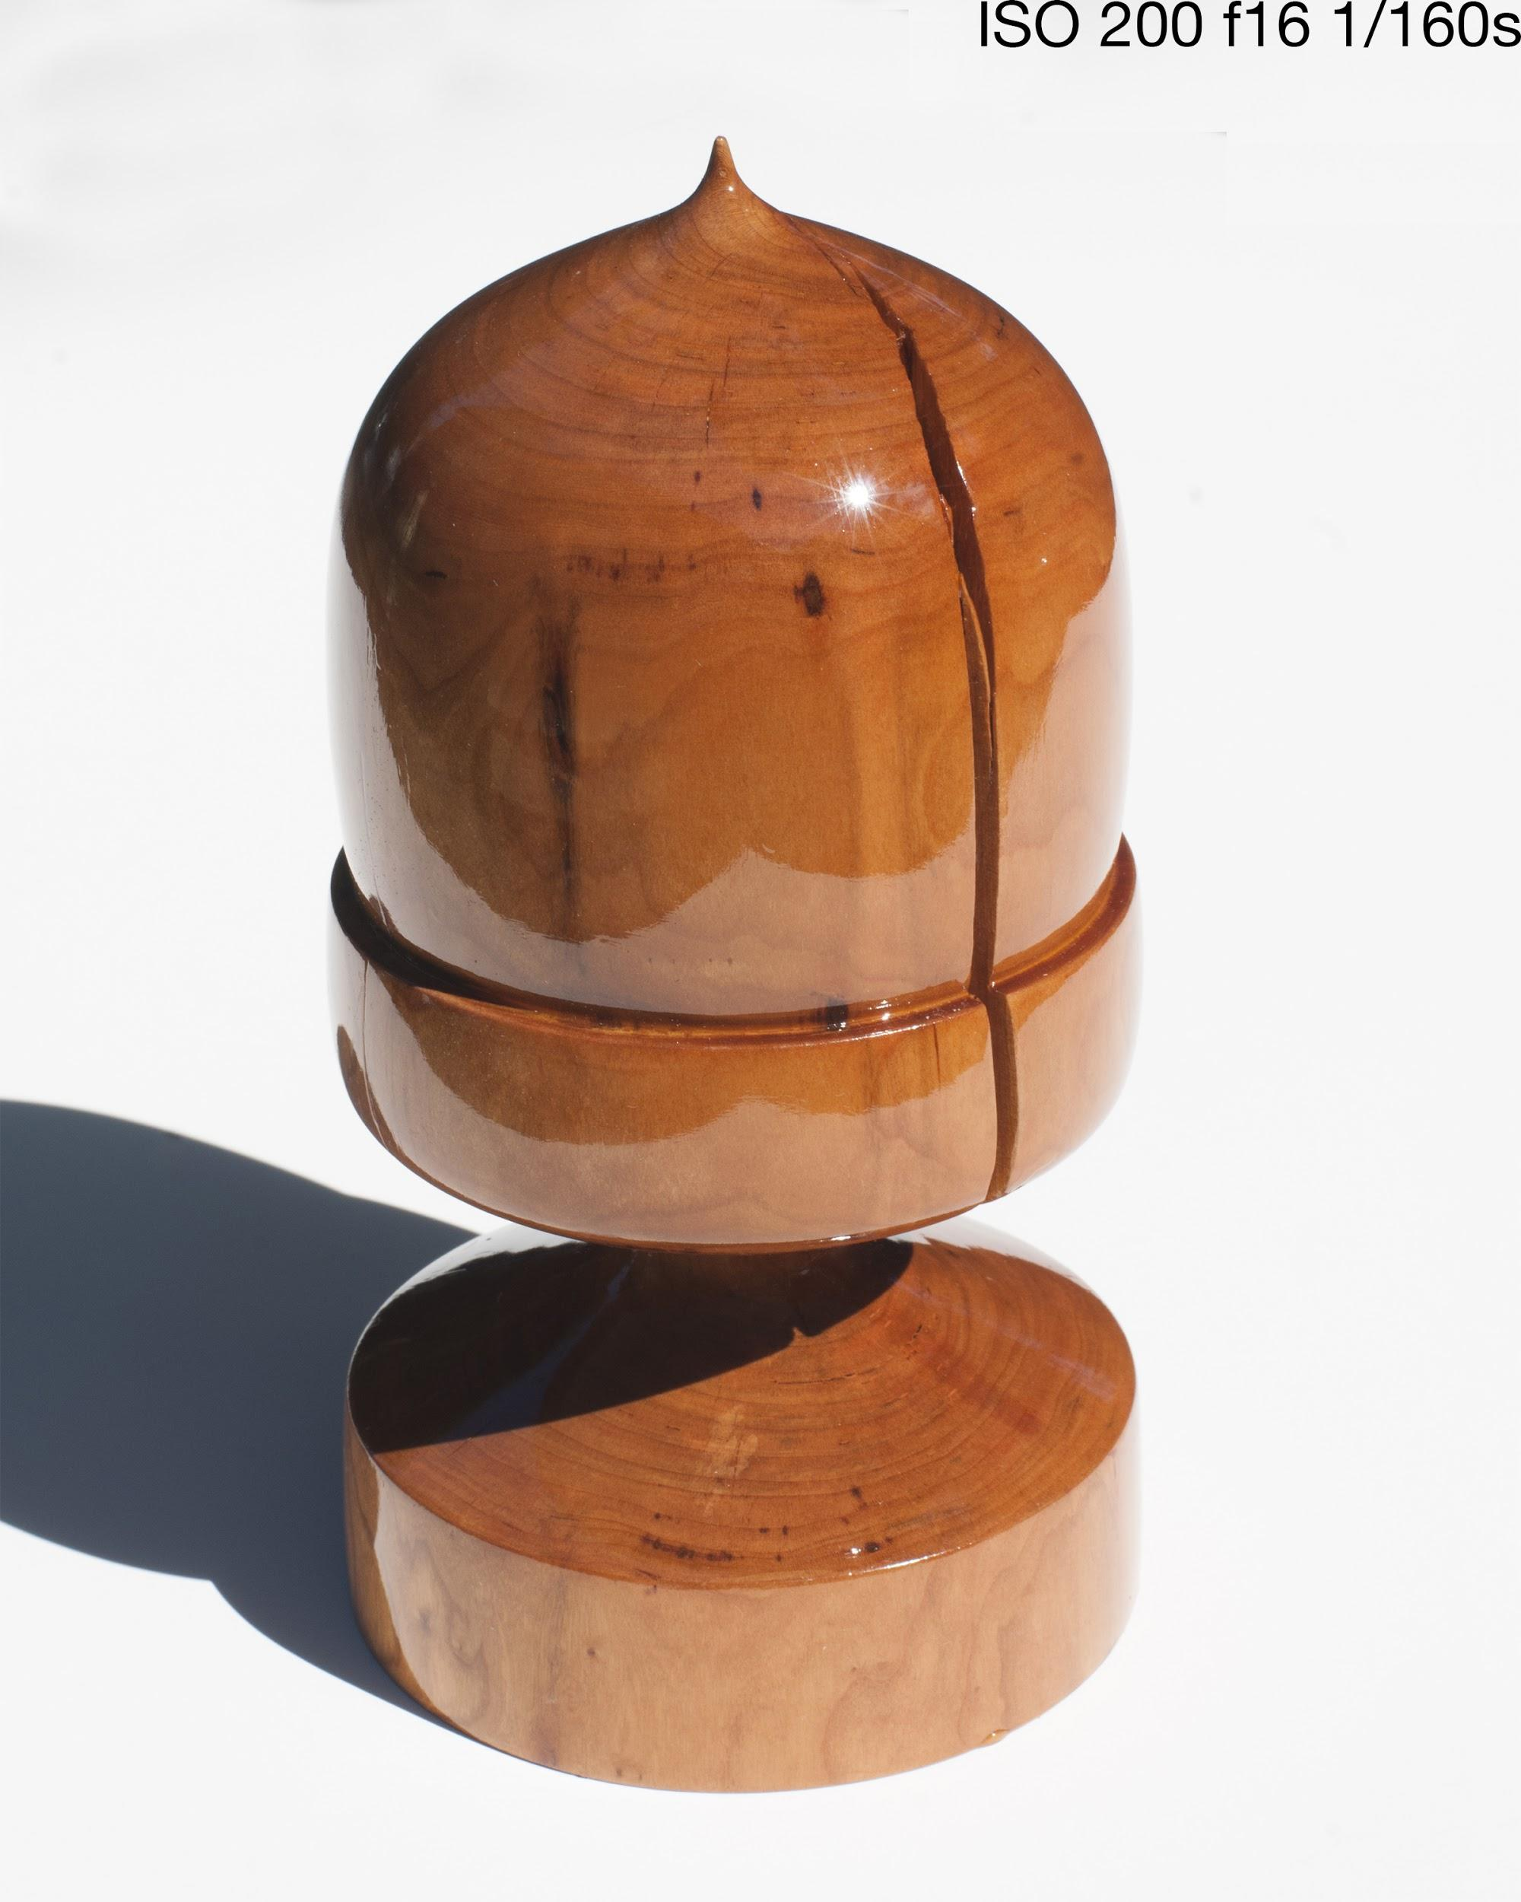
Managing Glare
Reflections that occur on your piece from strong direct sunlight.
Strategies:
Make sure the sun in not in the frame.
Use diffusion
Change the surface to something darker and less reflective.
Use a polarized lens

Slide 28
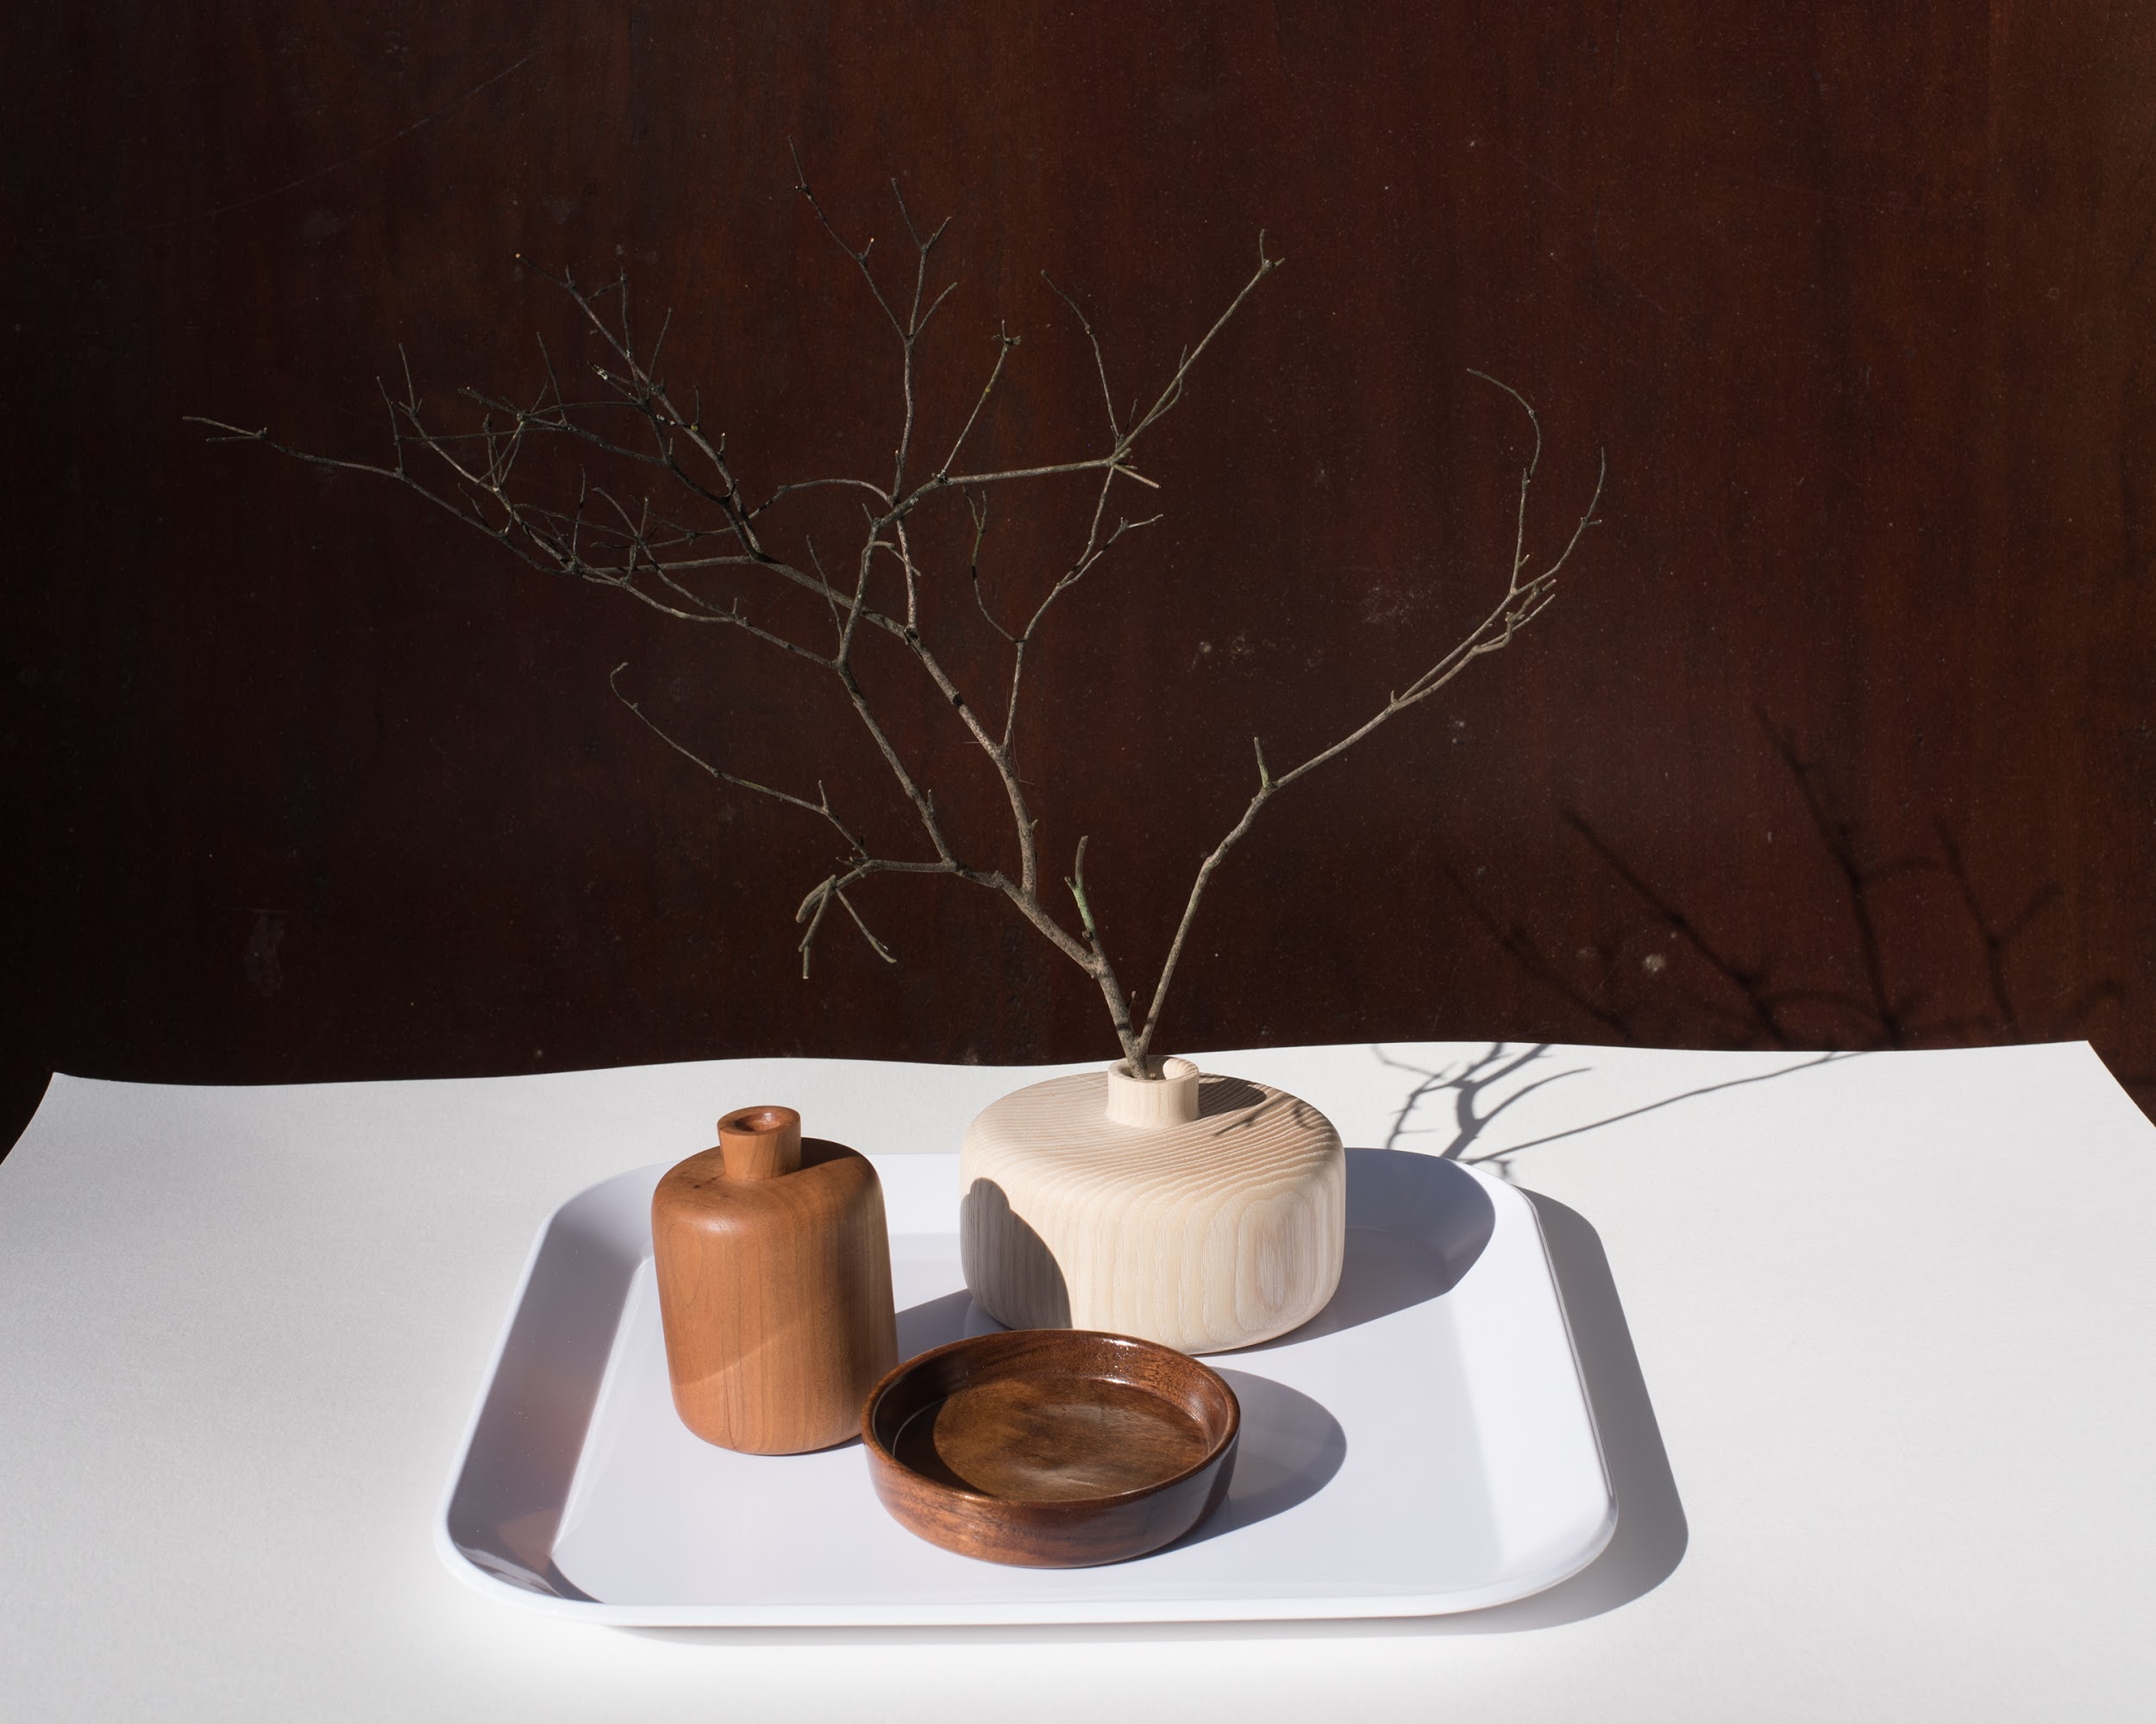
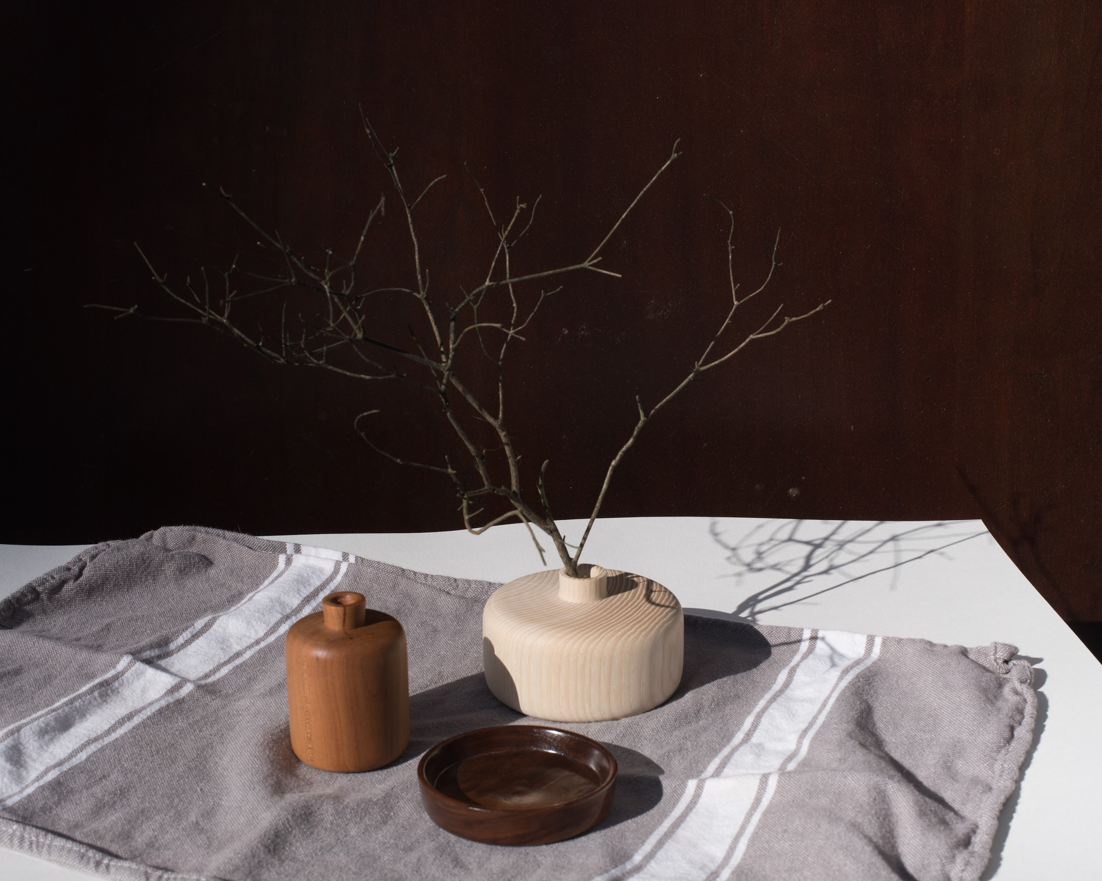
Changing surface backdrop:
White plastic surface versus gray cloth.

Slide 29
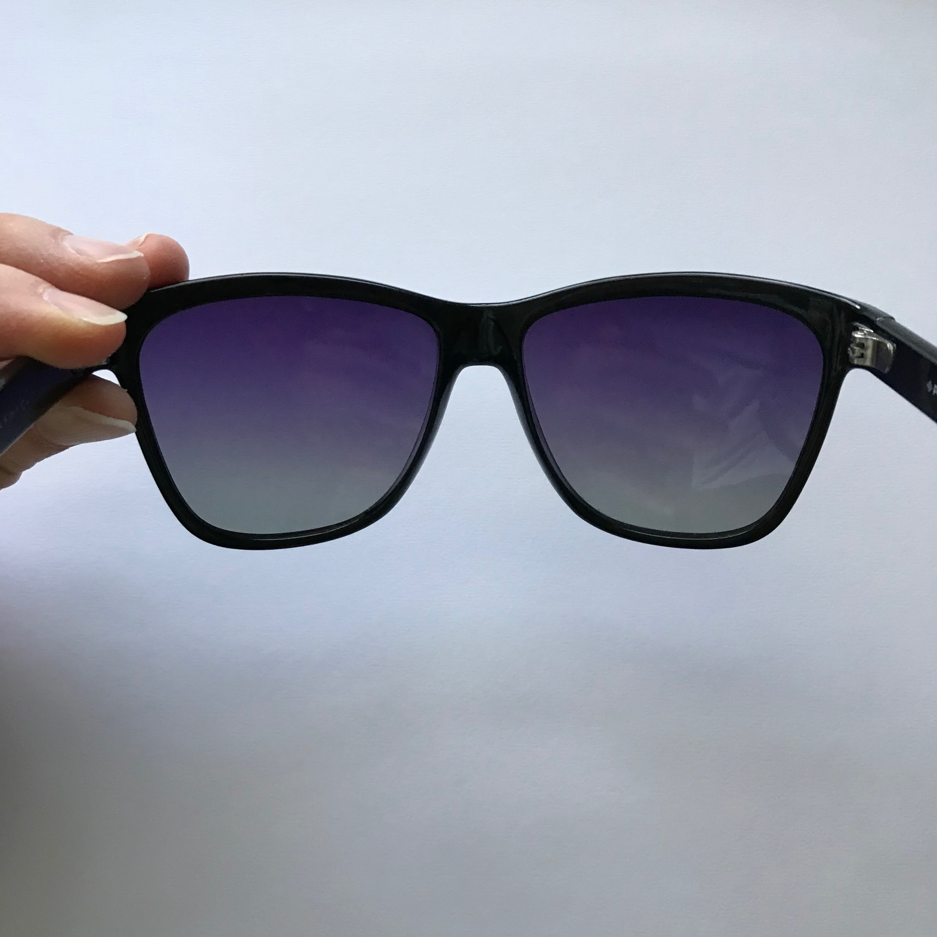
Polarized lenses trick for cell phone cameras

Slide 30
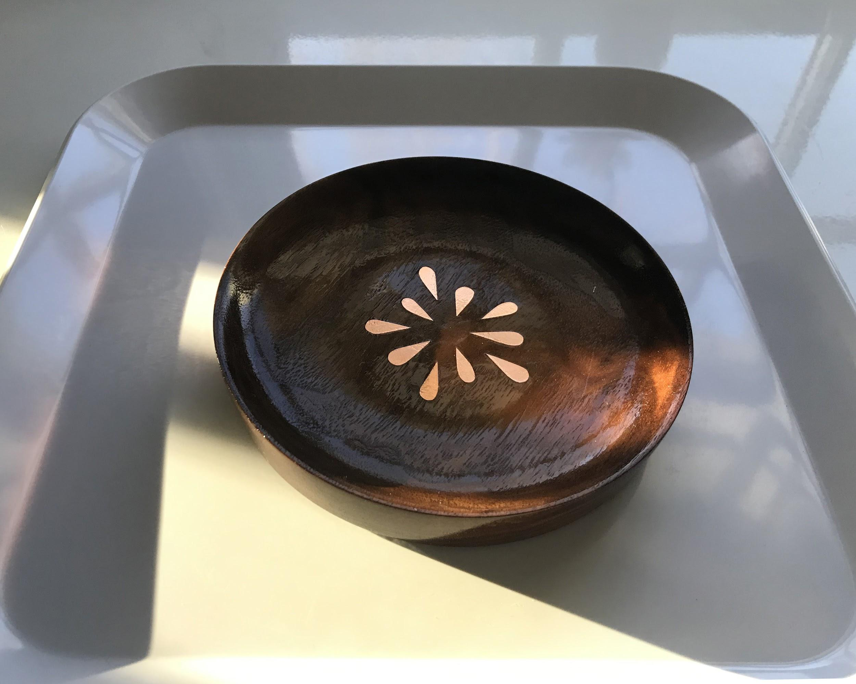
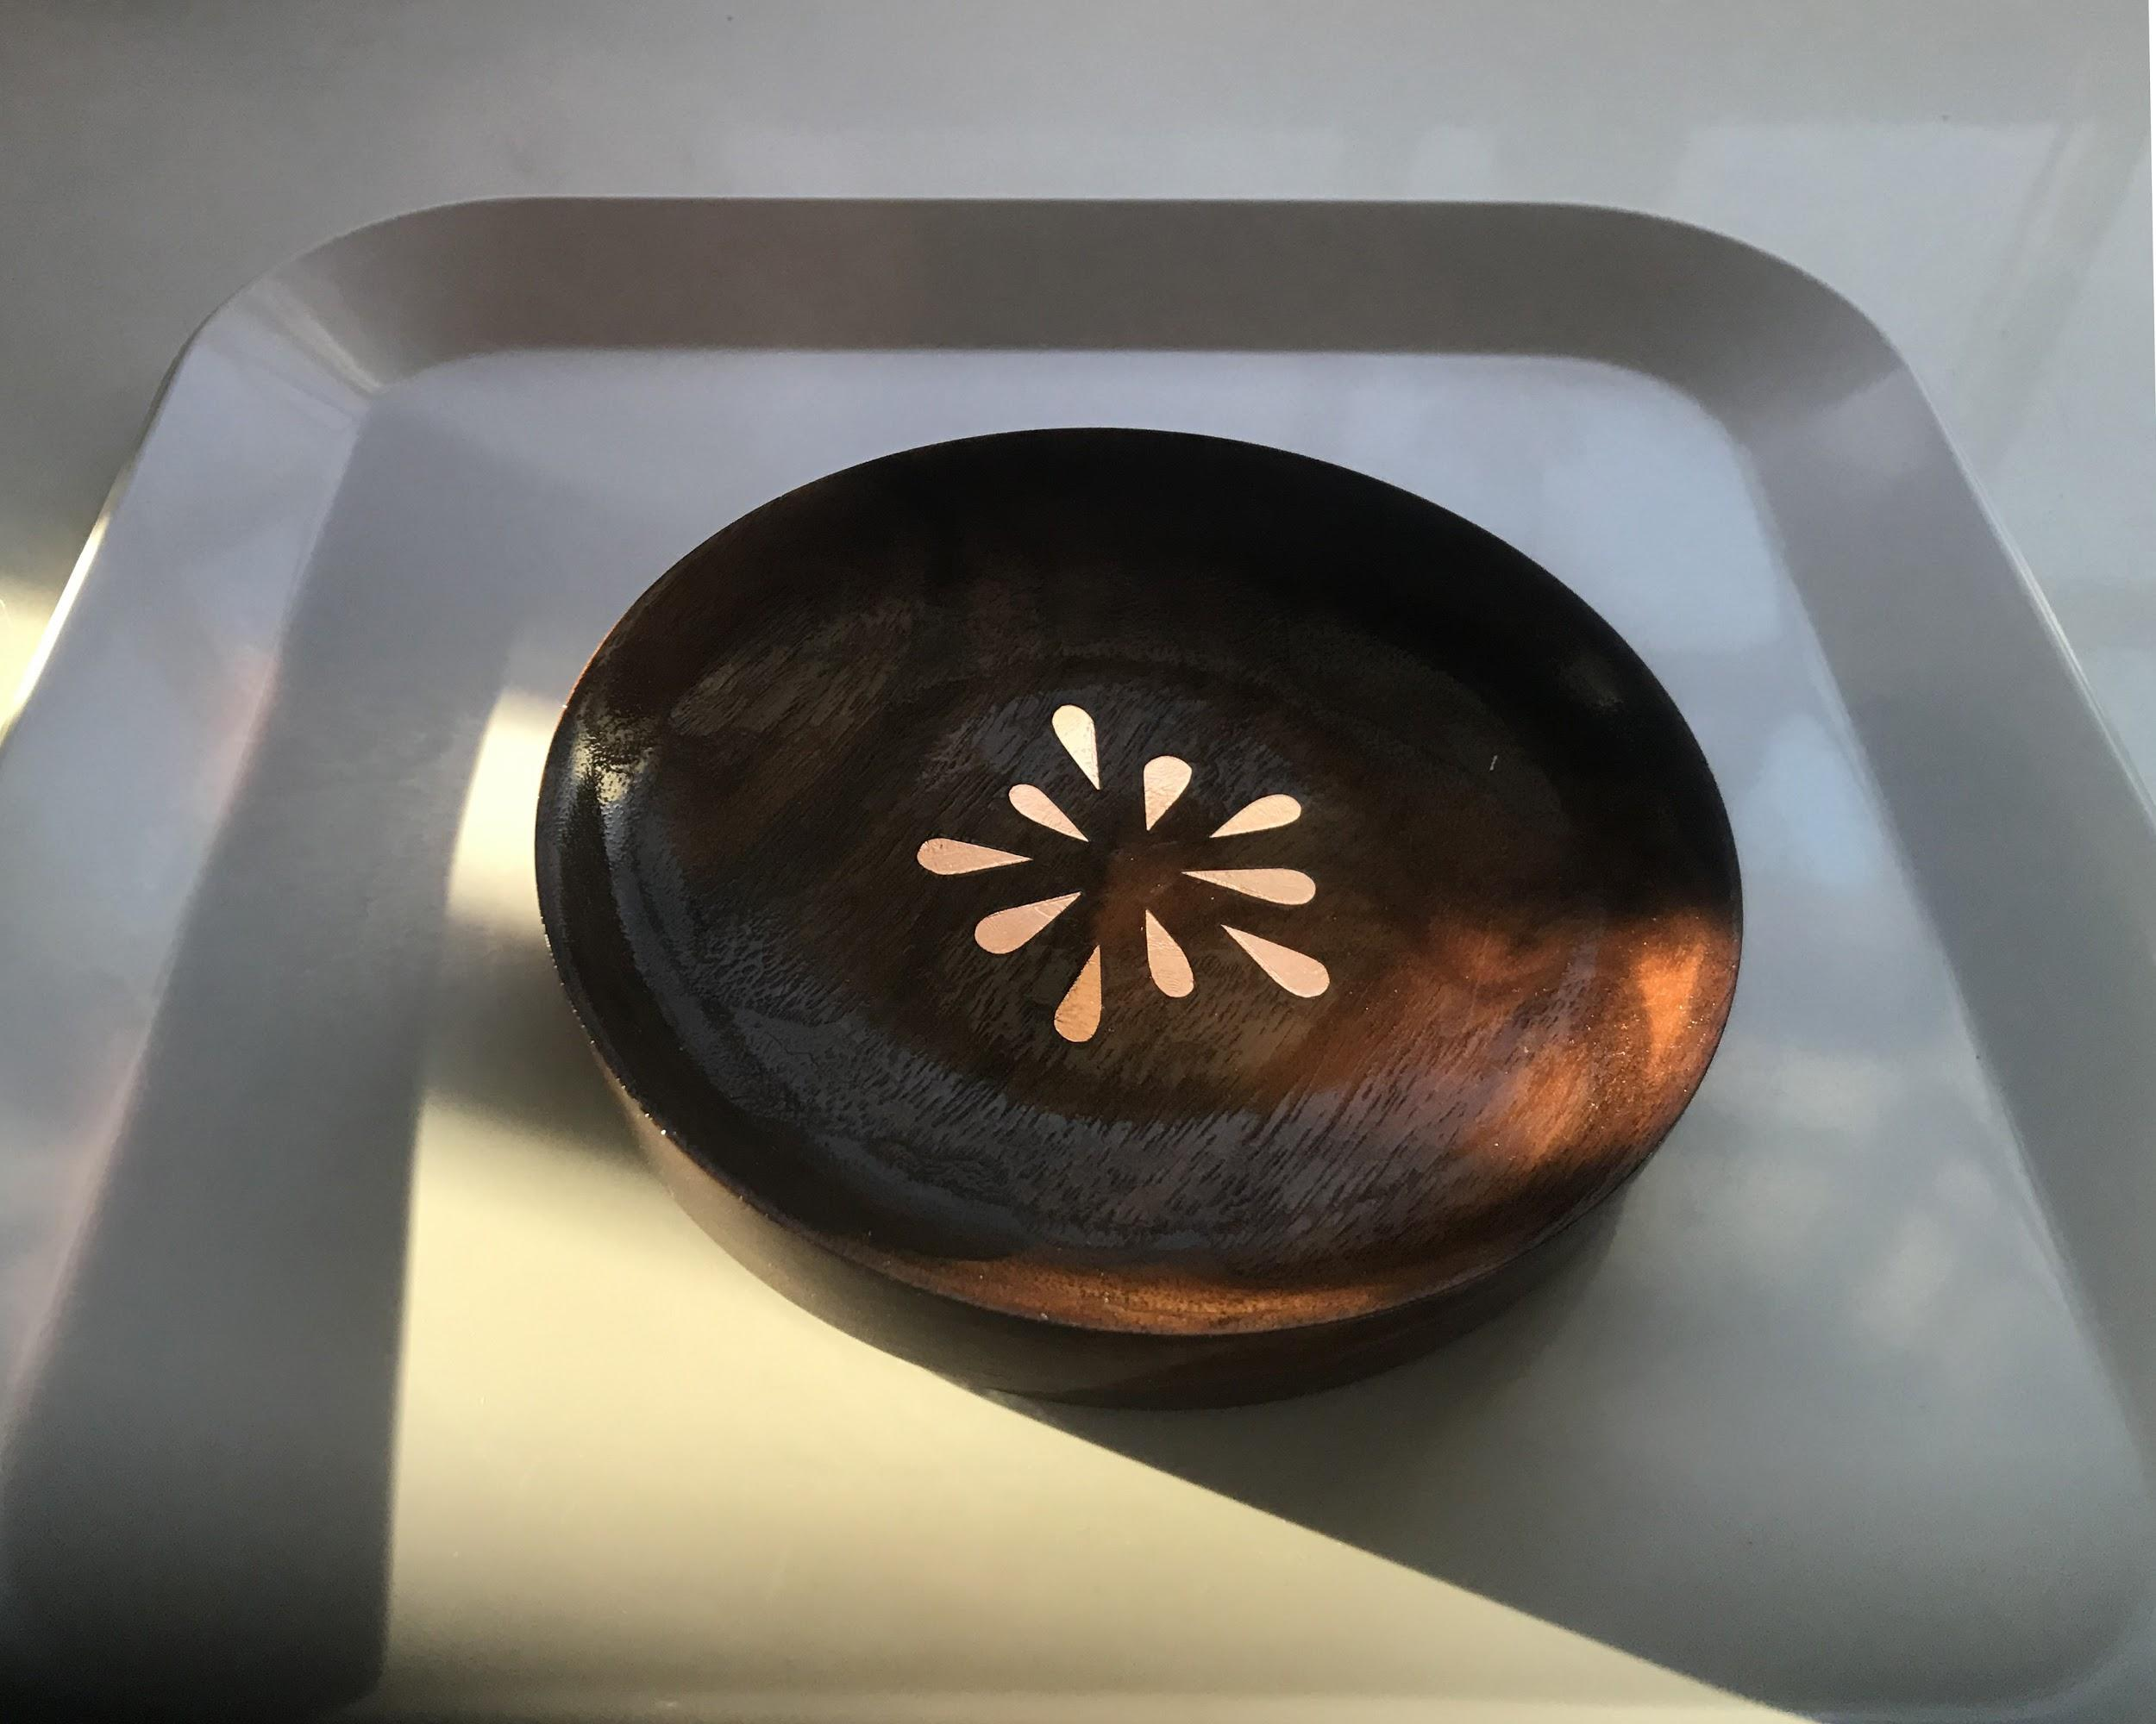

Slide 31
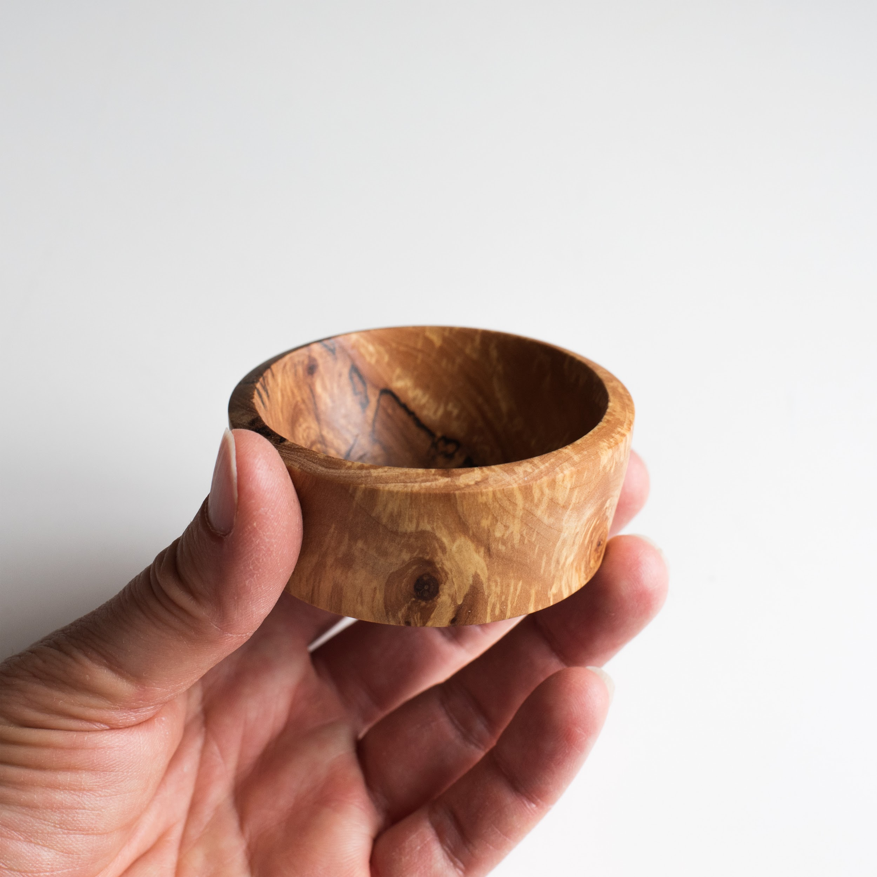
Diffused Sunlight
Softer aesthetic
Medium to low contrast
More creative options for your image making

Slide 32
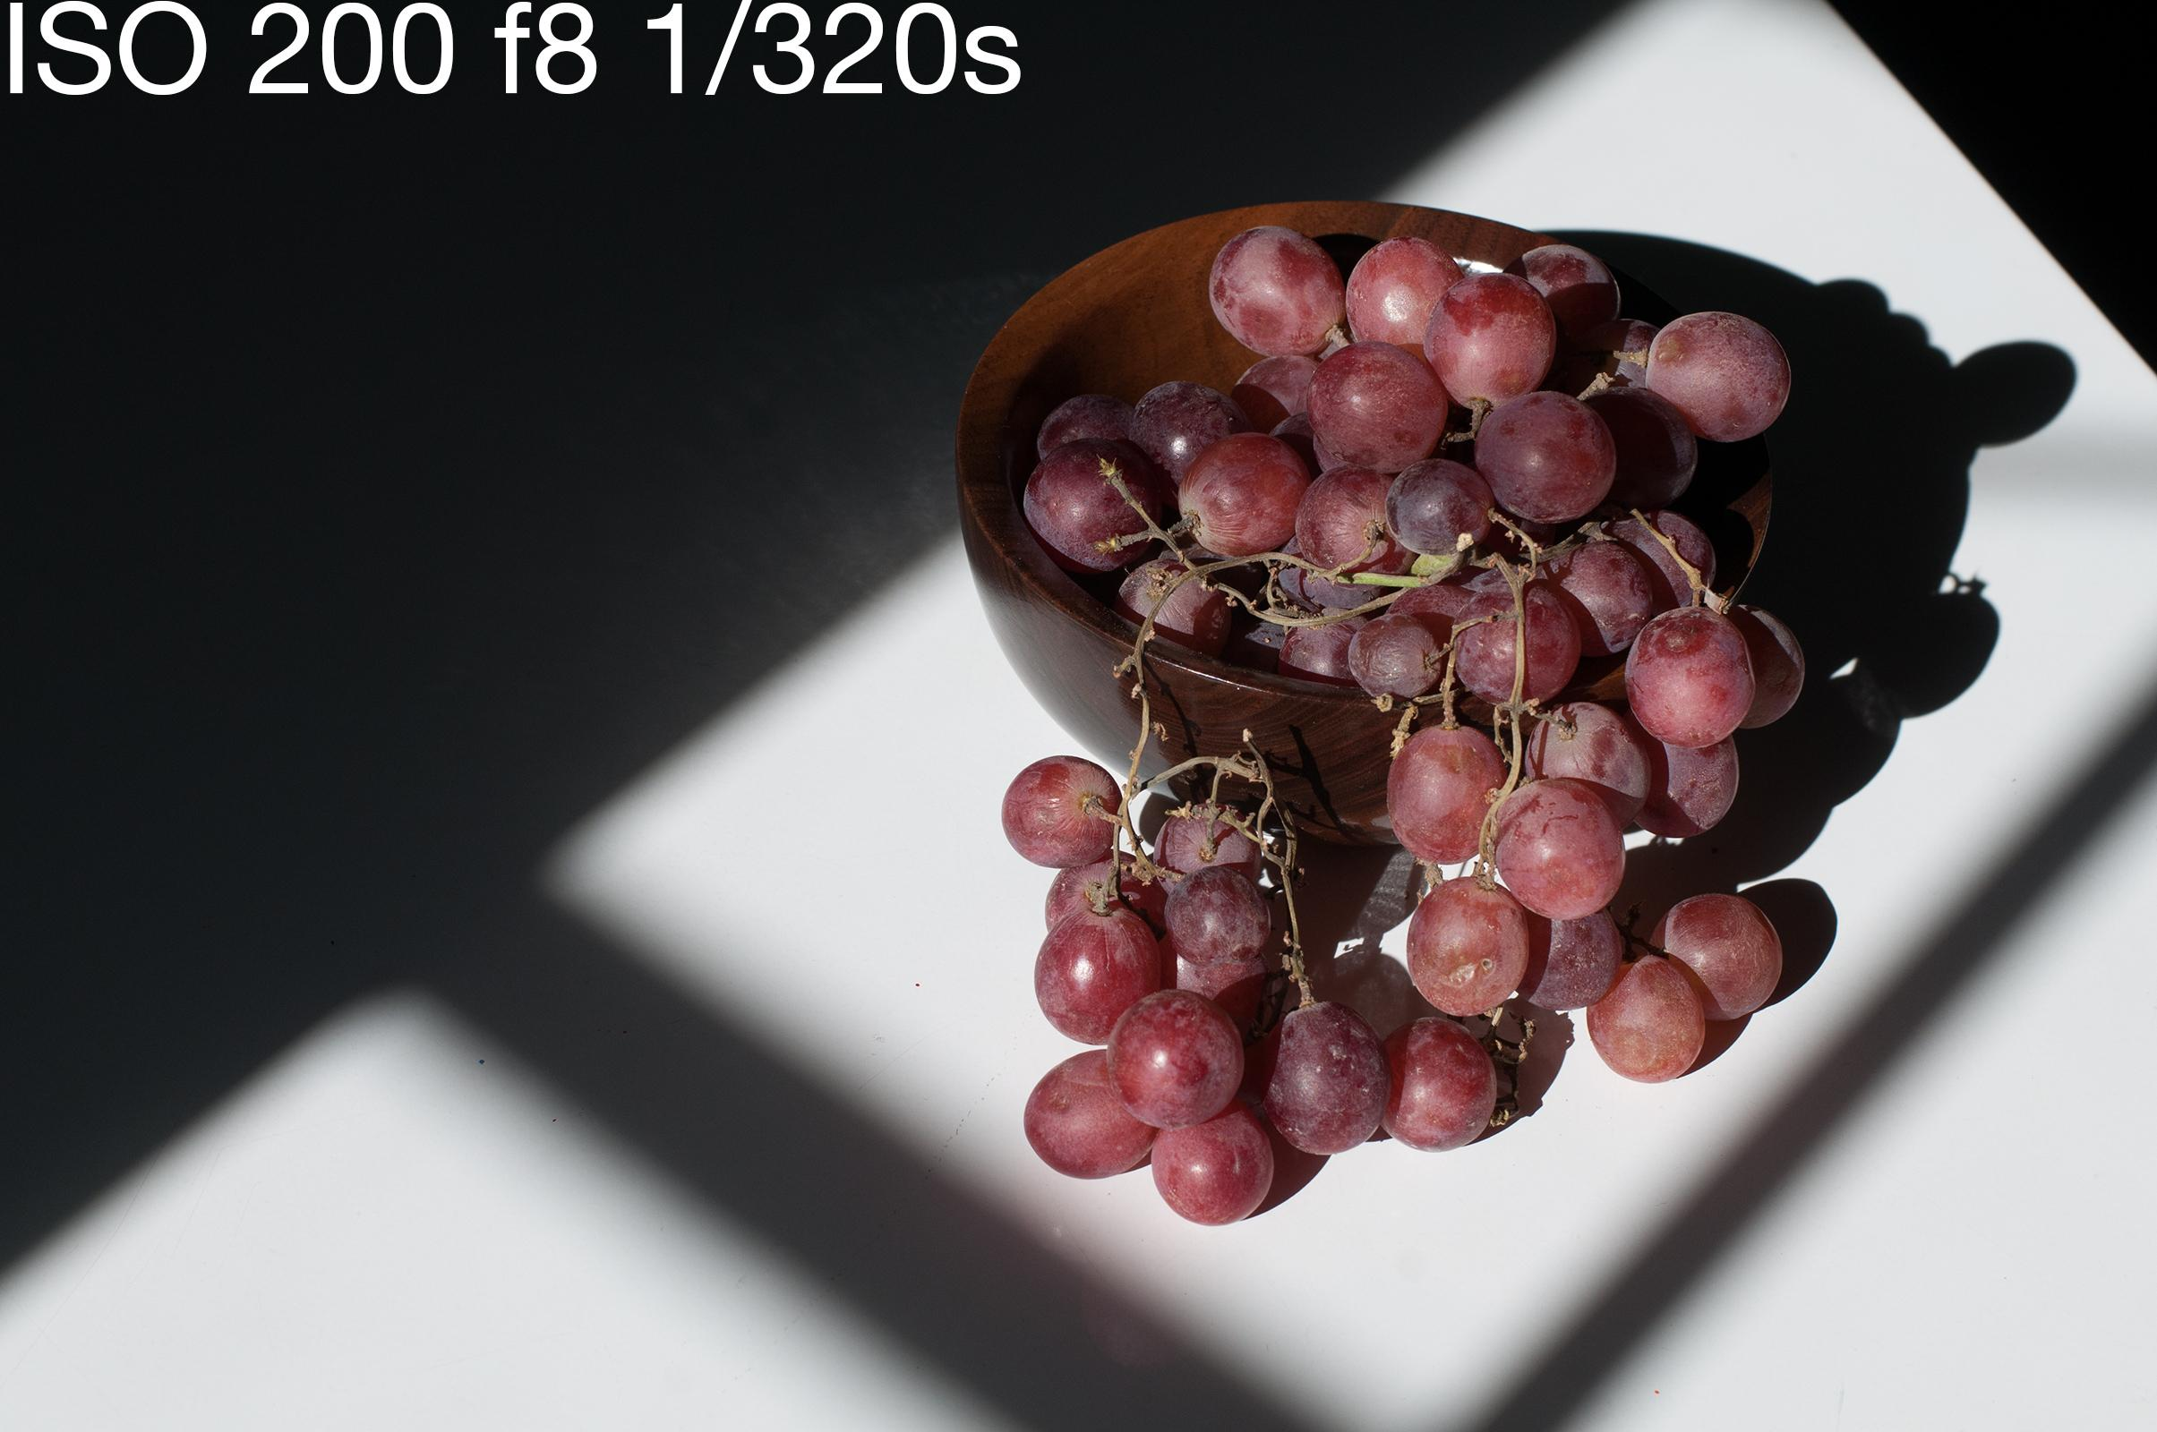

Slide 33
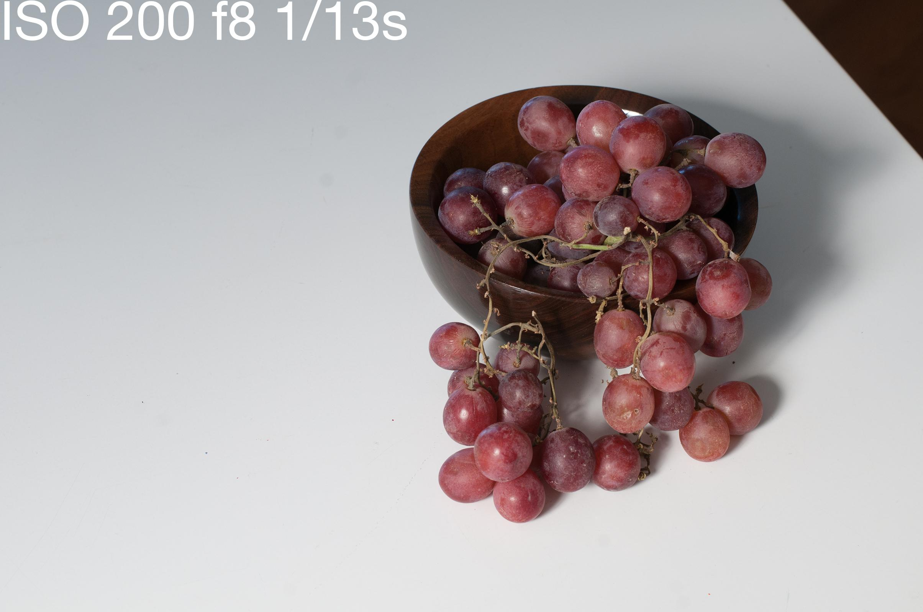

Slide 34
Things that can be used to diffuse sunlight:
Clouds
Shade
Diffusion disc
Thin white fabric (curtains)
Wax paper
ect...ect...

Slide 35
For maximum diffusion, place your device close to your piece and close to the lens, and just out of the frame.
Placement of the diffusing device farther away increases contrast.

Slide 36
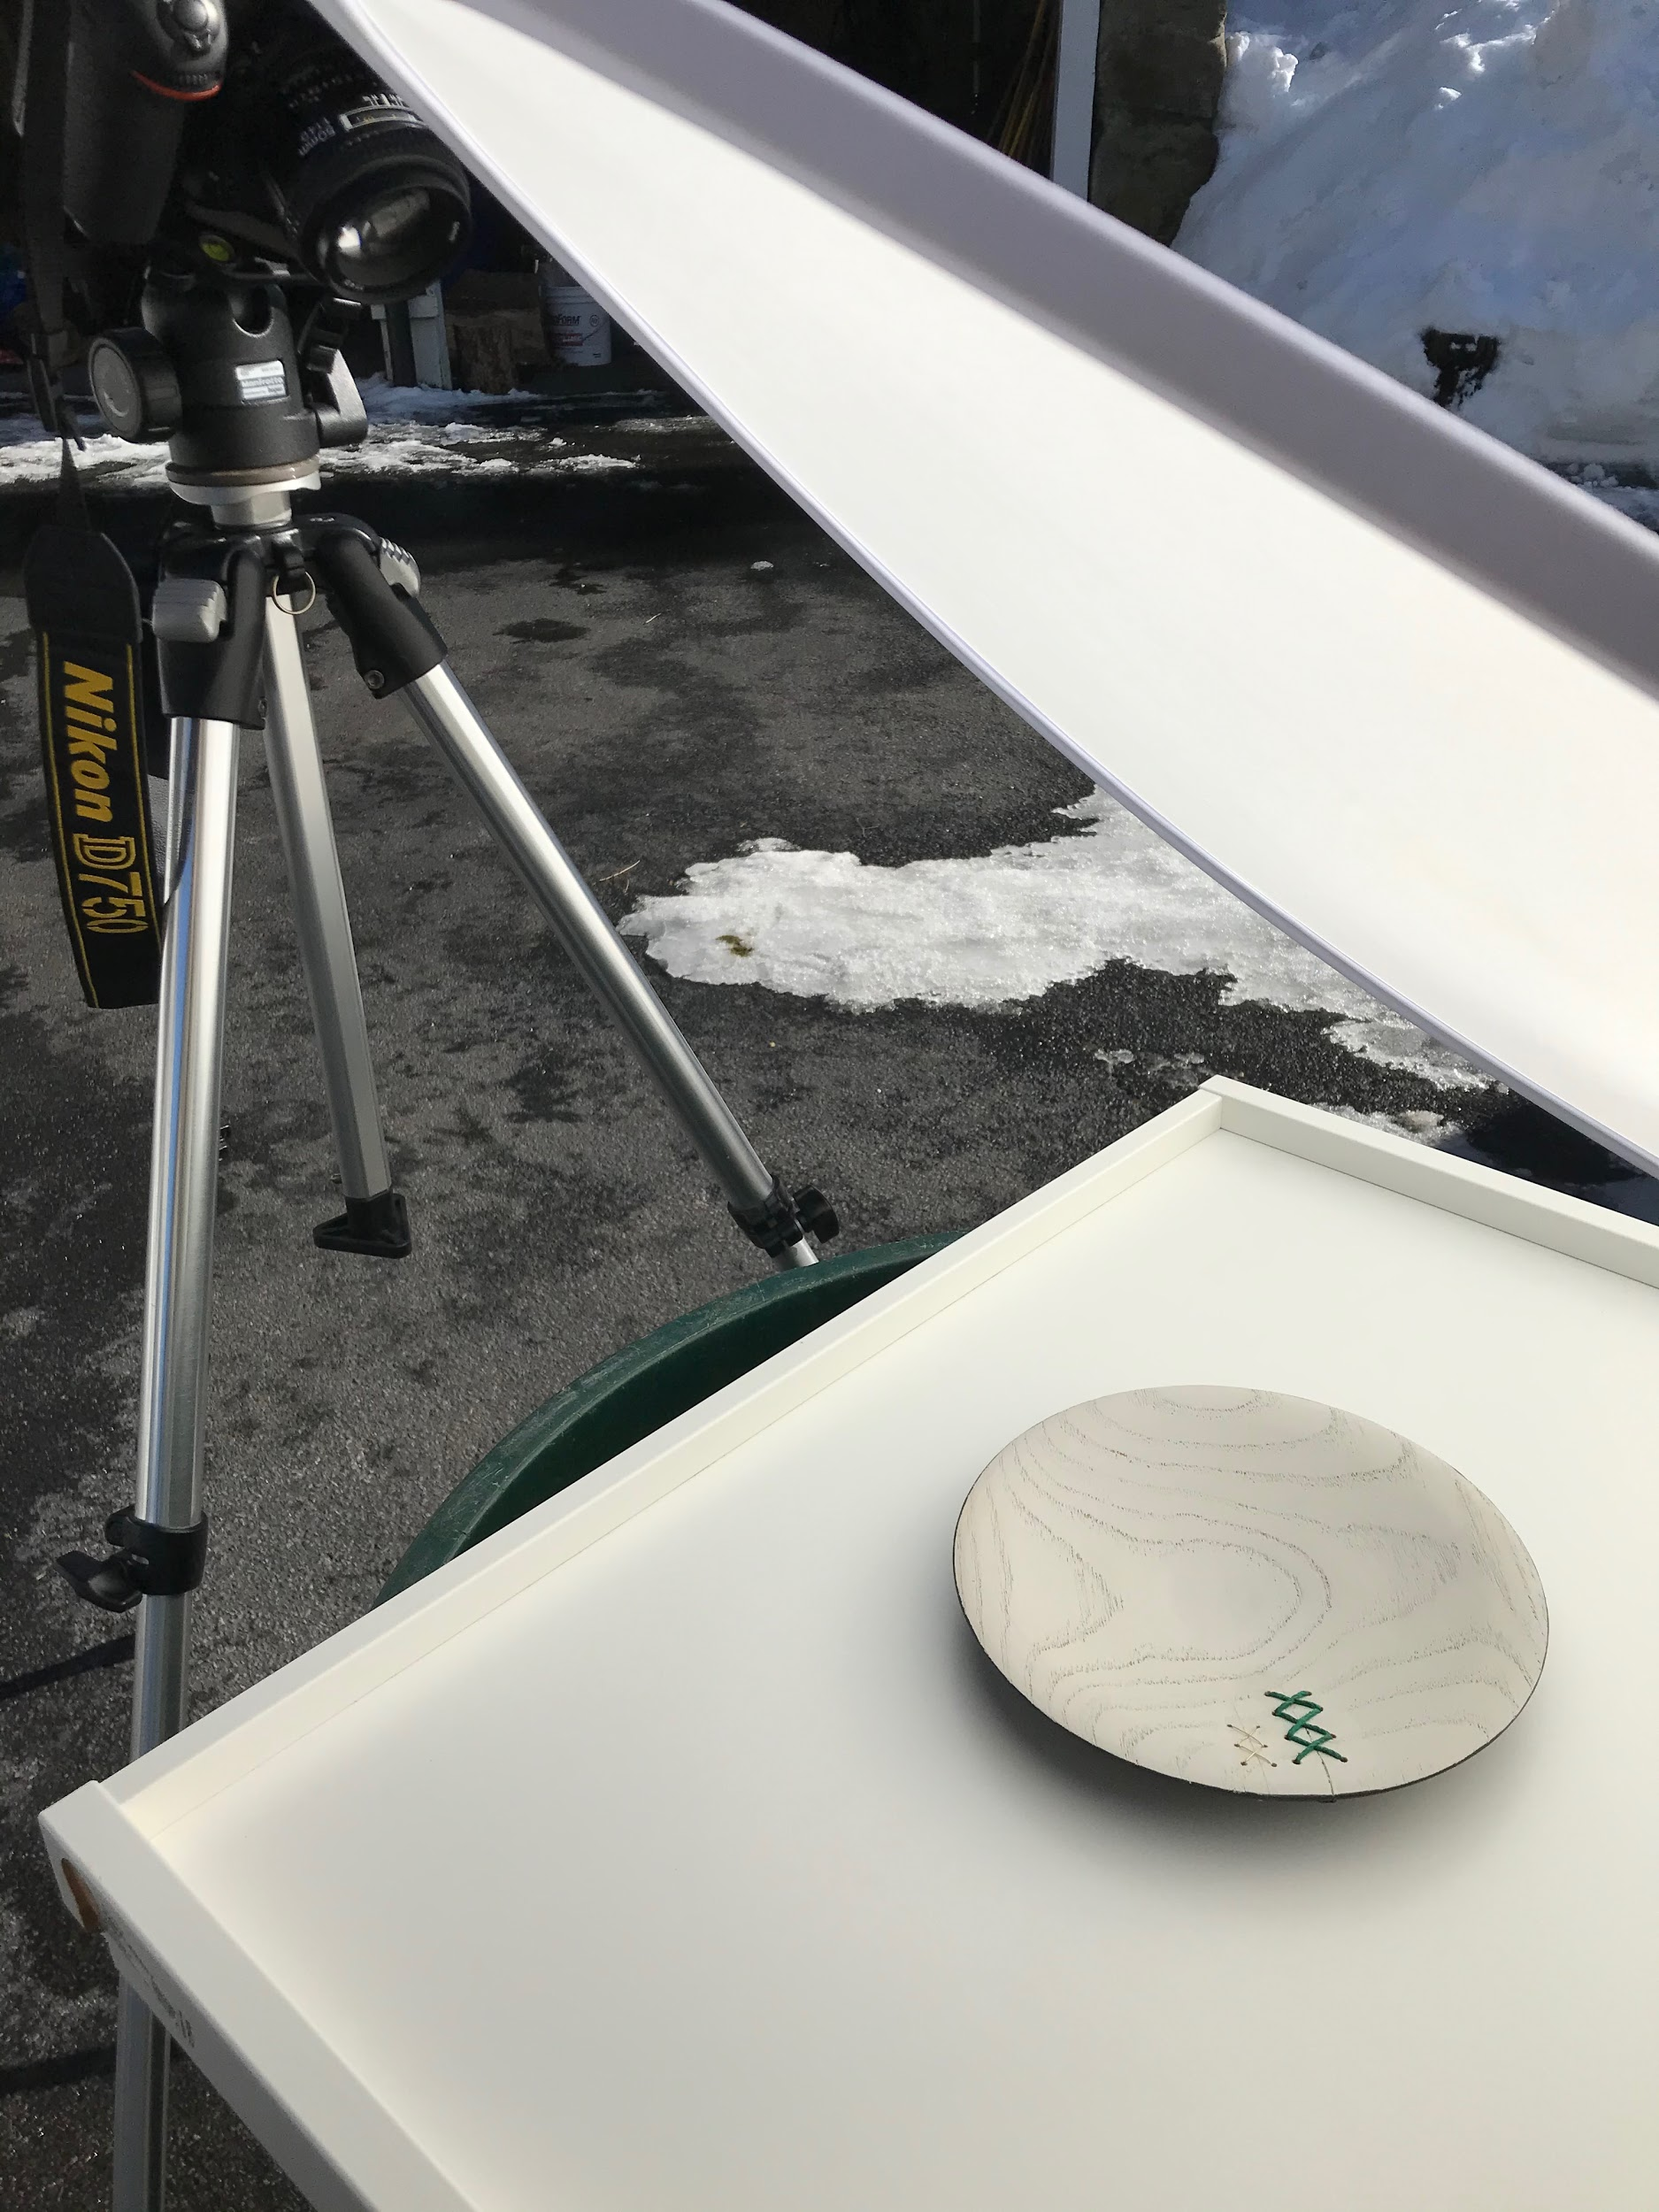

Slide 37
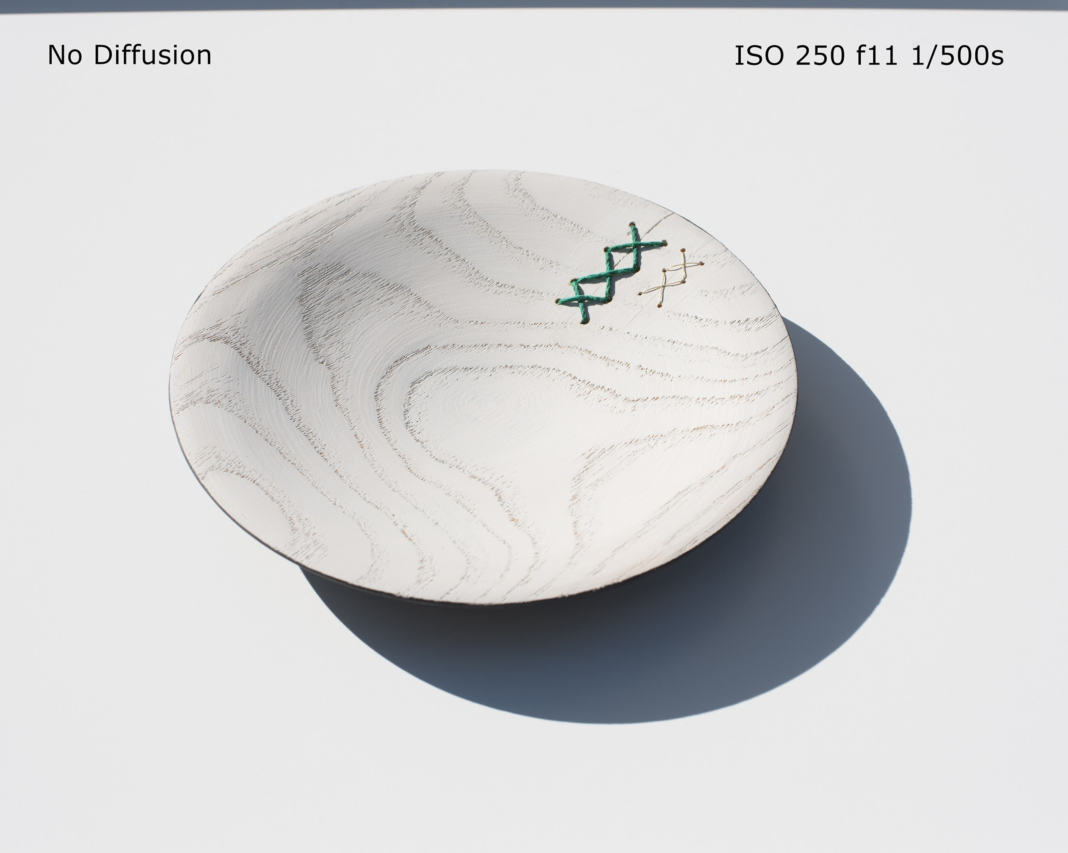

Slide 38
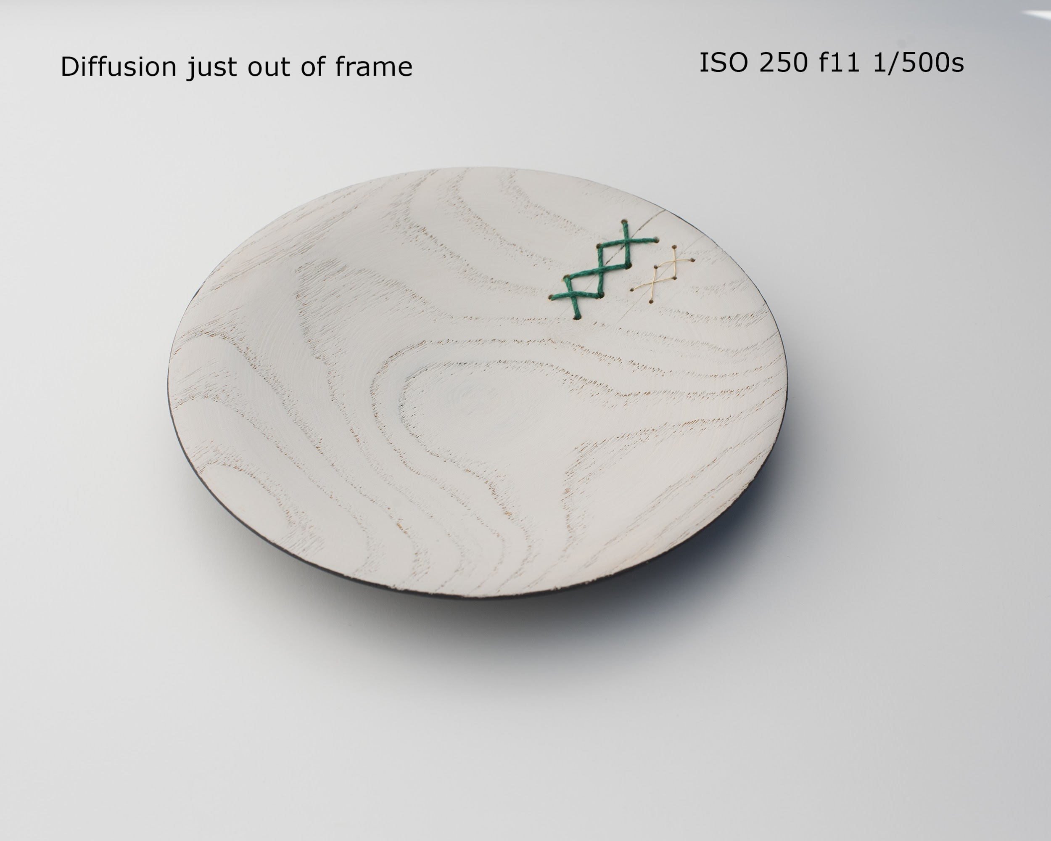

Slide 39
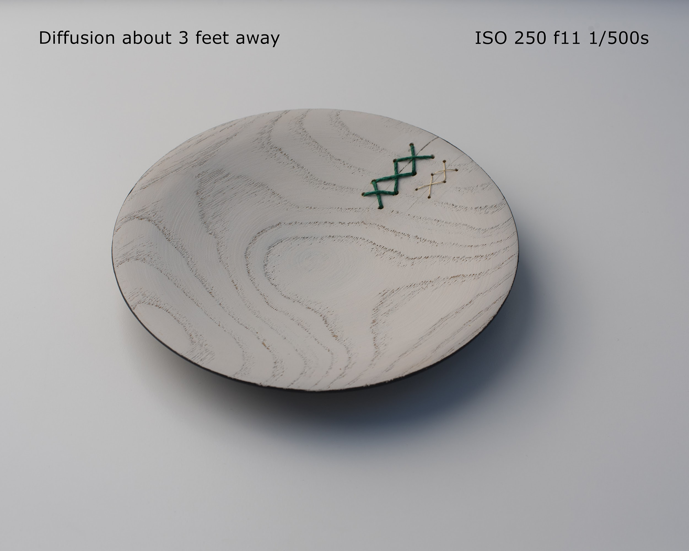

Slide 40
Final Thoughts:
Try to accomplish as much as you can in camera.
Use photo editing primarily for cropping, exposure, contrast and saturation adjustment.

